Slide 1
ACL reconstruction and Meniscus Repair Rehab For the Collegiate Athlete
Gary Johnson LAT, ATC, CSCS, SPT
UNC DPT 2015

Slide 2
Learning Objectives
Increased understanding of tissue healing properties in ACL reconstruction and meniscus repairs.
Increased understanding of rehabilitation timeline of two common sports medicine injuries.
Enhancement of intervention techniques when leading or assisting with an athlete rehabbing from a lower extremity post-surgical knee injury.
Enhancement of therapeutic exercise “tool bag”.
Notes:
Improve your knowledge of these injuries, the way they are repaired, and how they are rehabilitated.

Slide 3
Sports Medicine
Management of the medical problems of exercising individuals at all ages and all levels of participation.
The pathophysiology, biomechanics and optimization of human performance.
The use of exercise as a therapeutic modality in the treatment and prevention of disease.
The promotion of health and the prevention of disease or injury at a population level.
Notes:
Sports Medicine does not mean dealing with athletes only, but maintaining function within the whole population.

Slide 4
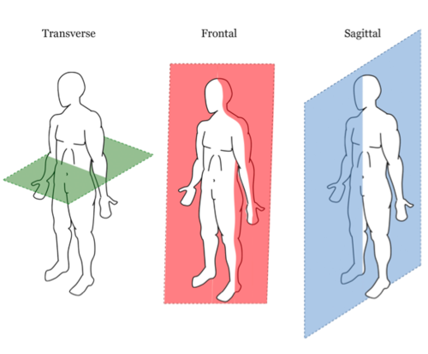
Quick Review
Notes:
Ask class: What motions happen in each plane?
Transverse: Rotation (IR/ER) Sup to inf axis
Frontal: Medial and lateral movements (ABD/ADD, lateral flexion of neck and trunk) Ant to Post axis
Sagittal: Ant/posterior motions (Flexion and extension) Medial to lateral axis
http://media.tumblr.com/03b81e2db25c64d2a3bec45af8a90c3c/tumblr_inline_ms74myvc5Q1qz4rgp.png

Slide 5
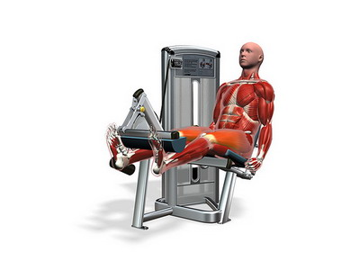
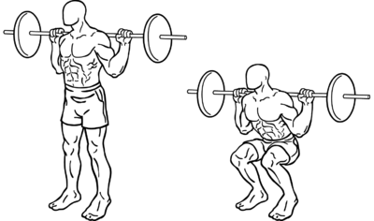
Notes:
http://image.slidesharecdn.com/chapter1-111107082042-phpapp02/95/basic-principles-of-kinesiology-21-728.jpg?cb=1323277706
http://topics.dirwell.com/health/files/2010/03/Leg-extension.jpg
http://upload.wikimedia.org/wikipedia/commons/thumb/0/04/Squats.png/400px-Squats.png

Slide 6
ACL Injury
Most commonly injured knee ligament.
Approximately 100,000-200,000 ACL ruptures per year in the United States.
Majority of injuries are non-contact injuries.
According to the NCAA injury surveillance system, American football players have the highest ACL injury rate of all NCAA athletes (33%).
… but females have a greater predisposition to this type of injury*.
Notes:
* Due Q-angle, quadriceps dominant, effects of estrogen (relaxin), decreases intercondylar notch

Slide 7
Meniscus Injury
Most common soft tissue injury in the knee.
Account for 750,000 arthroscopies per year in the US.
Acute tears often occur during dynamic twisting motions.
Chronic degenerative tears are more common in older adults.
Notes:
2. http://bestpractice.bmj.com/best-practice/monograph/826/basics/epidemiology.html → Cite

Slide 8
ACL Anatomy
Primarily composed of collagen fibers (94%).
Tibial attachment is wider and stronger than the femoral attachment.
Contains mechanoreceptors that are sensitive to rapid movement.
Double bundle ligament:
Anteromedial bundle: Primarily prevents anterior tibial displacement.
Posterolateral bundle: Dominant restraining force in knee extension.

Slide 9
ACL Ligament Anatomy
Notes:
http://ajs.sagepub.com/content/39/4/743/F1.large.jpg

Slide 10
How is the ACL Injured?
The ACL is the primary restraint of anterior translation of the tibia in relation to the femur (Prevents knee hyperextension)
Valgus Injuries?
GENU VALGUM: Latin - Definition
Genu→ Knee
Valgus→ bent outwards
How does this knee position affect the ACL?
Notes:
Valgus” refers to the outward angulation of the distal segment of a bone or joint. Valgus happens in the frontal and/or transverse plane.
http://drwaltlowe.com/media/files/user/ACL_tear.jpg

Slide 11
Dynamic Structures for Dynamic Movement
A 2009 Study by Quatman and Hewett.
ACL injuries are multiplanar, don’t just occur in sagittal plane. (Females)
Load sharing amongst knee ligaments is intricate and complex.
Notes:
ASK CLASS 1st: What is the MCL’s job? (Valgus movement right?) ACL’s job is….?
I actually tore my ACL, MCL and meniscus in my right knee when I landed awkwardly playing football. Felt my knee hyper extend…
3. http://www.ncbi.nlm.nih.gov/pmc/articles/PMC4003572/ : Cite

Slide 12
Quatman and Hewett cont.
ACL and MCL offer restraint to external valgus moment.
MCL may have higher rupture threshold than the ACL.
Why perform lateral pivot shift test if the ACL is purely a sagittal plane restraint?
Notes:
JUST READ PRESENTER NOTES
Cadaveric studies show that the ACL appears to restrain knee valgus by limiting axial tibial rotation, whereas the MCL restrains knee valgus by limiting medial joint space opening.
In other cadaveric studies, ACL failure loads are between 640 and 2100 Newtons, MCL failure loads are as high as 2300 Newtons.
Why perform Pivot shift test (Frontal and transverse plane movement) on a ligament that is said to protect against sagittal movement and forces? Pivot shift is the most specific clinical test for ACL injury (98% specificity) : IR of tibia, valgus force, knee passively flexed, ACL deficient knee will sublux ~ 20-30 degrees of flexion then will reduce in deeper flexion. If you feel it, you know it (Stafford story??).
http://faculty.washington.edu/alexbert/MEDEX/Winter/ch266fg7.jpg
3. http://www.ncbi.nlm.nih.gov/pmc/articles/PMC4003572/ : Cite

Slide 13
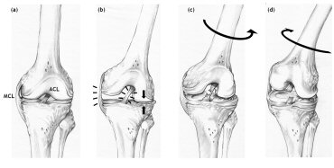
How is the ACL Injured?
Lateral cut, pivot or landing from jump.
Contact injuries.
Clinical imaging of ACL injuries demonstrates valgus collapse.
Static Valgus = ACL injury?
ACL reflex decreases hyperextension, not valgus moment…
Notes:
Observational studies indicate that most non-contact ACL injuries occur during lateral pivoting, landing or deceleration maneuvers during sports play.
(Movements Cause valgus and ant. tibial displacement, remember ant. tibial displacement is relative, post femur positioning such as knee hyperextension can damage ACL).
MRI’s of acutely torn ACL’s display bone bruises on the lateral femoral condyle and posteriorlateral tibia plateau. Confirms compression occurs laterally while the medial joint unloads (Valgus)
Static knee valgus have 30% increase in ACL strains compared to non-valgus knee.
*ACL reflex: motor program reflex that activates hamstring contraction to prevent ACL injury during a strong quadriceps contraction. Not protective reflexive, latency too slow, afferent input used for feed forward control or planning of motor activity
http://www.howardluksmd.com/public/break-a-leg.jpg
http://www.klokavskade.no/upload/Nyheter/bilder/Koga_ACL%20injury%20mechanism.370.jpg

Slide 14
Why doesn’t a sprained ACL heal?
Scar tissue vs. normal tissue
Inability to form “Fibrin Clot” in rupture.
Surgical procedure using fibrin clot →
Notes:
*Evidence suggests injured ligament tissue is replaced with tissue that is histologically and biomechanically similar to scar… (ligaments don’t heal well). Think about recurrence of injured ATF ligament in ankle.
*A complete rupture of an ACL will not heal or scar due to the inability of the injured ligament to form a fibrin-plate clot which acts as scaffolding to repair the ligament (such as in an MCL). The inability to form this fibrin-platelet clot is due to the synovial fluid in the joint dispersing the blood as a haemarthrosis.
*Fibrin clot has the same healing mechanisms as PRP: Platelet rich plasma (speed healing through increases growth factor)
http://www.orthonet.pitt.edu/content/doublebundle.htm

Slide 15
ACL Reconstruction Grafts
Bone-patella-tendon-bone.
Hamstring (Gracilis and semitendinosus)
Allograft
Xenograft
Notes:
No real evidence one graft is better than another (autograft)
*BPTB can lead to ant. knee pain, patellar tendonitis, increased crepitus and discomfort with kneeling.
*h/s graft may take longer to strengthen h/s (h/s is key stabilizer that works with ACL to prevent anterior tibial displacement), some evidence suggests that there is a decreased risk of extension loss with this graft.
*Cadaveric grafts reduce donor site morbidity, can be used to treat multi-ligament repairs, reduce operation time, reduced post-operative pain and lower risk of arthrofibrosis. Increased risk of donor to recipient diseases transmission and decreased integrity of graft radiation sterilization procedure.
*Xenograft: Graft from another specifies (non-human): Used commonly in burn victims, some surgeons use for RCR (pig graft) .
1982 bovine grafts used on 13 human patients, ALL failed, but they used the old primitive “plaster cast rehab” technique. http://informahealthcare.com/doi/pdf/10.3109/17453678909150080: Cite
Recently in 2007 use of “Porcine” grafts were used on Rhesus monkeys with success.→ http://www.ncbi.nlm.nih.gov/pubmed/17418335: Cite
http://www.geekalerts.com/u/tiger-blood-energy-drink.jpg

Slide 16
Menisci Anatomy
Medial Meniscus
Lateral Meniscus
C-shaped
Attached to MCL and H/S
Less mobile
More commonly injured
O-shaped
More mobile
Notes:
The menisci primary functions are transmitting weight-bearing forces, providing shock absorption, increasing knee joint stability, facilitating nutrients, providing lubrication for the articular cartilage and promoting knee proprioception. Menisci actually deform (lateral more than medial) to absorb and disperse axial loads in knee joint.
Studies show that 85-90% of axial forces are transmitted through the menisci with knee flexion during CKC weight bearing.

Slide 17
Menisci Anatomy
Primarily Composed of Type I collagen fibers.
Periphery is vascular, while the central portion is avascular (poor healing).
Alignment of fibers is mostly “circumferential”, with decreased “radial” oriented fibers.
Notes:
Tears in the avascular zone have a 50% chance of healing (may or may not want to share that with the athlete)
*Circumferential shape gives menisci hoop stress and allows structures to withstand anterior and posterior tension.
*Decreased radial oriented fibers make the menisci susceptible to medial and lateral tension.

Slide 18
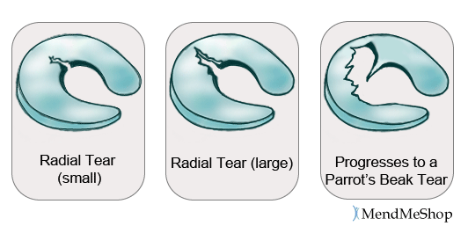
Notes:
Types of meniscus tears… Longitudinal “bucket handle” most common.
Small amount of radial fibers makes menisci susceptible to longitudinal fibers when transverse (rotation) and frontal (med/lateral) loads are directed through knee. Pulls medial and lateral portions of meniscus apart.
Think of the orientation of the fibers, circumferential fibers will prevent radial tear when sagittal load is directed through knee.
Discussed how meniscus is injured (Pivots, cuts, twists, lateral movements) Straight line movements usually don’t cause injury unless meniscus is degenerative .
Agility and plyo’s always one of the last activities to perform before full athletic clearance.
http://www.mendmyknee.com/_img/meniscus-radial-tear.gif

Slide 19
Notes:
Video on Meniscus tears and repairs
http://www.youtube.com/v/OuiIXMgTlyI?version=3&start=1&end=55&autoplay=1&hl=en_US&rel=0

Slide 20
Meniscus Mechanism of Injury
Posterior horn of medial meniscus is most common sight of injury… why?
Why is there a flexion ROM limitation with post-operative meniscus repairs?
Notes:
During deep flexion, the main loading of the medial meniscus occurs at the posterior region, as the posterior horn slides slightly over the posterior rim of the tibial plateau. Significant stress is placed on the posterior horn.
80-90% of the axial load of the body is transmitted through menisci when knee is flexed in CKC. 50% when knee is extended in CKC. Activation of the knee flexor muscles
is also limited due to knee flexion displacing posterior horn of the meniscal. Medial meniscus is attached to the semimembransus. This is why knee flexion ROM restrictions are common in post-surgical meniscus
http://www.courses.vcu.edu/DANC291-003/knee_capsule.jpg

Slide 21
Meniscus Repair Surgery
SEVERAL variations in surgical repair.
Strong evidence for double vertical suture repair in longitudinal meniscus tears.
Notes:
Different thoughts on inside out, and outside in. Double vertical suture is the strongest.
Trephination or “debridement” of the vascular part of the meniscus occurs, along with debridement of the torn edges to cause bleeding so the edges of the tear will heal.
Remember that the lateral 1/3 of the meniscus has better healing rate and will heal faster than repair of tear in the lateral 2/3rds…
http://ajs.sagepub.com/content/39/5/1008/F2.large.jpg

Slide 22
Meniscus Repair
Notes:
http://www.youtube.com/v/WAdTnrI_VUE?version=3&start=385&end=481&autoplay=1&hl=en_US&rel=0

Slide 23
ACL and Meniscus Rehab
Outpatient Clinic
Collegiate Setting
Surgeon directed
Physical therapist in charge of rehab
1-3 rehab sessions a week
Extensive home exercise program
Timeline is more flexible
Surgeon directed
Physical therapist, athletic trainer, strength and conditioning coaches, dieticians, students etc.
Multiple rehab sessions a day, 5-7 days a week
Timeline = pressure!
Notes:
Pressure from coaches, players, parents etc. for RTP in time for season or playoffs.

Slide 24
The Collegiate Athlete and Rehab
Diet
Weight
Psyche
REFER when appropriate!!
Notes:
Athlete needs more caloric intake for fuel than the average adult. Average adult needs a 2,000 calorie diet a day to function. The elite D1 athlete that is rehabbing 5-7 days a week needs between 19-23 kcal per pound a day (depending on stage of rehab, don’t need this much if they are in early phase mat drills) Athletes diet while exercising or in high-level rehab (Phase II): Are they eating and not skipping breakfast? They need more calories to turn
3.3 to 4.4g of protein per lb. of body weight
11 to 13 g of carbohydrates per lb. of body (in non-endurance athletes)
20% of calories should be from fat with an emphasis on HDL
Recommending vitamins and minerals?: Eat a well balanced meal (what do you get when you buy expensive supplements? expensive urine)
Hydration important (you know this): These numbers are more for practice and games
16 fl oz of a cool beverage before
6-8 fl oz during
Replenish 1 pint for every pound lost during
On top of normal 9-13 cups of H2O daily
Weight: We have seen athletes rapidly gain or lose weight after a major orthopedic injury. When appropriate…
Gain weight: 2,500 extra kilocalories are required to gain 1 pound of lean tissue
Lose weight: no less than 1,800 to 2,000 kcal/day as a starting point
Psychological: Rehab is as much mental as physical, look for signs of withdrawal, anxiety, mood swings etc. You guys know more than anyone how stressful it can be to balance school and athletics. Be a cheerleader for the athlete: Explain that rehab is not always a steady gain in improvements, sometimes there are plateau’s.
These are all general recommendations. REFER to appropriate personnel if you are unsure or if situation is outside your scope of practice.
https://racingweight.files.wordpress.com/2012/12/rw2_facebookcoverpage.jpg?w=584&h=216
CSCS book (cite correctly)

Slide 25
Your responsibilities…
Know your role
Delegation
Ask for help
Notes:
Your role on rehab team, surgeon sets protocol who is the primary clinician responsible for rehab? PT, ATC?
Be able to delegate to students and strength coaches, according to the National strength and conditioning association (certifies strength coaches) athletes SHOULD not begin lifting with strength coaches until they have a sports physical and green light from the team docs and/or ATC’s. Injured athletes should have detailed instructions from sports med team about what is appropriate and not appropriate to do in the weight room or field.
If you don’t know get help! From the MD, PT, other ATC’s, high level research etc.
Any questions so far, please ask questions!!!

Slide 26
Pre-surgery Rehabilitation
Goals
Protect injured tissue and unstable joint
Reduce edema and minimize pain
Increase ROM and strength
Notes:
Following injury before surgery
Goals: Get them ready for surgery
NOTE: The protocols being presented may vary from other physician protocols, they are only suggestions based in evidence for a stand alone ACL-R or stand alone meniscus repair. Timelines can also vary.

Slide 27
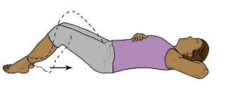
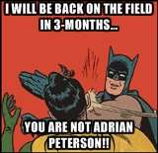
Pre-surgery Rehabilitation
R.I.C.E.
Gait training
Quad sets (QS)
Flexion AROM and PROM
EDUCATE PATIENT
Notes:
2 point gait with crutches (2 with the advancement to 1 crutch)
Eccentric quad strengthening → Make sure quad is contracting only and the knee flattens to the table, avoid squeezing entire LE muscle group to attain leg strengthening. ( This helps isolate quad muscle for later stages of neuro re-ed.
Heel slides: Movement Prevents swelling from turning into arthrofibrosis. Some surgeons will have a pre-surgical strength and ROM goal (ie: 90 degrees of flexion and 0 degrees of extension with a SLR)
Educate patient: Discuss surgery → timeline, rehab goals, surgical procedure, do’s and don’ts, pain, address any questions the patient has. As future providers you will spend the most time with patient, they will trust you and come to you with questions.
http://www.whyiexercise.com/images/Knee.exercises.quad.sets.jpg
http://www.sw.org/misc/health/images/%7B72DABDF4-21DD-48F8-AD08-981ECE8B4271%7D.JPG

Slide 28
Phase I ACL Reconstruction (ACL-R)
1 day to 4 weeks post surgery
Goals
Tissue
Notes:
Goals Protect the graft, control pain and swelling. Recover PROM and AROM as well as neuromuscular control. Decrease and prevent quad inhibition.
Knee is swollen, painful, warm, red and stiff. The graft is in the early healing phase, strength is not optimal, weakest at bone-graft interface due to formation of scar at interface. Overly aggressive activities are detrimental to the graft.

Slide 29
Phase I Meniscus Repair
1 day to 6-weeks post surgery
Goals
Tissue
Notes:
Goals: Same as ACL, protect the repair
Tissue: Hardest lit search I have ever done!! Not able to find a lot of information on meniscus healing at specific stages after surgical repair. (Not sure why).
One animal study stated at 6-weeks the meniscus is 50-100% fully healed in the avascular white zone of sheep that underwent suture repair.
Another animal study states that tensile strength was not fully restored in a non-surgical meniscus tear of the vascular 1/3 red zone left in situ, until 12-16 weeks (non-surgical)
Be cautious with rehab!

Slide 30
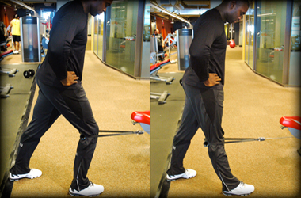
Phase I Exercises
Modalities for pain and swelling
QS
Heel slides
Terminal knee extensions (TKE)
Patellar mobilizations
Gluteal strengthening
Modalities for quad strength
Gait Training
Notes:
RICE, stim, u/s
QS
Heel slides (limited to 90 usually at this phase)
TKE: This statement confused me, is a TKE an exercise or state of knee position? BOTH. Terminal knee extension is when the knee is fully extended, the joint is at it’s maximal congruency (closed packed position) “Screw home mechanism” in place (anyone know what that is?) OKC→ tibia externally rotated around 20 degrees about the femur. CKC→ Femur is internally rotated about the tibia. (Knee model)
Have everyone do a LAQ and squeeze quad at end range ext: explain tibia externally rotated on the femur to lock out or “screw home” the knee
Everyone perform a mini squat: The femur internally rotated on on the tibia to “screw home” knee
There are pictures with people performing TKE’s with bands around the knee or balls behind the knee, does this encourage h/s activation?
Patella mobs next slide
Glute strength: Glute sets, clams, hip abd, bridges when flexion and WB status allows.
Russian stim: Decrease quad inhibition, increases QS strength.
http://www.scielo.br/img/revistas/clin/v62n1/a10fig02.gif
https://www.t-nation.com/img/photos/2010/10-646-03/TKEstart-380.jpg

Slide 31
Patellar Mobilizations
Notes:
Don’t need the towel. Be aggressive!! Patellar mobility plays an important part in knee ROM and strength. A hypomobile patella will not allow the knee to bend, also, the patella increases the leverage of the quad musculature on the femur (helps knee extension). If it is restricted due to pain, swelling or scar tissue, the knee joint will not function correctly. Also remember to move the knee cap into it’s other anatomical movements, such as A/P tilt and med/lat tilt. (have students try)
https://youtu.be/StxJ8ToDqUA

Slide 32
Phase I Rehab
ACL-R
Meniscus
Precautions
OKC vs. CKC
ROM precautions
WB status
Brace wear
Precautions
Limit flexion to 90 degrees
WB status
Brace
Notes:
OKC exercise should be performed with no weight in either full or nearly full extension or between 90-40 degrees of flexion. Anyone know why?
ACL is the primary restraint against anterior tibial displacement on the femur. When performing a leg extension from 90-40 degrees the quad is pulling the tibia anteriorly on the femur to achieve knee extension (everyone do a LAQ again: Knee model??). This movement will stress the reconstructed ACL as it attempts to keep the tibia from shifting too far anteriorly against the massive quad. DO NOT do this until later in rehab, it may damage the weak ACL. Avoid aggressive CKC activities as well that may stress the new graft.
Some (not all) surgeons limit knee flexion to app. 90 degrees with ACL, MOST surgeons limited knee flexion to 90 degrees with meniscal repair (we already discussed implications of flexion on knee meniscus.
WBAT usually for straight ACL’s, but use physicians protocol, they may want NWB or PWB initially. NWB-TDWB phase I meniscus repairs
Physician may want patient to wear brace all the time except during knee PT and showering, including sleeping. Follow physician protocol, as well as protocol on when to unlock brace. Generally brace is locked in extension initially for both (think implications of flexion on meniscus, also quad inhibition can cause instability in WB post-surgical knee, brace is locked to prevent buckle)
Still using modalities to decrease pain and swelling.

Slide 33
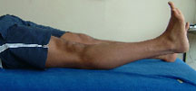
Extension Lag
Notes:
Extension lag is common post surgery due to quad inhibition
Full knee extension to advance to phase II for both procedures
Failure to achieve early knee extension may lead to arthrofibrosis
Intercondylar notch arthrofibrosis in ACL-R is called a Cyclops lesion: usually need surgery to fix a cyclops lesion
Full TKE and SLR usually make FWB possible in ACL-R (Out of brace, off crutches as well).
PLEASE DON’T DO SLR with quad lag!! If you do SLR with a patient that has quad lag, locked them in extension in there brace. A SLR with quad lag is doing nothing, it’s not even a really a straight leg raise, and it could strain the ACL, remember the OKC rule?
http://www.physio-pedia.com/images/thumb/a/a9/Lag_Active.jpg/700px-Lag_Active.jpg
http://www.kneeguru.co.uk/assets/images/Community_Hub/dictionary/extension03.jpg

Slide 34
Phase II ACL-R
4-10 weeks post-surgery
Goals
Tissue
Continue all interventions from phase I
Notes:
Goals: Flexion ROM >/= 90, restoration of normal gait, achieve and maintain active knee extension, increased proprioception, increased strength and protection of graft
Tissue: Knee size due to swelling should almost or fully returned to normal size compared to other knee.
ACL graft in proliferation phase: Revascularization of graft at 6-8 weeks, loss of collagen crimp, graft is at it’s WEAKEST.
Continue to treat edema, continue with pain control, increasing ROM in entire LE. Begin core program

Slide 35
Phase II Meniscus Repair
6 -12 weeks post surgery
Goals
Tissue
Continue phase I interventions
Notes:
Goals: Same as ACL-R phase II
Tissue: may take > 16 weeks for a meniscus to fully heal

Slide 36
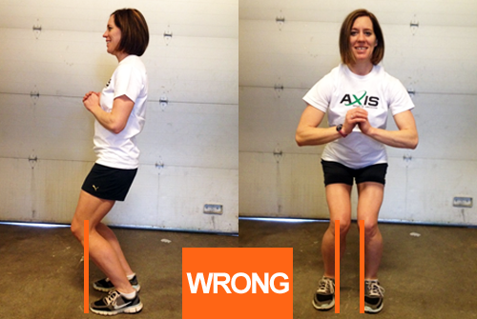
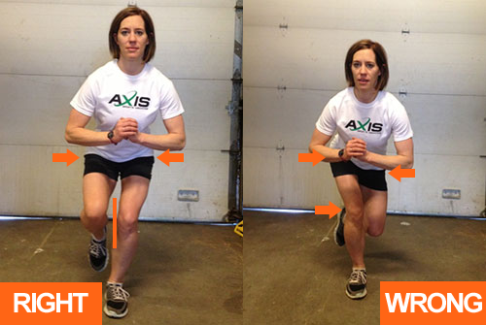
Phase II Exercises
NC A&T
Dynamic balance
CKC activities
Squats
Calf raises
Leg Press
Eccentrics
OKC activities (8-weeks)
Ball h/s curl
Leg extension machine
NCCU/UNC
Dook
Notes:
Squats and single leg squats are important because they are precursors to impact. CORRECT FORM!! (Have someone demonstrate a squat)
DL squat: Knees behind toes, push butt back like boxing out, knees and feet should be pointed forward (not in or out), heels should be flat on the ground, upper torso should be erect. Don’t go below parallel yet (at all?).
SL squat: Same as DL, just make sure the hips are level, trendelenburg posture demonstrates glute weakness. (SL Squat demo)
Master DL and SL squats to advance to impact
≤ 60 degree squat with meniscus repair (always remembering deep flexion CKC implications)
OKC exercises such as leg ext start at 8-weeks with an ACL-R, progress weights
Low leg ext wt for ACL-R (is this exercise functional?)
Remember h/s activation can pull on post. horn of meniscus, progress weight smartly on h/s curls with meniscus repair
Be creative, be functional, be critical. Athletes will bore with the same exercise program, making program fun, creative and functional to their sport doesn’t necessarily mean progressing protocol without MD permission. CHALLENGE athlete!! Swap ideas with the other medical personnel, look at your books, con-ed classes, Google. All within the protocol.
Want functional movement exercises because Functional movement training improves the interaction between stabilizing structures of the kinetic chain (trunk, hip, knee and ankle). Think about the quad and calf atrophy, the disconnect and poor balance after injury and surgery, retrain it functionally.
http://www.moveforwardpt.com/image.axd?id=4e535910-bcd5-4655-99b8-bf8c342119dd&t=635276174434870000

Slide 37
Phase II Rehab
ACL-R
Meniscus Repair
Precautions
Graft is at it’s weakest
Athletes mindset
Physician orders
Precautions
Avoid deep knee flexion in CKC
Brace?
Notes:
ACL-R
Athletes will start feeling good, will push the boundaries of what they can do (Males)
Some surgeons will allow you to remove sutures, d/c brace and crutches. Some will want to be involved in every detail of rehab. Follow physicians orders to the best of your ability as a competent medical provider.
Advance to phase III when gait is normalized, full knee extension can be maintained, minimal swelling, flexion > 90,
Meniscus
Can increase flexion ROM > 90 when joint is NWB
Pt may just be getting out of brace at this phase
Advancement to phase III of meniscus repair: Want functional movement without post. knee pain

Slide 38
Phase III ACL-R
10-16 weeks post-surgery
Goals
Tissue
Continue all interventions from phase II
Notes:
Goals: Protect graft, full knee A/PROM, hamstring and quad strength ≥ 75% contralateral side, impact and running begin.
Tissue: Graft is in the ligamentization phase: Collagen fibers are aligning in proper parallel alignment, vascularity decreases and begins to resemble natural ACL.

Slide 39
Phase III Meniscus Repair
12-16 weeks post surgery
Goals
Tissue
Notes:
Goals: Restore full knee ROM, no knee pain
Tissue may take > 16-weeks to fully heal

Slide 40
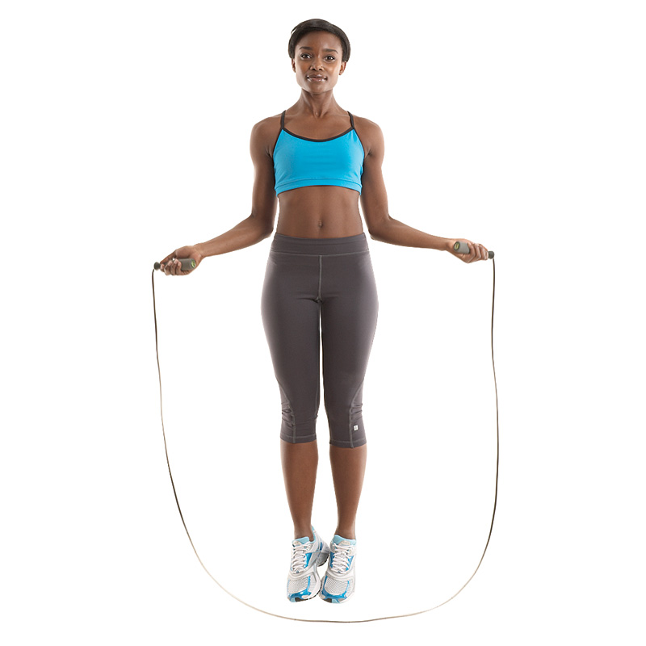
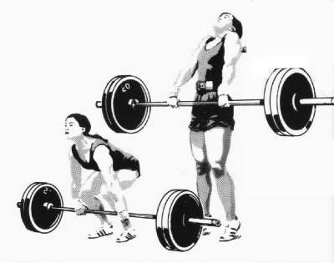
Phase III Exercises
Isokinetic Testing
Running (Are they ready to run?)
Light agility
Begin Olympic lifts
Cardiovascular training
Strength training for power
Strength coach assistance?
Notes:
Isokinetics: Variable speed of movement exercises: Cybex, biodex. (Generally for ACL-R, could be used for strengthening with any injury)
H/s to quadriceps ratio: Quad strength should be 80-100% of body weight, while hamstring should be 2/3 (~66%) of quad strength: There is evidence this ratio can help prevent ACL injuries. Performed on BOTH legs, can improve ratio on non-surgical leg.
Does the athlete meet the criteria to run based on your clinical judgment, do they possess the strength, ROM and technique to run based on their rehab so far? Will they be a knuckle head? If they are a male they have probably already tried to run…
Progressive impact program: Start with light impact (Pogo jumps, SL UE A jumps, rebounder hops to reduce impact)
Jump rope, light jogs on treadmills for 30 sec bouts, increase distance before intensity, progress intensity, BE CRITICAL, identify abnormal running gate and mechanics, listen to impact, use running to identify biomechanical flaws (calf tightness, quad weakness)
Advance Olympic lifts if not already performing them (get help if not familiar with olympic lifts)
Training
Hypertrophy and strength: Moderate weight and reps, long rest break ( 3x10)
Power: low rep high weight large rest break 4 sets of 1-3 reps
Endurance: High rep, low weight, short rest breaks 4x15
If you feel comfortable, a good strength coach can focus on lifting, ROM, Olympic lifts and cardio with YOUR guidance while you focus on impact exercises. Some places the strength coach may actually advance patient after phase III.
https://youtu.be/kj1wfv6LhfU?t=1m1s
http://www.o2fitnessclubs.com/wp-content/uploads/2013/10/1005-knockout-bod-jump-rope.jpg
http://myfitteru.com/blog/wp-content/uploads/2009/12/CLNPULL2.jpg

Slide 41
Phase III Rehab
ACL-R
Meniscus Repair
Precautions
Wait for surgeons clearance for impact activities
Notes
Continue to challenge athlete
SLIGHT Soreness and swelling normal
Precautions
Surgeon clearance for:
CKC exercises with flexion >60º
Sports specific drills
Notes:
Challenge: To stimulate coordination through efferent and afferent information processing, challenge athlete with variations in exercises
somatosensory feedback (BOSU, airex, dynadisk, perturbations)
visual input (eyes closed balanced, multiple objects in air tracking)
Speed (speed of activity)
Complexity of task (if it looks easy, IT IS, make it harder in a functional way)
Increase resistance: shouldn’t be leg pressing 90lbs for 2-weeks straight
Make them perform tasks on 2 legs, then have them perform same task on 1 leg
Soreness: Pt has not ran or jumped since injury, body may react to impact with soreness and slight swelling, treat with modalities, monitor, decide if impact should continue.

Slide 42
Phase IV ACL-R
16-24 weeks post surgery
Goals
Tissue
Notes:
Goals: maximize strength and endurance of knee muscle stabilizers and entire LE, improve arthrokinetic reflexes. Strength of surgical LE ≥ 85% of non-surgical LE. 85% strength and function is sometimes used for clearance for return to sport. Begin sports specific activities and plyometrics, sprinting, acceleration and deceleration training.
Tissue: ACL in Ligamentization phase of healing (same as phase III).

Slide 43
Phase IV Meniscus Repair
16-weeks post surgery to full RTP.
Goal
Tissue
Notes:
Goals: Sports specific training and maintenance of ROM and strength.
Tissue: May or may not be fully healed??

Slide 44
Phase IV Exercises
Aggressive agility
Increased running distances and intensity
Full return to Olympic lifts
Functional tests
Plyometrics
Notes:
This is the beginning of the return to sport phase, want to see the athlete be an athlete.
Aggressive cuts, pivots jumps in cleats, on field, in gym, mimicking practice and game movements.

Slide 45
Plyometrics
Plyometric Phase | Volume (# of Jumps)
Early/beginner | 80-100
Intermediate | 100-120
Advanced | 120-140
Lower Body Plyometric Exercises Considerations
Strength | 1 RM squat at 1.5% of athletes BW.
Speed | Able to perform 5 squat reps in 5 sec with 60% BW.
Balance | Beginner: SLB x30sec hold
 | Intermediate: SL ¼ squat x30sec hold
 | Advanced: SL half squat x30sec hold
Weight | ≥ 220 Lbs.: Avoid high intensity, high volume plyo training. No depth jumps > 18in.
Notes:
Technique for plyos same as squat as far as knee and hip positioning. Listen to impact (should be soft).
This is from the CSCS book, you won’t always see people perform these clearance tests, but they can be good things to look at for assessment.

Slide 46
DEPTH JUMPS
Notes:
https://youtu.be/AzPJZHOmGEg

Slide 47
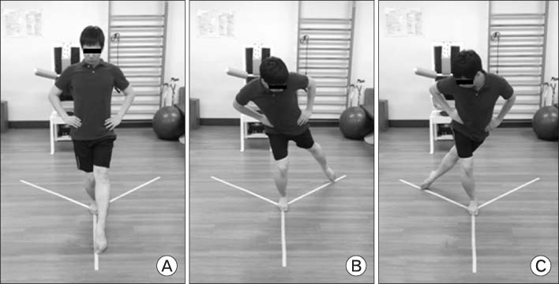
Y-excursion Test
Hop Tests
Notes:
Have pt perform on both legs, compare surgical leg to non-surgical. Is surgical leg within 85% of distance with non-surgical leg? Technique should be 100% of non-surgical leg. Look for:
Weakness, poor mechanics, instability, eccentric control of quad, shock absorption, apprehension, ROM restriction and other poor performance movement errors. Identify and correct flaws with stretching, strengthening etc.
Try Y-excursion??
Personal experience: I saw a ballet dancer sit on her heel while doing the anterior motion.
https://youtu.be/Ct0BYwN11-I
http://www.youtube.com/v/L8ZSSeDgzJo?version=3&start=22&end=56&autoplay=1&hl=en_US&rel=0
http://synapse.koreamed.org/ArticleImage/0171KJSM/kjsm-32-120-g002-l.jpg

Slide 48
Phase IV Rehab
Precautions
Athlete assumes they are free to do EVERYTHING
Notes
Surgeon may prescribe brace for RTP
Notes:
Make sure athlete understands that while they are close to being cleared, they are not cleared yet. Monitor athlete, you may catch them at practice doing all drills at 100%. NOT YET.
Bracing: Increase girth through hypertrophy and power exercises, realize girth may take 1-2 years to reach girth of other leg. Girth does not always equal strength or Power. Good time to get brace and get athlete use to running and jumping in it.

Slide 49
Phase V ACL-R
≥ 6 months post surgery
Goals: Return to sport at 100% participation
Tissue
Precautions
Notes:
Tissue is still in ligamentization phase. Take 1-2 years to reach the morphology and mechanical strength of an intact non-surgical ACL.
Precautions: DO NOT let athlete favor surgical side, can lead to injury in contralateral leg.

Slide 50
Final Rehab Phase Exercises
Position specific drills
Progression of contact drills in practice from light to full.
Limited minutes in practice
Include strength and position coaches.
Notes:
Include coaches to analyze sports specific movement.
Is athlete moving the way they were before injury, are there flaws in their technique only a coach can see?
Keep in mind no patient comes off major surgery initially looking like they did before injury. Athlete will be apprehensive, may try to load non-surgical side more than surgical side (this can cause them to hurt other knee).
Make sure athlete has tried most of the movements (cuts, pivots, jumps) with you alone in an athletic setting (field, court)
make sure athlete performs EVERY movement they will need to perform in a game in practice with a coach and an ATC watching.
http://www.youtube.com/v/83QGgBXUWBY?version=3&start=28&end=53&autoplay=1&hl=en_US&rel=0

Slide 51
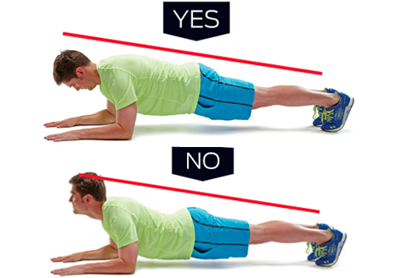
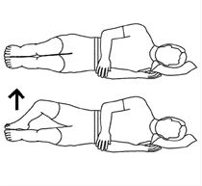
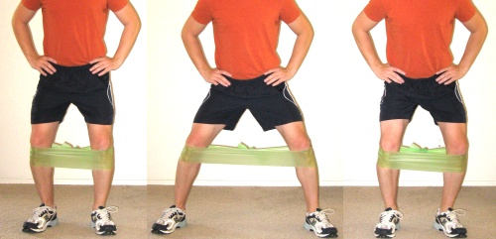
Don’t Forget
Work the core
Increase gluteal muscle strength to protect the knee joint (prevent valgus)
Stretch
Continue with modalities to decrease pain and swelling.
Aerobic activities
Notes:
http://static.tabatatimes.com/wp-content/uploads/2012/10/article_590_quads.jpg
http://amandaruns.com/wp-content/uploads/2013/07/exercise1.png
http://www.golfdigest.com/golf-instruction/blogs/theinstructionblog/fitness-friday-planks.jpg
http://yegfitness.ca/wp-content/uploads/2014/03/elastic-band-walk-lateral.jpg

Slide 52
Monitor…
Complaints of locking, catching instability, pain.
Loss of ROM.
Slower than usual strength gains.
Persistent joint effusion and inflammation.
Talk with surgeon and other medical professionals as needed…
Notes:
If you don’t know get help, remember to challenge the athlete, remember to be functional

Slide 53
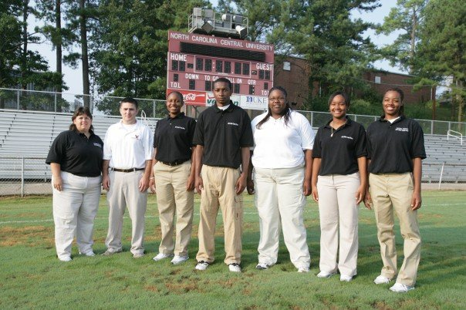
THANK YOU

Slide 54
References
Duthon et al. Anatomy of the anterior cruciate ligament. Knee Surg Sports Traumatol Arthrosc. 2006; 14: 204-213.
LaBella CR, Hennrikus W, Hewett TE. Anterior cruciate ligament injuries: diagnosis, treatment, prevention. Pediatrics. 2014; 133(5): 1437-1450.
van Grinsven S, van Cingel REH, Holla CJM, van Loon CJM. Evidence-based rehabilitation following anterior cruciate ligament reconstruction. Knee Surg Sports Traumatol Arthrosc. 2010;18: 1128-1144.
Chen CH. Graft healing in anterior cruciate ligament reconstruction. Sports Medicine, Arthroscopy, Rehabilitation, Therapy & Technology. 2009; 1: doi:10.1186/1758-2555-1-21.
Fu FH, Bennett CH, Lattermann C, Ma CB.Current trends in anterior cruciate ligament reconstruction. Part 1: Biology and biomechanics of reconstruction. American Journal of Sports Med. 27(6): 821-830.
Goldblatt JP, Fitzsimmons SE, Balk E, Richmond JC. Reconstruction of the anterior cruciate ligament: Meta-analysis of patellar tendon versus hamstring tendon autograft. The Journal of Arthroscopic and Related Surgery. 21(7): 791-803.
Hauser RA, Dolan EE. Ligament injury healing: an overview of current clinical concepts. Journal of Prolotherapy. 3(4): 836-846.
Janssen RP, Scheffler SU. Intra-articular remodeling of hamstring tendon grafts after anterior cruciate ligament reconstruction. Knee Surg Sports Traumatol Arthrosc. 2014; 22: 2102-2108.
Brindle T, Nyland J, Johnson DL. The meniscus: review of basic principles with application to surgery and rehabilitation. Journal of Athletic Training. 2001; 36(2): 160-169.

Slide 55
References cont.
Kiapour AM, Murray MM. Basic science of the anterior cruciate ligament injury and repair. BJR. 3(2): 20-31.
Krossgard MR, Dyhre-Poulsen P, Fischer-Ramussen T. Cruciate ligament Reflexes. Journal of Electromyography and Kinesiology. 2002; 12: 177-182.
Smigielski R et al. Medial meniscus anatomy-from basic science to treatment. Knee Surg Sports Traumatol Arthrosc. 2015; 23: 8-14.
Friedberg RP. ACL injuries. In: UpToDate, Post TW (Ed), UpToDate, Waltham, MA. Accessed: 02/22/2015. www.uptodate.com.
Haklar U et al. Results of arthroscopic of partial or full thickness longitudinal medial meniscus tears by single or double vertical sutures using the inside-out technique. Am J Sports Med. 2013; 41(3): 596-602.
Chivers MD, Howitt SD. Anatomy and physical examination of knee menisci: a narrative review of orthopedic literature. JCCA. 2009; 53(4): 319-333.
Noyes FR, Heckmann TP, Barber-Westin SD. Meniscus repair and transplantation: a comprehensive update. JOSPT. 2012; 42(3): 274-290.
Muller B, Bowman KF, Bedi A. ACL graft healing biologics. Clin Spors Med. 2013; 32: 93-109.
Pinczewski LA et al. A 10-year comparison of anterior cruciate ligament reconstructions with hamstring tendon and patellar tendon autograft: a controlled, prospective trial. AJSM. 2007; 35(4): 564- 574.

Slide 56
References cont.
Quatman CE, Hewett TE. The anterior cruciate ligament injury controversy: is valgus collapse “a sex-specific” mechanism? Br J Sports Med. 2009; 43(5): 328-335.
Schmidt T et al. Sterilization with electron beam irradiation influences biomechanical properties of and the early remodeling of tendon allografts for reconstruction of the ACL. Cell Tissue Bank. 2012; 13: 387-400.
Kawamura S, Lotito K, Rodeo SA. Biomechanics and healing response of the meniscus. Operative Techniques in Sports Medicine. 2003; 11(2): 68-76.
Lyons ME. Isokinetic hamstring: quadriceps strength ratio in males and females: implications of ACL injury .2006; 64: 1-14.
Petersen W et al. The effect of locally applied vascular endothelial growth factor on meniscus healing: gross histological findings. Arch Orthop Trauma Surg. 2007; 127: 235-240.
Hacke J. The Knee Joint: examination/intervention. [PowerPoint]. UNC Chapel Hill: UNC-DPT; 2013.
Gross MT. Meniscal fibrocartilage: composition, structure, function, mechanical properties, and healing. [PowerPoint – Voicethread]. University of NC Chapel Hill DPT; 2014.
Anderson BC. Meniscus injury of the knee. In UpToDate. Post TW (Ed), UpToDate, Waltham, MA. Accessed : 02/23/2015. www.uptodate.com.
Baechle TR & Earle RE. Essentials of strength training and conditioning 3rd ed. Champaign, IL: Human Kinetics; 2008.

Slide 57
Questions/Comments?
garyejohns@med.unc.edu
gjohnson0823@gmail.com

