Slide 1
Health Disparities – Broader Perspectives
"Lightning talk", April 11, 2016
Victor J. Schoenbach, Ph.D., http://go.unc.edu/vjs/
Department of Epidemiology and Minority Health Project
UNC Gillings School of Global Public Health
Marion E. Schoenbach (Enabler)

Slide 2
No conflicts to disclose
But first, a word from our “sponsors” . . .

Slide 3
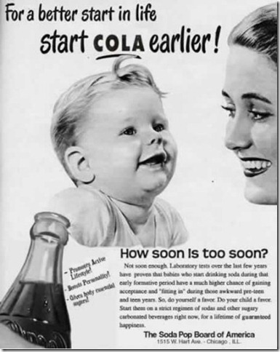
How soon is too soon? Not soon enough. Laboratory tests over the last few years have proven that babies who start drinking soda during that early formative period have a much higher chance of gaining acceptance and “fitting in” during those awkward pre-teen and teen years. So, do yourself a favor. Do your child a favor. Start them on a strict regimen of sodas and other sugary carbonated beverages right now, for a lifetime of guaranteed happiness.
-Promotes Active Lifestyle!
-Boosts Personality!
-Gives body essential sugars!

Slide 4
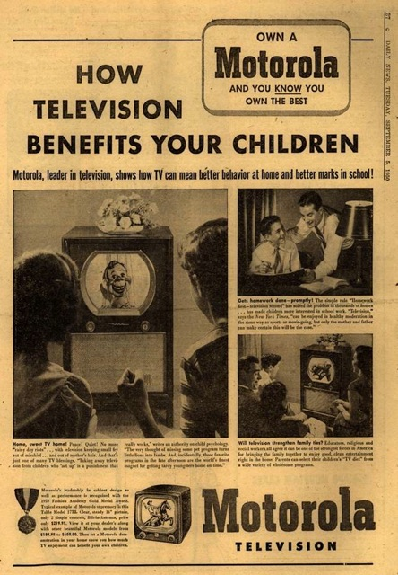

Slide 5
Outline
What makes us healthy or unhealthy?
The movement to document and eliminate health disparities
Adapting to the complexity of reality
Epidemiology for enlightenment
Notes:
It was noted by many at the time that the health disadvantages of American minorities was not a new discovery. W.E.B. DuBois, for example, had written about these at the turn of the century. [The Negro Health Improvement movement?] Some 15 years earlier, the Kerner Commission on Civil Disorders had described the racial dualism pervading American society, echoing the observations made by Swedish economist Gunnar Myrdal in An American Dilemma. 1985 was only two decades after African Americans had endured mass arrests, cattle prods, arson, bombings, assassinations, and other legal and extra-legal actions carried out to enforce disparities in employment opportunity, housing, public accommodations, health care access, and other areas. But even if the health disparities documented by the Heckler Report were neither new nor unexpected, the Report nevertheless did draw considerable attention and served as a touchstone for putting health disparities on the national agenda.

Slide 6
What makes for health?
Notes:
It was noted by many at the time that the health disadvantages of American minorities was not a new discovery. W.E.B. DuBois, for example, had written about these at the turn of the century. [The Negro Health Improvement movement?] Some 15 years earlier, the Kerner Commission on Civil Disorders had described the racial dualism pervading American society, echoing the observations made by Swedish economist Gunnar Myrdal in An American Dilemma. 1985 was only two decades after African Americans had endured mass arrests, cattle prods, arson, bombings, assassinations, and other legal and extra-legal actions carried out to enforce disparities in employment opportunity, housing, public accommodations, health care access, and other areas. But even if the health disparities documented by the Heckler Report were neither new nor unexpected, the Report nevertheless did draw considerable attention and served as a touchstone for putting health disparities on the national agenda.

Slide 7
What makes for health?
Physical security, safety
Pure air, water, food, environment
Good nutrition, physical activity, immunizations, public health, health care
Education, economic resources, social support, opportunities
Notes:
It was noted by many at the time that the health disadvantages of American minorities was not a new discovery. W.E.B. DuBois, for example, had written about these at the turn of the century. [The Negro Health Improvement movement?] Some 15 years earlier, the Kerner Commission on Civil Disorders had described the racial dualism pervading American society, echoing the observations made by Swedish economist Gunnar Myrdal in An American Dilemma. 1985 was only two decades after African Americans had endured mass arrests, cattle prods, arson, bombings, assassinations, and other legal and extra-legal actions carried out to enforce disparities in employment opportunity, housing, public accommodations, health care access, and other areas. But even if the health disparities documented by the Heckler Report were neither new nor unexpected, the Report nevertheless did draw considerable attention and served as a touchstone for putting health disparities on the national agenda.

Slide 8
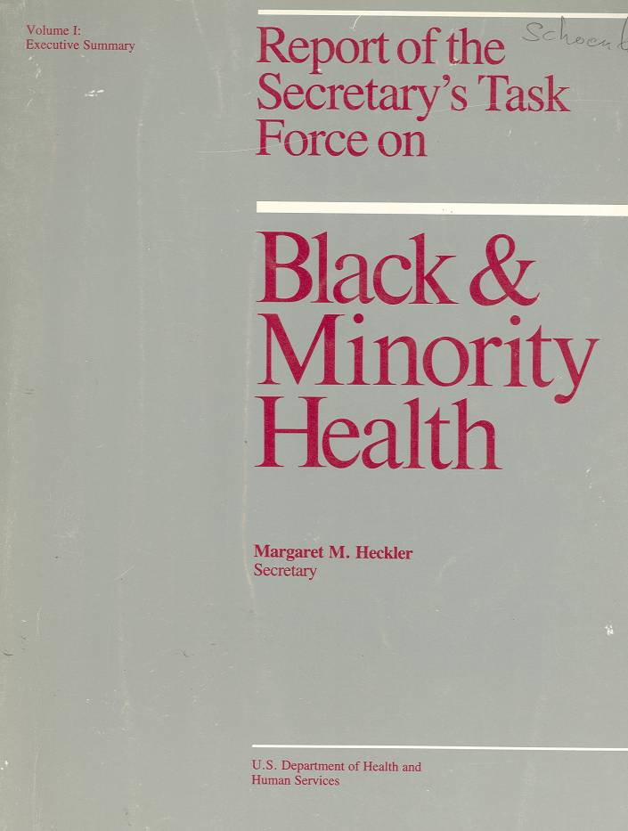
Official recognition of “Excess deaths” among minorites
1985 “Heckler Report”
Useful landmark
Minorities experience 60,000 excess deaths
8 main recommendations, including: outreach, cultural awareness, coordination, health care access, data, research
Notes:
Perspectives in Disease Prevention and Health Promotion
Report of the Secretary's Task Force on Black and Minority Health
MMWR February 28, 1986 / 35(8);109-12
http://www.cdc.gov/mmwr/preview/mmwrhtml/00000688.htm
The Task Force made eight main recommendations to the Secretary, each of which was followed by several specific suggestions:
1. Implement an outreach campaign, specifically designed for minority populations, to disseminate targeted health information, educational materials, and program strategies.
2. Increase patient education by developing materials and programs responsive to minority needs and by improving provider awareness of minority cultural and language needs.
3. Improve the access, delivery, and financing of health services to minority populations through increased efficiency and acceptability.
4. Develop strategies to improve the availability and accessibility of health professionals to minority communities through communication and coordination with nonfederal entities.
5. Promote and improve communication and coordination among federal agencies in administering existing programs for improving the health status and availability of health professionals to minorities.
6. Provide technical assistance and encourage efforts by local and community agencies to meet minority-health needs.
7. Improve the quality, availability, and use of health data pertaining to minority populations.
8. Adopt and support research to investigate factors affecting minority health, including risk-factor identification, education interventions, and prevention and treatment services.

Slide 9
Report of the Secretary’s Task Force
"Despite the unprecedented explosion in scientific knowledge and the phenomenal capacity of medicine to diagnose, treat, and cure disease, Blacks, Hispanics, Native Americans, and those of Asian/Pacific Islander heritage have not benefited fully or equitably from the fruits of science or from those systems responsible for translating and using health sciences technology.“ (Introduction and Overview)
Notes:
It was noted by many at the time that the health disadvantages of American minorities was not a new discovery. W.E.B. DuBois, for example, had written about these at the turn of the century. [The Negro Health Improvement movement?] Some 15 years earlier, the Kerner Commission on Civil Disorders had described the racial dualism pervading American society, echoing the observations made by Swedish economist Gunnar Myrdal in An American Dilemma. 1985 was only two decades after African Americans had endured mass arrests, cattle prods, arson, bombings, assassinations, and other legal and extra-legal actions carried out to enforce disparities in employment opportunity, housing, public accommodations, health care access, and other areas. But even if the health disparities documented by the Heckler Report were neither new nor unexpected, the Report nevertheless did draw considerable attention and served as a touchstone for putting health disparities on the national agenda.

Slide 10
1990s initiatives
1990 NIH Office of Minority Programs
1993 Health Revitalization Act, NIH ORMH
1997 Presidential apology for Tuskegee
APHA/HHS Campaign to Eliminate Racial and Ethnic Health Disparities
2000 PL 106-525: Minority Health & Health Disparities Research & Education Act
Notes:
http://www.nih.gov/about/almanac/organization/NIMHD.htm
http://www.apha.org/advocacy/policy/policysearch/default.htm?id=246

Slide 11


Healthy People 2010
Overarching goals:
Goal 1: Increase Quality and Years of Healthy Life
Goal 2: Eliminate Health Disparities
Notes:
Healthy People 2000 had specific objectives related to reducing health disparities (need to verify?). Healthy People 2010 marked the first formal enunciation of the goal of eliminating health disparities.
“Healthy People 2010 is designed to achieve two overarching goals:
Goal 1: Increase Quality and Years of Healthy Life
The first goal of Healthy People 2010 is to help individuals of all ages increase life expectancy and improve their quality of life.
Goal 2: Eliminate Health Disparities
The second goal of Healthy People 2010 is to eliminate health disparities among different segments of the population.”
http://www.healthypeople.gov/2010/About/goals.htm

Slide 12
Trans-NIH strategy
A primary goal of PL.106-525 - ensure that NIH health disparities research be an integrated and inclusive field of study, rather than an aggregate of independent research activities in separate research domains.
27 NIH institutes and centers developed strategic plans during 2002-2006
Notes:
http://iom.edu/~/media/Files/Report%20Files/2006/Examining-the-Health-Disparities-Research-Plan-of-the-National-Institutes-of-Health-Unfinished-Business/nihdisparities.pdf

Slide 13

IOM: Examining the NIH Health Disparities Research Plan (2006)
Conceptual issues
Need more attention to social determinants, …
Update strategic plans
Budget not allocated
More staffing
Need more trans-NIH coordination
Notes:
Conceptual issues concerning definition, measurement, and methodologies.
http://www.nap.edu/download.php?record_id=11602#

Slide 14

Healthy People 2020: overarching goals
Attain high quality, longer lives free of preventable disease, disability, injury, and premature death.
Achieve health equity and eliminate disparities.
Create social and physical environments that promote good health for all.
Promote quality of life, healthy development, and healthy behaviors across all life stages.
Notes:
http://www.healthypeople.gov/2020/consortium/HP2020Framework.pdf
Healthy People 2020 objectives have one mention of “disparities”:
http://www.healthypeople.gov/2020/topicsobjectives2020/pdfs/HP2020objectives.pdf

Slide 15
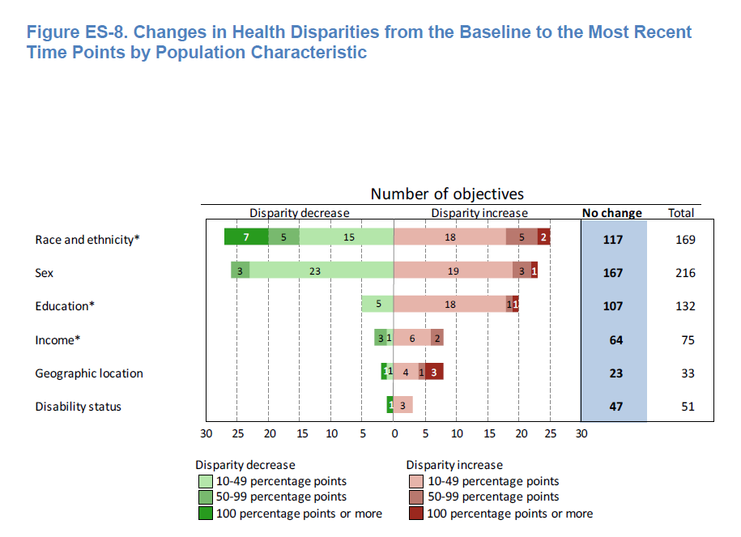
Healthy People 2010 Final Review: Changes in health disparities
“most of the population-based objectives with data to measure disparities had no change in health disparities.”
(Healthy People 2010 Final Review)
Notes:
Healthy People 2010 Final Review [published in 2013]
Executive Summary Page ES-26
Figure ES-8. Changes in Health Disparities from the Baseline to the Most Recent Time Points by Population Characteristic
NOTES: Changes in disparity from the baseline to the most recent time points are only shown when they could be assessed. Changes could not be assessed for 54, 82, 4, 3, 10, and 17 objectives by race/ethnicity, sex, education, income, geographic location, and disability status, respectively. “No change” includes: changes of less than 10 percentage points, regardless of statistical significance; and all changes that were not statistically significant, when estimates of variability were available. See Technical Appendix.
* Number of objectives with changes in the summary index as a measure of disparity. Health disparities by income were not included for Focus Area 19 due to data limitations.
http://www.cdc.gov/nchs/data/hpdata2010/hp2010_final_review_executive_summary.pdf
See also Technical Appendix: http://www.cdc.gov/nchs/data/hpdata2010/hp2010_final_review_technical_appendix.pdf

Slide 16
What is race? Racism.
Biological “races” (subspecies) do not exist in humans
Socially constructed race: “Arbitrarily utilizes aspects of morphology, geography, culture, language, religion, etc., in the service of a social dominance hierarchy.” (Joseph Graves, “The Meaning of Race in Medicine”, 2006 annual Summer Public Research Videoconference on Minority Health
http://sph.unc.edu/webcast/sph-webcasts/?webcast_id=2006-06-26_vc1210sc2006/)
Notes:
Although many of us speak as if we know what disease is – I do that all the time – the term is notoriously difficult to define. Consider the following definition: “a type of internal state which is either an impairment of normal functional ability–that is, a reduction of one or more functional abilities below typical efficiency–or a limitation on functional ability caused by environmental agents” (C. Boorse, What is disease? In: Humber M, Almeder RF, eds. Biomedical ethics reviews. Humana Press, Totowa NJ, 1997, 7-8 (quoted in Temple et al., 2001)
This definition refers to “normal” and “typical efficiency”, which begs the question how do we define “normal” and “typical”.
Conditions that rapidly lead to death rarely arouse debate about whether or not they qualify as “disease”. But many non-fatal conditions are less easily classified. Two current examples are attention deficit hyperactivity disorder (ADHD) and chronic fatigue syndrome. Both of these syndromes (a syndrome is a collection of symptoms that often occur together) are regarded by many as resulting from a “disease”, yet in the absence of regularly demonstrable biological dysfunction or abnormality how does one differentiate these syndromes from other variation in “normal” experience?

Slide 17
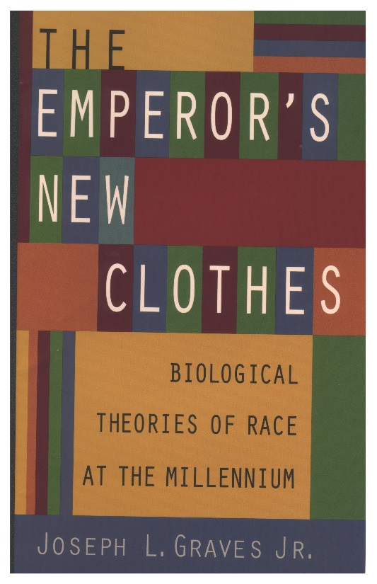
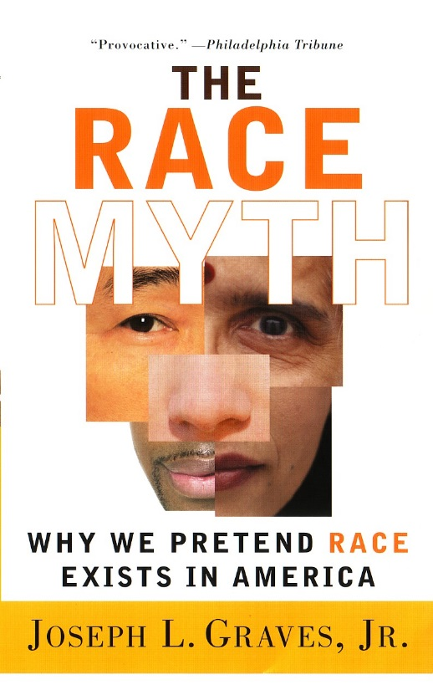
Good reads:
J.L. Graves, The Emperor’s New Clothes: Biological Theories of Race at the Millennium, Rutgers University Press, 2001, 2005; The Race Myth: Why We Pretend Race Exists in America, Dutton Press, 2005.

Slide 18
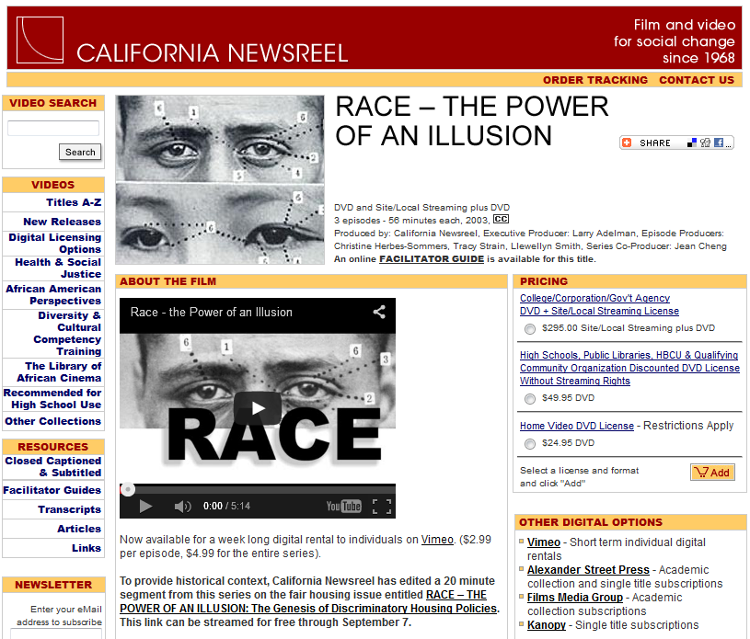
Good viewing:

Slide 19
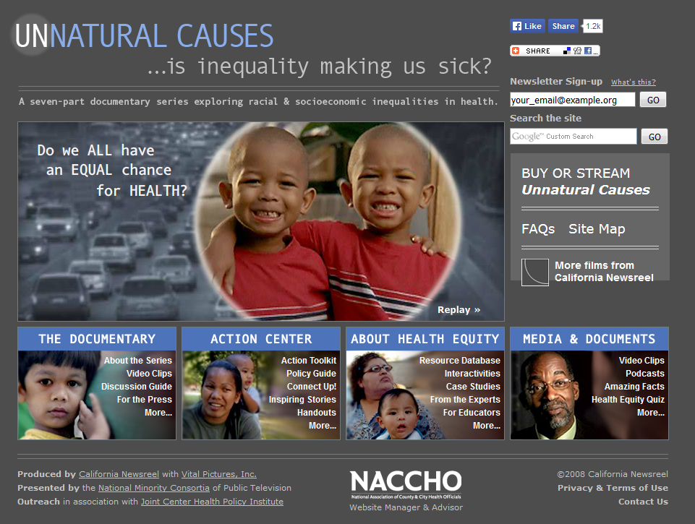
Poverty is bad for our health
Notes:
.

Slide 20
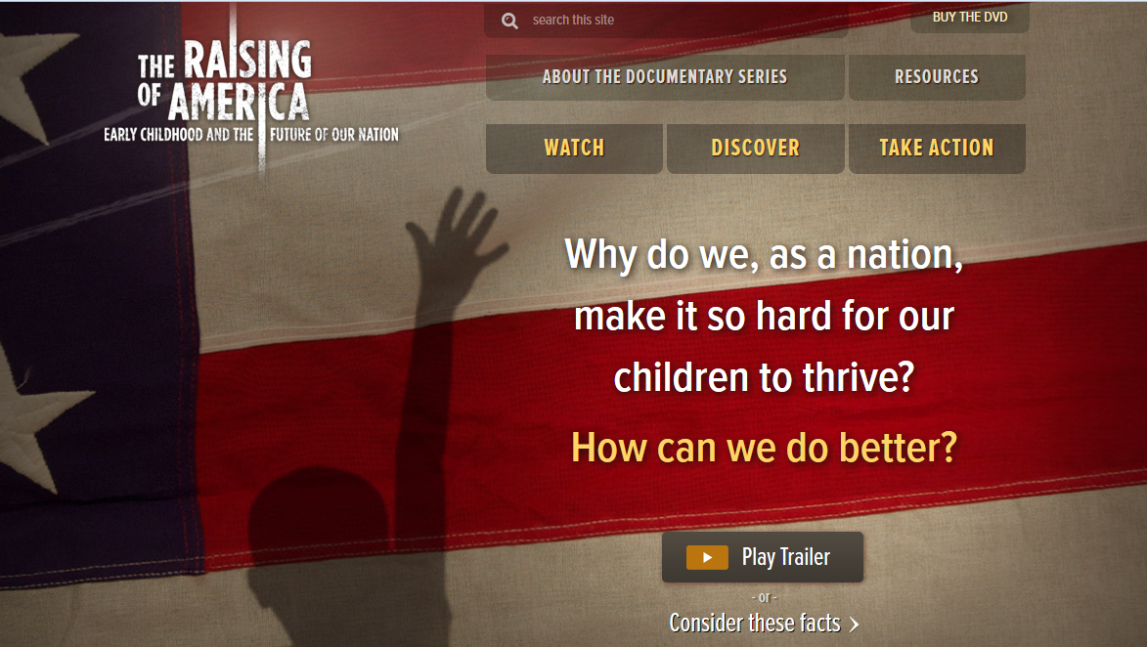
And bad for our childen
Notes:
.

Slide 21
NIH Health Disparities Strategic Research Plan and Budget, Fiscal Years 2009-2013
Health disparities persist and are seen across a broad spectrum of diseases and adverse outcomes.
Health disparities are a concern for the nation.
Health disparities are costly ~ 230 billion
Health disparities are “shaped by the interaction of … social, environmental, behavioral, and biological factors.”
Notes:
“… health disparities are complex, dynamic, and multidimensional in nature. Health and ultimately health disparities are shaped by the interaction of multiple factors, including: social, environmental, behavioral, and biological factors. These interacting factors are dynamic and vary in their impact depending upon when in the life course they occur, access to appropriate and timely health care, and the existence of effective policies and interventions.”
“2009 report on the economic burden of health disparities in the U. S. commissioned by the Joint Center for Economic and Political Studies revealed that between 2003 and 2006, an estimated 30.6% of direct medical care expenditures for African Americans, Asian Americans, and Hispanics were excess costs due to health inequalities2 (LaVeist et al. 2009). The same study revealed that the combined costs of health inequalities and premature deaths from preventable diseases in the United States in that same time period rose to $1.24 trillion. African Americans, Hispanics, and Asians accounted for $229.4 billion in direct medical expenditures due to health disparities.”

Slide 22
How Far Have We Come in Reducing Health Disparities
Recurring themes from an April 8, 2010 Institute of Medicine workshop:
Health disparities are not going away
Economic hardship is an important contributor
Institutional racism and racial discrimination persist
Residential segregation, community environment
Low levels of awareness among general public
Policies of federal agencies besides those directly related to health
Community input/initiation is key
The Affordable Care Act should help
Notes:
The 9/12/2012 summary of the April 8, 2010 Institute of Medicine workshop identified a number of themes that recurred throughout the workshop. http://www.iom.edu/Reports/2012/How-Far-Have-We-Come-in-Reducing-Health-Disparities.aspx

Slide 23

2012: How Far Have We Come in Reducing Health Disparities?
Paula Braveman:
More and better research on social determinants, …
Intervention research
Translational research:
How inform public?
How get them to care?
How create political will
Notes:
Source: Chapter 6: What Do We Still Need to Learn About Reducing Health Disparities?
http://www.nap.edu/download.php?record_id=13383#

Slide 24
What is missing?
“In order to eliminate disparities in health, we need leaders who care enough, know enough, will do enough and are persistent enough.”
(David Satcher, MD, PhD, “From Eliminating Health Disparities to Achieving Health Equity Bridging the Gap”, American College of Epidemiology 2015 annual meeting on “Systemic determinants of health”)
Notes:
Life is too complex for central planning.

Slide 25
But can we centrally plan away health disparities?
All aspects of life affect health, and we don’t understand any aspect fully.
Actions have multiple causes and effects (direct vs. indirect, now vs. later, …).
Different people have different views and are affected differently.
We can’t all agree, and there is no one in charge.
Notes:
Life is too complex for central planning.

Slide 26
Behavior is fundamental
Health disparities arise from and are maintained by behavior:
Personal behavior
Expressive behavior
Professional behavior
Economic behavior
Political behavior
What influences behavior?
Notes:
h

Slide 27
Brain changes from early abuse
Child abuse alters hyothalamic-pituitary-adrenal stress responses & suicide risk.
Comparison of suicide victims with and without a history of child abuse found decreased levels of and differences in glucocorticoid receptor mRNA in brain.
Epigenetic regulation of hippocampal glucocorticoid receptor expression.
(McGowan PO et al., Epigenetic Regulation Brain Child Abuse, Nature Neuroscience, March 2009;12(3):241-3)
Notes:
“Maternal care influences hypothalamic-pituitary-adrenal (HPA) function in the rat through epigenetic programming of glucocorticoid receptor expression. In humans, childhood abuse alters HPA stress responses and increases the risk of suicide. We examined epigenetic differences in a neuron-specific glucocorticoid receptor (NR3C1) promoter between postmortem hippocampus obtained from suicide victims with a history of childhood abuse and those from either suicide victims with no childhood abuse or controls. We found decreased levels of glucocorticoid receptor mRNA, as well as mRNA transcripts bearing the glucocorticoid receptor 1F splice variant and increased cytosine methylation of an NR3C1 promoter. Patch-methylated NR3C1 promoter constructs that mimicked the methylation state in samples from abused suicide victims showed decreased NGFI-A transcription factor binding and NGFI-A-inducible gene transcription. These findings translate previous results from rat to humans and suggest a common effect of parental care on the epigenetic regulation of hippocampal glucocorticoid receptor expression.” (abstract)
(McGowan PO et al., Epigenetic Regulation Brain Child Abuse, Nature Neuroscience, March 2009;12(3):241-3)

Slide 28
Contextual influences
“… Americans are exposed, via television, to nonverbal race bias, and such exposure can influence perceivers' race associations and self-reported racial attitudes. Nonverbal behavior that communicates favoritism of one race over another can be so subtle that even across a large number of exposures, perceivers are unable to consciously identify the nonverbal pattern. Yet despite (or perhaps because of) this subtlety, exposure to nonverbal race bias may transmit race bias to perceivers." 1714
Max Weisbuch, Kristin Pauker, Nalini Ambady. The subtle transmission of race bias via televised nonverbal behavior. Science 18 Dec 2009;326:1711-1714.
Notes:
Also effects of segregation, psychological impact from hate crimes

Slide 29
Your brain on hormones
“… hormones alter emotional states (such as fear), bias attention (for example, toward sexual stimuli), or change the pleasantness or aversiveness of stimuli (such as infant odors) to alter behavioral probabilities in ways that depend on prior experience.” p1146
“The basic endocrine mechanisms and brain structures have been remarkably conserved in the course of evolution . . .”
(Elizabeth Adkins-Regan. Under the influence of hormones. Science 29 May 2009;324:1145. Review of Peter T. Ellison and Peter B. Gray, eds. Endocrinology of social relationships. Harvard, 2009)
Notes:
Men with one sexual partner have lower testosterone levels than those with multiple or no partners.
http://www.sciencemag.org/content/324/5931/1145.citation

Slide 30
Our brains are plastic
Habitual actions require less mental effort than actions selected to achieve an outcome but must be inhibited if the situation changes.
Rats subjected to chronic stress became less sensitive to changes in outcomes.
Chronic stress caused structural changes in the brain that may bias toward habit and dysfunctional decision-making.
(Eduardo Dias-Ferreira et al., Chronic stress causes frontostriatal reorganization and affects decision-making. Science 31 July 2009;325:p621-625)
Notes:
Chronic stress can change the structure of the brain to bias decision making toward habitual behavior.
Habitual actions require less mental effort than actions selected to achieve an outcome but must be inhibited if the situation changes.
Rats subjected to chronic stress became less sensitive to changes in outcomes.
Chronic stress caused structural changes in the brain that may bias toward habit.
“The present results show a divergent structural reorganization of corticostriatal circuits after chronic stress, with atrophy of the associative corticostriatal circuits and hypertrophy of the circuits coursing through the sensorimotor straitum. This frontostriatal reorganization is accompanied by a shift toward habitual strategies, affecting the ability of stressed animals to perform actions based on their consequences. . . . Our results, using a natural model, indicate that the relative advantage of the sensorimotor network after chronic stress biases behavioral strategies toward habit and offer further insight into how chronic stress can lead to dysfunctional decision-making.” (Eduardo Dias-Ferreira et al., Chronic stress causes frontostriatal reorganization and affects decision-making. Science 31 July 2009;325:p621-625:625, http://www.sciencemag.org/content/325/5940/621.abstract)

Slide 31
Is the college experience bad for your health?
“The results of this study show that long working hours may be one of the risk factors that have a negative effect on cognitive performance in middle age.” 604
Long working hours and cognitive function: The Whitehall II Study. Marianna Virtanen et al. Am J Epidemiol 2009;169:596-605

Slide 32
“We have met the enemy and (s)he is us” – or is (s)he?
“For a long time, it was generally assumed that many of the mental processes that make goal pursuit possible require consciousness. But in the past decade or so, the scientific study of goal pursuit has discovered that these processes can also operate without conscious awareness, and hence, human behavior may originate in a kind of unconscious will.
Ruud Custers and Henk Aarts. The unconscious will: how the pursuit of goals operates outside of conscious awareness. Science 2010 (July 2);329(5987):47-…

Slide 33
Can consciousness be improved?
Transcendental Meditation is attracting increasing interest.
(www.davidlynchfoundation.org)
“Quiet time” programs have shown great promise in urban schools with typical problems. (e.g., NBC newscast LINK)
Can epidemiologists evaluate a wholistic intervention with long-term impact?

Slide 34
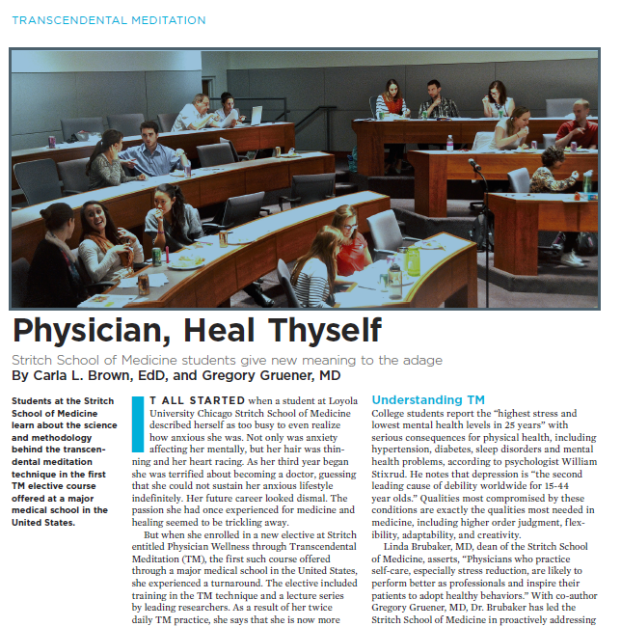

Slide 35
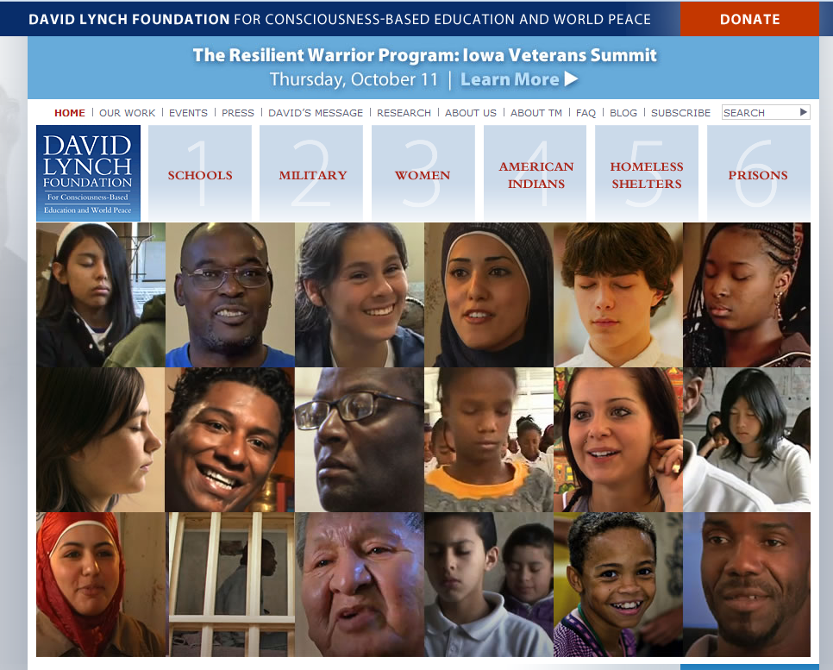
Can consciousness be improved?

Slide 36
Thank you – let’s talk!
Your comments here
And here
More on these themes at:
  http://go.unc.edu/sjae (see “library of resources”)
  My YouTube channel (interviews)
  Webcasts at www.minority.unc.edu
  Next is 22nd National Health Equity Research Webcast on June 7, 1:30pm.

Slide 37
Extra slides for the discussion

Slide 38
Suggested readings
1. Social Context, Sexual Networks, and Racial Disparities in Rates of Sexually Transmitted Infections. Adaora A. Adimora and Victor J. Schoenbach.The Journal of Infectious Diseases 2005;191 (Issue Supplement 1):S115-S122 http://jid.oxfordjournals.org/content/191/Supplement_1/S115.full
2. Powell Memorandum: Attack On American Free Enterprise System, 1971, Lewis F. Powell, Jr. http://law2.wlu.edu/powellarchives/page.asp?pageid=1251
3. Things ain't what they ought to be: social forces underlying racial disparities in rates of sexually transmitted diseases in a rural North Carolina county. James C Thomas, Karen K Thomas. Social Science & Medicine 1999(October);49(8): 1075–1084 http://www.sciencedirect.com//science/article/pii/S0277953699001975

Slide 39
Propositions on human behavior: looking under the hood
Living systems are made up of fundamental building blocks (e.g., quarks, electrons, protons, atoms, molecules) organized into organelles, cells, organs, etc.
Notes:
Propositions on the human nervous system
1. Living systems are made up of fundamental building blocks (e.g., molecules, atoms, protons, electrons, quarks, etc.) These fundamental elements interact according to fundamental laws. From these building blocks arise creations of great diversity and complexity, which eventually disintegrate back into fundamental elements.

Slide 40
Propositions
Living systems replicate, diversify, compete, cooperate, invade one another, incorporate one another, combine, and evolve into systems of increasing complexity.
Notes:
2. As described by evolutionary theory, living systems replicate, diversify, compete, cooperate, invade one another, incorporate one another, combine, and evolve into systems of increasing complexity. What exists on any given day is rooted in this long past history. Humans are the product of billions of years of evolution, though only a couple of hundred thousand years for our current species.

Slide 41
Propositions
Complex living systems have nervous systems that can create the experiences of consciousness, memory, imagination, deductive logic, extrapolation, anticipation, prediction, and other mental functions.
Notes:
3. One key feature of modern humans is a nervous system that can produce the experience of consciousness, including imagination, rational thinking, deductive logic, extrapolation, anticipation, prediction, conscious memory, and other mental functions. Connections between the nervous system and cognition are being investigated, and scientific description of the nature of mental processes, including some of their limitations, is expanding.

Slide 42
Propositions
These mental functions are generated by the interactions of over 80 billion individual agents (neurons), in the context of other types of cells and the factors they secrete, as well as other internal and environmental chemico-physical influences.
Notes:
4. The macroscopic functioning of the human nervous system reflects the combined results of actions by billions of neurons and other types of brain cells, as well as of endocrine and other chemico-physical influences, both internal and environmental. The functioning of these innumerable living agents, individually and collectively, is the basis of all thoughts and behavior, although our perception is often of a conscious ego making choices and decisions. Of course, "is the basis of" does not necessarily man completely determined by, and there are also "random" disturbances.

Slide 43
Propositions
The resulting thoughts and actions, which are also influenced by perceptions and expectations of others’ thoughts and actions, are generally aimed at advancing the organism’s interests, as these are perceived by the organism and responded to by 80 billion+ agents.
Notes:
5. Research on cognition and the brain is shedding light on some of these processes and their implications, and on ways to influence them. On the macro level, much of what all of us do every waking hour, including both the mundane and the profound, is influenced by what others say and do, including what we think they will or would say and do. Conversely, much of what we say and do has the objective of influencing mental processes of others, whether that be through courtesy, attraction, explanation, persuasion, negotiation, distraction, deception, threat, coercion, and a panoply of other ways, both deliberate and involuntary, even unconscious. Much, perhaps most or all of these actions have the objective of obtaining access to resources (broadly defined) and advancing our interests in all manner of ways.

Slide 44
Propositions
Collaborations, organizations, governments, strategic plans, policies, legislation, enforcement actions, and everything else reflect these myriad, competing influences. Ultimately, better outcomes require that thoughts and actions reflect more accurate, efficient, coherent and integrated brain functioning.
Notes:
6. Collaborations, organizations, governments, strategic plans, policies, legislation, enforcement actions, and essentially everything we think and do reflects these and other myriad, typically competing influences. Even when we vote for "hope and change", the same underlying processes determine the outcome. Thus, the best prospect for improving the outcome is through wholistic improvement in the functioning of human nervous systems so that thoughts and actions reflect more accurate, efficient, coherent and integrated brain functioning. Indeed, there is no other way to accomplish outcomes that are better for everyone. If an outcome is not better for everyone and seen to be better, then there will be opposition, which at some point will interfere with the accomplishment.

Slide 45
Propositions
Epidemiology should assign greater importance to understanding nutritional, microbiological, hormonal, environmental, behavioral, social, and institutional influences on the functioning of the nervous system and behavioral implications.
Notes:
7. To achieve their missions, epidemiology and other public health sciences should help to increase understanding of the functioning of the nervous system, what influences it, what the consequences are, and how to improve that functioning. There are almost certainly environmental influences of innumerable types (e.g., nutrition, physical and chemical exposures, social experiences, media, …). I personally feel that one particularly promising technology for improving the wholistic functioning of the nervous system is the Transcendental Meditation technique. There are many kinds of meditation and other self-improvement techniques, but to the extent that they do influence functioning, it is important that there be a deep understanding of them and an opportunity to observe long-term effects in all areas of functioning. There is a great deal of published research, that would be the subject for another talk, but there are also very impressive demonstrations and testimonials that are more quickly presented.

Slide 46
Collective action problems
“We call attention, however, to the behavioral features of collective action and their implications for solving public health policy problems.”
Gil Siegal, Naomi Siegal, Richard J. Bonnie. An account of collective actions in public health. AJPH 2009;99:1583-1587.

Slide 47
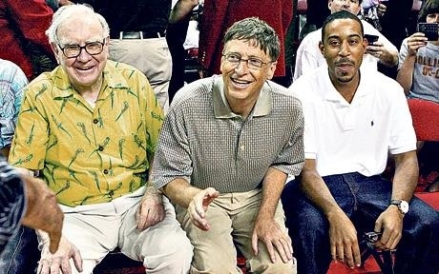
The dinner that cost Bill Gates, Warren Buffett and other celebrities billions
Warren Buffett and Bill Gates. Photo: Getty
Notes:
http://www.telegraph.co.uk/news/worldnews/northamerica/usa/7929657/The-dinner-that-cost-Bill-Gates-Warren-Buffett-and-other-celebrities-billions.html

Slide 48
What leads billionnaires to donate to good causes?
“This week … 40 billionaires – worth a combined $230 billion (£145 billion) – signed a "giving pledge" to donate at least 50 per cent of their wealth to good causes. It is a remarkable act of noblesse oblige, even in a country whose tradition of philanthropy is the strongest in the industrialised world.”
www.telegraph.co.uk/news/worldnews/northamerica/usa/7929657/The-dinner-that-cost-Bill-Gates-Warren-Buffett-and-other-celebrities-billions.html

Slide 49
A Tale of Two Disparities
Childhood immunization / measles elimination
HIV/AIDS
Notes:
Consider two health disparities, both known and well documented by the mid-1980s.

Slide 50
Childhood immunization / measles elimination
Dual strategy: universal interventions + targeted interventions
Gap in measles vaccine coverage narrowed from 15% (1985) to 6% (1992) to 2%.
Risk ratio for disease among nonwhite children (vs. white) declined from 4-7 to 4 to elimination of endemic disease
Elimination of Measles and of Disparities in Measles Childhood Vaccine Coverage among Racial and Ethnic Minority Populations in the United States
Sonja S. Hutchins, Ruth Jiles, Roger Bernier. JID 2004;189:S146-S152
Notes:
Full citation:
Elimination of Measles and of Disparities in Measles Childhood Vaccine Coverage among Racial and Ethnic Minority Populations in the United States
Sonja S. Hutchins, Ruth Jiles, and Roger Bernier
The Journal of Infectious Diseases 2004 (May 1);189, Supplement 1. Progress toward Measles Elimination: Absence of Measles as an Endemic Disease in the United States (May 1, 2004), pp.S146-S152

Slide 51
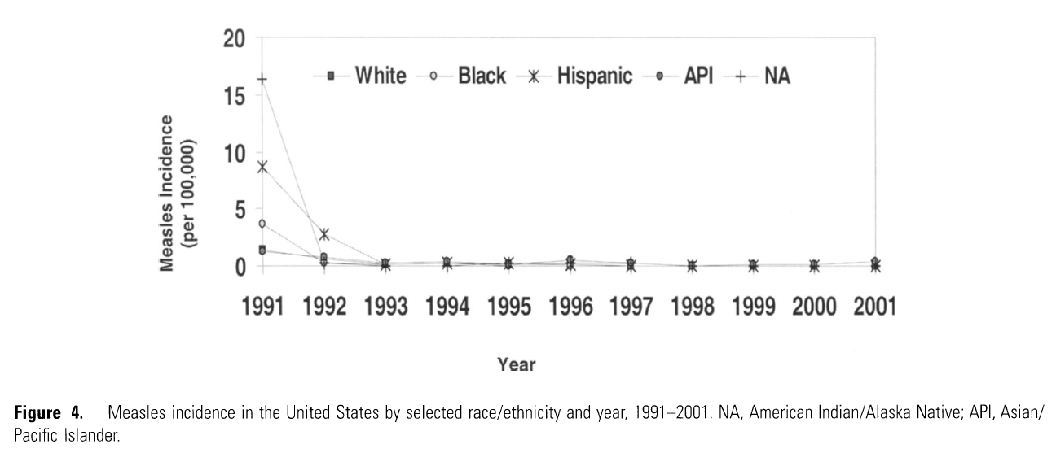
Elimination of measles and disparity
Elimination of Measles and of Disparities in Measles Childhood Vaccine Coverage among Racial and Ethnic Minority Populations in the United States
Sonja S. Hutchins, Ruth Jiles, and Roger Bernier
JID 2004(May 1);189: S146-S152
Notes:
Full citation:
Elimination of Measles and of Disparities in Measles Childhood Vaccine Coverage among Racial and Ethnic Minority Populations in the United States
Sonja S. Hutchins, Ruth Jiles, and Roger Bernier
The Journal of Infectious Diseases 2004 (May 1);189, Supplement 1. Progress toward Measles Elimination: Absence of Measles as an Endemic Disease in the United States (May 1, 2004), pp.S146-S152

Slide 52
Endgame: HIV/AIDS in African Americans (PBS Frontline)
1983: The CDC begins tracking breakdown of HIV by race.
1985: First Black AIDS Organizations founded
1986: First Black AIDS Conference
1986: No one of color is invited to participate in the American Public Health Association’s first session on AIDS in October
2000: The CDC announces that black and Latino men now represent a majority of new AIDS cases among gay and bisexual men, exceeding their white counterparts.
2004: HIV Becomes Leading Cause of Death for Young Black Women
2008: CDC data shows that 1 in 16 black men will be diagnosed with HIV in their lifetime, as will 1 in 32 black women.
2009: Congress removes ban on federal funding for needle-exchange programs; 2011: Congress reinstates ban.
2012: Black AIDS Institute Report “Exit Strategy: Ending the AIDS Epidemic in Black America”
Notes:
“No one of color is invited to participate in the American Public Health Association’s first session on AIDS in October. At the event, Craig Harris, who is black, gay and living with AIDS, storms the stage shouting, “I will be heard!” He takes the microphone away from San Francisco health commissioner Dr. Merv Silverman and explains the challenges of AIDS in communities of color.
“In response, Harris and other activists, including Paul Kawata, Gil Gerard, Suki Ports and Marie St. Cyr, form the National Minority AIDS Council in 1987. One of its spokespeople is singer Patti Labelle, who appears in its “Live Long, Sugar” campaign in 1989 along with four HIV-positive men and women of color.”
Source: http://www.pbs.org/wgbh/pages/frontline/social-issues/endgame-aids-in-black-america/timeline-30-years-of-aids-in-black-america/
Black AIDS Institute, Feb 2012 report: www.blackaids.org/images/media/12_exit.pdf
1986 MMWR: In an October Morbidity and Mortality Weekly Report (MMWR) the CDC reports that that the incidence rate for blacks and Hispanics is three times as high as that of whites. Among the cases diagnosed between June 1981 and August 1986, 25 percent are in blacks, who make up 12 percent of the population at the time, and 14 percent are in Hispanics, who make up 6 percent of the population. Among children, the disparity is even higher: 58 percent of cases are in blacks, and 22 percent are in Hispanics.

Slide 53
A Tale of Two Disparities
Childhood
immunization HIV
Magnitude of problem + +++
Embedded in socio-economic + ++
Availability of interventions ++ +
Cost, cost-effectiveness ++ +
Use existing health care infrastructure ++ +
Neutral or favorable to commercial,
religious, political interests ++ -
Near-term, visible, marketable impact ++ ?
Notes:
Consider two health disparities, both known and documented since the 1990s.
For childhood immunization, where the disparity has been largely eliminated, although the disparity arises from socioeconomic disparities, it is not strongly tied to them. Thus, various discrete, readily implementable interventions can be introduced through the existing health care infrastructure at relatively low cost. The interventions are neutral or favorable to commercial interests, religious constituencies, and political constituencies. The impact can be measured, in the near-term, and can be publicized.

