Slide 1


“Meeting of the Minds”
Why haven’t compelling epidemiologic data eliminated health disparities?
Presented at the Social Epidemiology Seminar
UNC Department of Epidemiology
September 20, 2017
Victor J. Schoenbach, Ph.D., http://go.unc.edu/vjs
Department of Epidemiology
UNC Gillings School of Global Public Health
Notes:
The Social Epidemiology Seminar was coordinated by Allison Aiello.
Video recording is at:
https://youtu.be/VmeUW_iFkjg (part 1)
https://youtu.be/lKi6WMaMPt8 (part 2),
https://youtu.be/mNFlUUwP_q4 (part 3)
Audio recording is at http://www.epidemiolog.net/audio/VicAt2017SocialEpidSeminar-AudioOnly.mp3
A longer version of this presentation will be made at the American College of Epidemiology Minority Affairs Committee workshop, September 23, 2017, in New Orleans, LA – www.acepidemiology.org

Slide 2
Outline
Public health achievements are dramatic but not universally shared.
Efforts to reduce or eliminate disparities extend over many decades.
Can we make epidemiology great again?

Slide 3
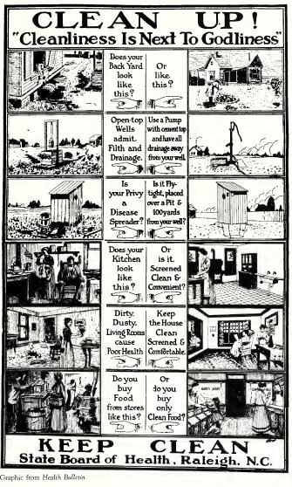
Public health achievements

Slide 4
Ten Great Public Health Achievements -- United States, 1900-1999
Vaccination
Motor-vehicle safety
Safer workplaces
Control of infectious diseases
Decline in deaths from coronary heart disease and stroke
Safer and healthier foods
Healthier mothers and babies
Family planning
Fluoridation of drinking water
Recognition of tobacco use as a health hazard
https://www.cdc.gov/mmwr/preview/mmwrhtml/00056796.htm

Slide 5
One achievement: Decline in infant mortality, 1915-2010*
*Note: For years 1915-1960, “White” included persons stated to be “White,” “Cuban,” “Mexican,” or “Puerto Rican.” All others during that time period were referred to as “Nonwhite.”
Figure courtesy of Bill Jenkins.
Notes:
From Bill Jenkins

Slide 6
Black-White Ratio of Infant Mortality, United States: 1915-2010*
YEAR
*Note: For years 1915-1960, “White” included persons stated to be “White,” “Cuban,” “Mexican,” or “Puerto Rican.” All others during that time period were referred to as “Nonwhite.”
Figure courtesy of Bill Jenkins
Notes:
From Bill Jenkins

Slide 7
Age Adjusted Death Rate Ratios
 | 1950 | 1960 | 1970 | 1980 | 1990 | 2000 | 2002
Heart Dis | 1.0 | 1.0 | 1.1 | 1.1 | 1.2 | 1.3 | 1.3
Stroke | 1.3 | 1.4 | 1.4 | 1.4 | 1.5 | 1.4 | 1.4
Cancer | 0.9 | 1.0 | 1.1 | 1.3 | 1.3 | 2.6 | 1.2
Diabetes | 1.0 | 1.2 | 1.2 | 2.0 | 2.2 | 2.2 | 2.1
HIV | --- | --- | --- | --- | 3.2 | 8.3 | 8.6
Homocide | 10.9 | 9.6 | 9.4 | 5.8 | 6.6 | 5.7 | 5.6
Slide courtesy of Bill Jenkins
Notes:
From Bill Jenkins

Slide 8
AIDS by Ethnicity: United States, 1990-2000
Slide courtesy of Bill Jenkins
Notes:
From Bill Jenkins

Slide 9
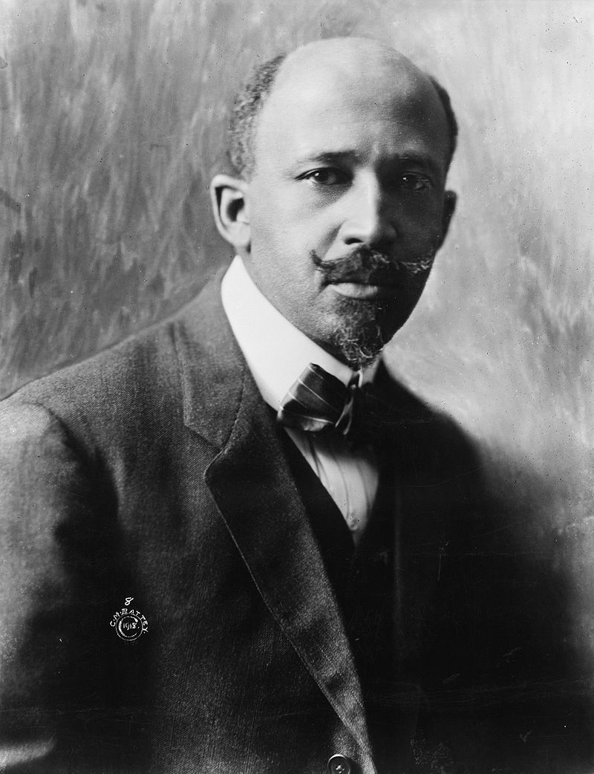
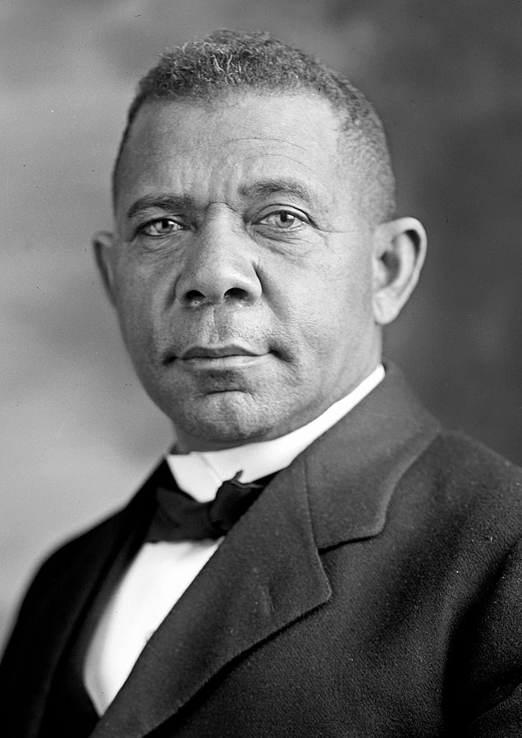
Efforts to reduce or eliminate disparities
Left: W. E. B. Du Bois (1868 – 1963), in 1918. by Cornelius Marion (C.M.) Battey (1873–1927)
Photo source: https://en.wikipedia.org/wiki/W._E._B._Du_Bois#/media/File:WEB_DuBois_1918.jpg
Right: Booker T. Washington, by Harris & Ewing, 1905. Photo source: https://commons.wikimedia.org/wiki/File:Booker_T_Washington_retouched_flattened-crop.jpg

Slide 10
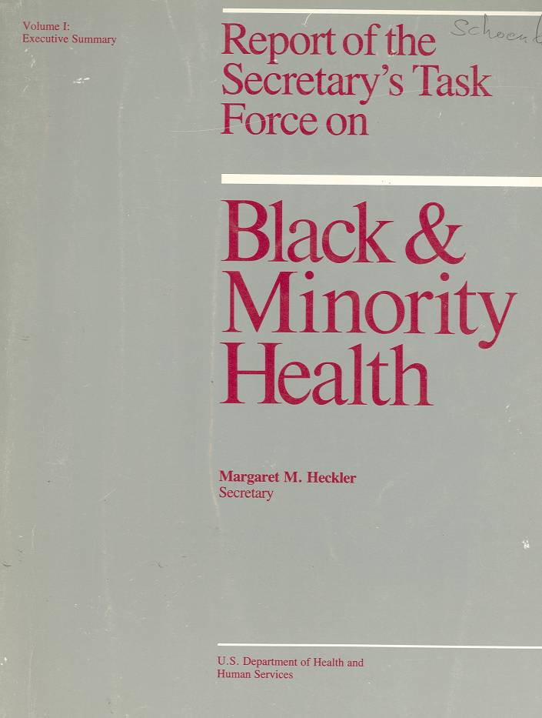
Are the data there?
W.E.B. Du Bois – The Philadelphia Negro
Booker T. Washington, The Negro Health Movement
Kerner Commission
APHA
Heckler Report
RFA’s, articles, conferences, …
Notes:
Perspectives in Disease Prevention and Health Promotion Report of the Secretary's Task Force on Black and Minority Health
MMWR February 28, 1986 / 35(8);109-12
http://www.cdc.gov/mmwr/preview/mmwrhtml/00000688.htm
http://www.nytimes.com/1985/10/17/us/minorities-seen-as-still-lagging-in-health-status.html?mcubz=3
The Task Force made eight main recommendations to the Secretary, each of which was followed by several specific suggestions:
1. Implement an outreach campaign, specifically designed for minority populations, to disseminate targeted health information, educational materials, and program strategies.
2. Increase patient education by developing materials and programs responsive to minority needs and by improving provider awareness of minority cultural and language needs.
3. Improve the access, delivery, and financing of health services to minority populations through increased efficiency and acceptability.
4. Develop strategies to improve the availability and accessibility of health professionals to minority communities through communication and coordination with nonfederal entities.
5. Promote and improve communication and coordination among federal agencies in administering existing programs for improving the health status and availability of health professionals to minorities.
6.Provide technical assistance and encourage efforts by local and community agencies to meet minority-health needs.
7.Improve the quality, availability, and use of health data pertaining to minority populations.
8. Adopt and support research to investigate factors affecting minority health, including risk-factor identification, education interventions, and prevention and treatment services.

Slide 11
1985 Report of the Secretary’s Task Force
"Despite the unprecedented explosion in scientific knowledge and the phenomenal capacity of medicine to diagnose, treat, and cure disease, Blacks, Hispanics, Native Americans, and those of Asian/Pacific Islander heritage have not benefited fully or equitably from the fruits of science or from those systems responsible for translating and using health sciences technology.“ (Introduction and Overview)
Notes:
It was noted by many at the time that the health disadvantages of American minorities was not a new discovery. W.E.B. DuBois, for example, had written about these at the turn of the century. Some 15 year’s earlier the Kerner Commission on Civil Disorders had described the racial dualism pervading American society, echoing the observations made by Swedish economist Gunnar Myrdal in An American Dilemma. 1985 was only two decades after African Americans had endured mass arrests, cattle prods, arson, bombings, assassinations, and other legal and extra-legal actions carried out to enforce disparities in employment opportunity, housing, public accommodations, health care access and other areas. But even if the health disparities documented by the Heckler Report were neither new nor unexpected, the Report nevertheless did drew considerable attention and served as a touchstone for putting health disparities on the national agenda.

Slide 12
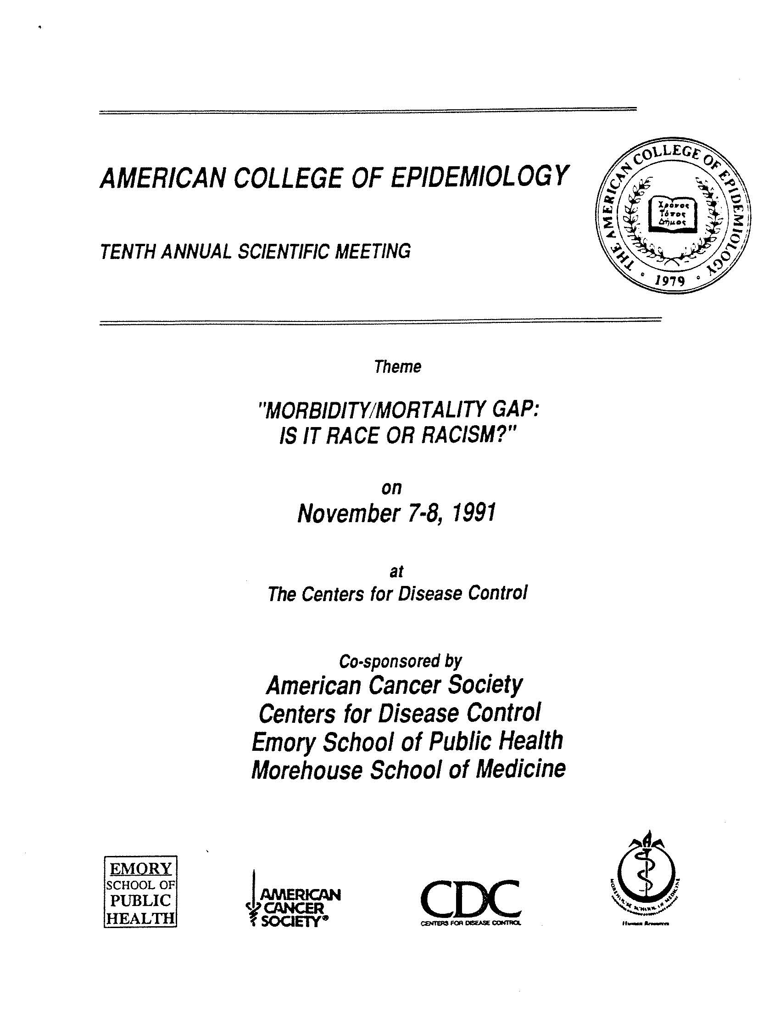
ACE 10th Annual Scientific Meeting, 1991 in Atlanta, GA
Morbidity/Mortality Gap:
Is it Race or Racism?”
Notes:
For members of the American College of Epidemiology, the next landmark is the 10th Annual Scientific Meeting, held at CDC in Atlanta in 1991
For many of us, the program was a consciousness-raising experience.
CDC notice of November 7-8, 1991meeting: http://www.cdc.gov/mmwr/preview/mmwrhtml/00001973.htm

Slide 13
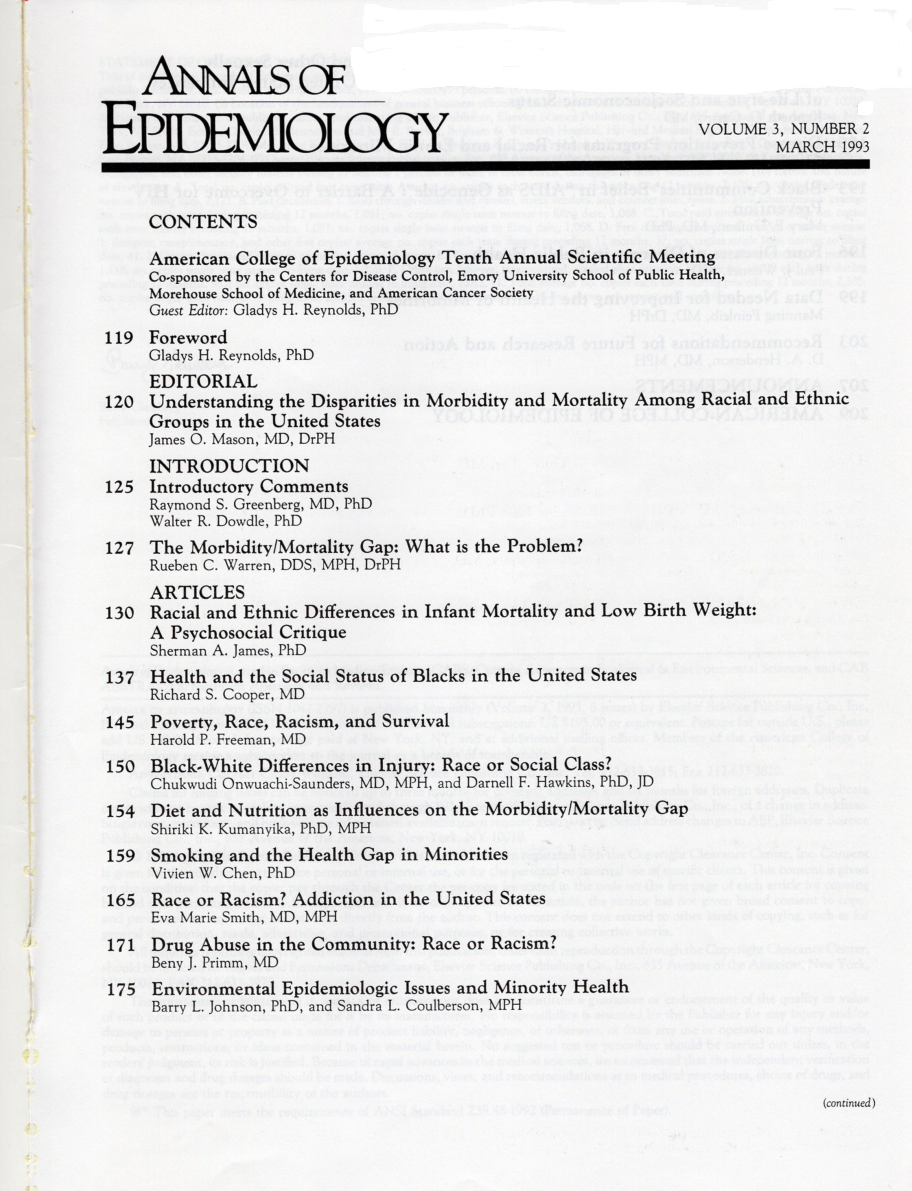
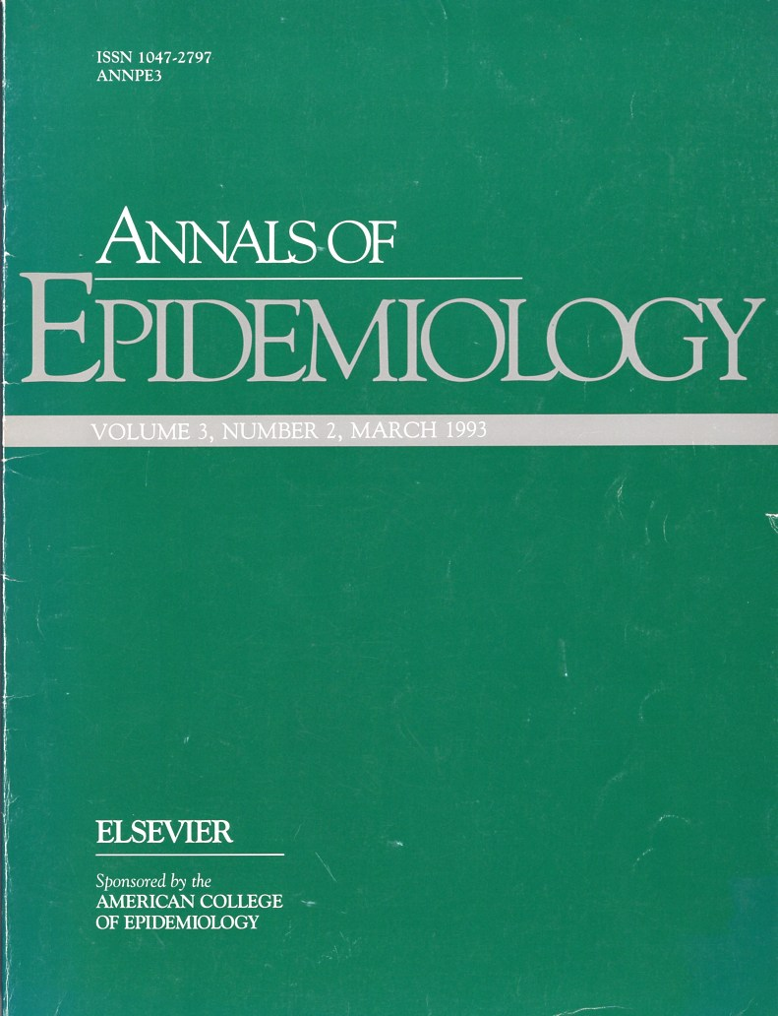
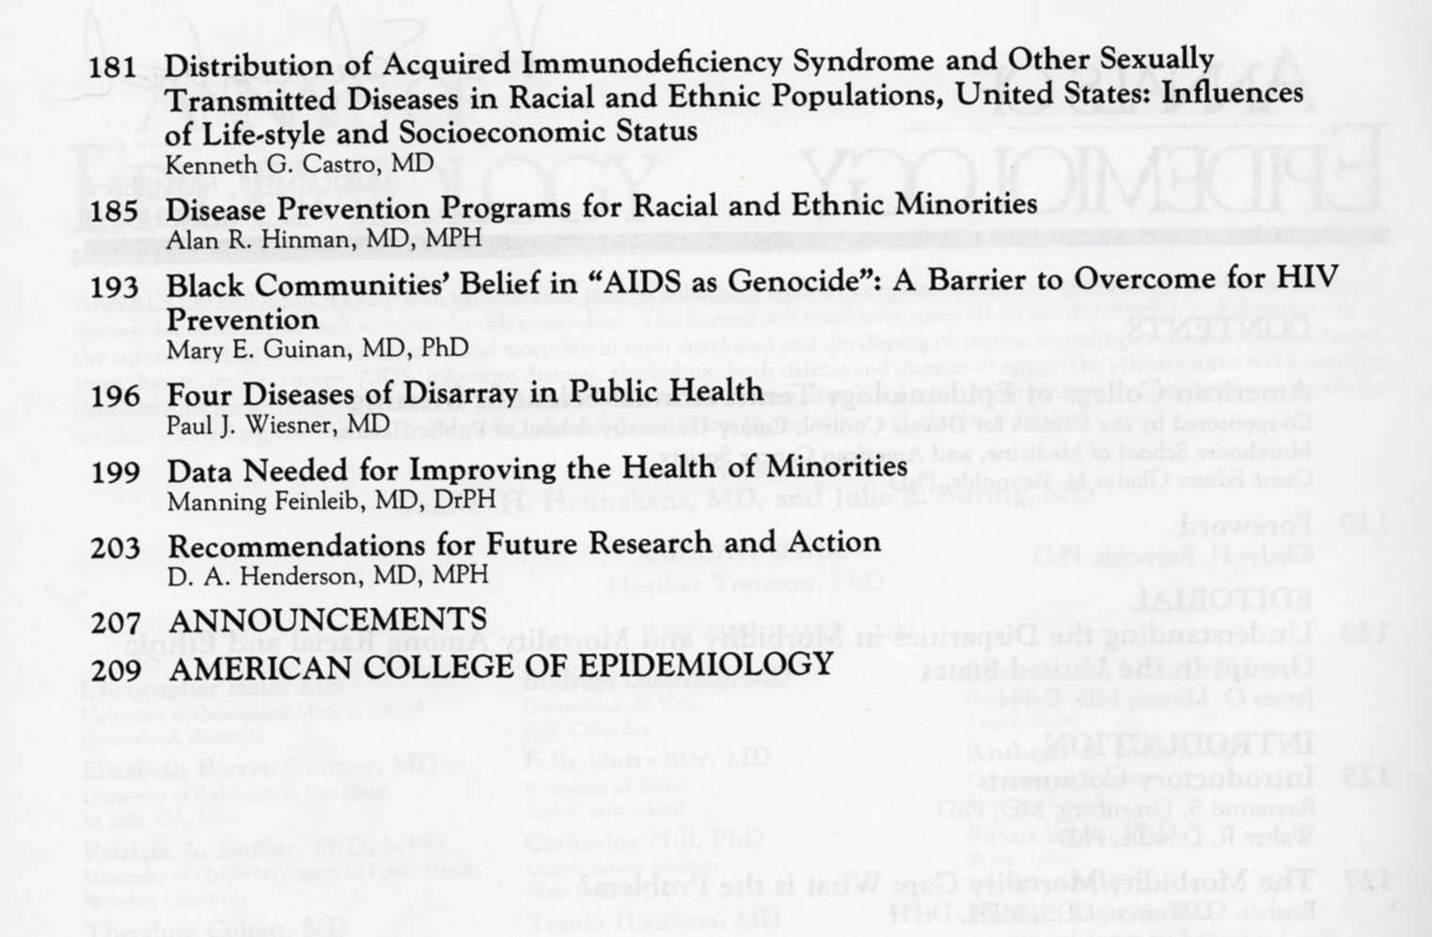
Notes:
The invited presentations were published together in a 1993 issue of the Annals of Epidemiology guest edited by Gladys Reynolds. Unlike most other ACE annual meetings, the 1991 meeting also had contributed papers. Many of these were published in Ethnicity & Disease, Spring, 1993 (Vol.3, No 2). Richard S. Cooper, one of the invited speakers was editor of Ethnicity & Disease. (Per Gladys Reynolds)

Slide 14
Foreward, by Gladys H. Reynolds, PhD
“We need to ask why these differences exist. We need to be concerned about the data we lack and the quality of the data we do have. We need to reanalyze and reinterpret the data in order to understand the relationship between these disparities and past and current racial discrimination in education, access to jobs, housing and health care, and political power…. Most importantly, we need to develop prevention and intervention strategies appropriately designed for different cultures…. People of different races, ethnic groups, genders, and backgrounds can and should be given active roles in defining themselves and in making the decisions that determine how much and to which groups, and to which health area or disease, resources are allocated.“
Annals of Epidemiology March 1993;3(2):119
Notes:
Many of the presentations were published together in a 1993 issue of the Annals of Epidemiology guest edited by Gladys Reynolds.

Slide 15
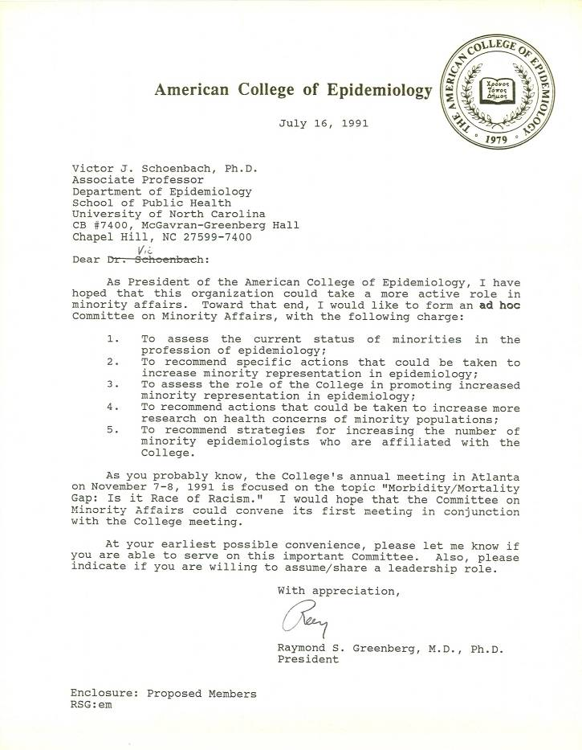
ACE President forms ad hoc Committee on Minority Affairs
“As President of the American College of Epidemiology, I have hoped that this organization could take a more active role in minority affairs.”
Raymond S. Greenberg, MD, PhD
Notes:
In 1991, the ACE was still trying to define its role in the profession. One of the basic motivations for creating the College, credentialing of non-physician epidemiologists, was being rethought. Few people had taken the credentialing examination, and the value of the credential was uncertain. But without the certification exam, what was the College’s raison-d’etre? At the same time, the College was the only epidemiology organization whose primary focus was serving the needs of practicing epidemiologists and at the time the only one willing and able to take official policy positions. The major initial policy thrust was about professional ethics. President Raymond Greenberg and others felt that racial disparities in health would be another policy area for which the organization might take leadership, and through which it could engage members who were not particularly motivated by the ethics issue.
So with enthusiastic support from the Board of Directors, President Greenberg created an ad hoc Committee on Minority Affairs. He put out a call to members seeking volunteers. I was one of those who responded, and Ray asked if I would serve as chair and convene an initial meeting in conjunction with the 1991 Annual Scientific Meeting. I objected, saying that someone like Sherman James should probably be chair. But when I asked Sherman, he said that I should be chair since I would follow his advice and he wouldn’t have to devote as much time! On that basis I agreed.

Slide 16
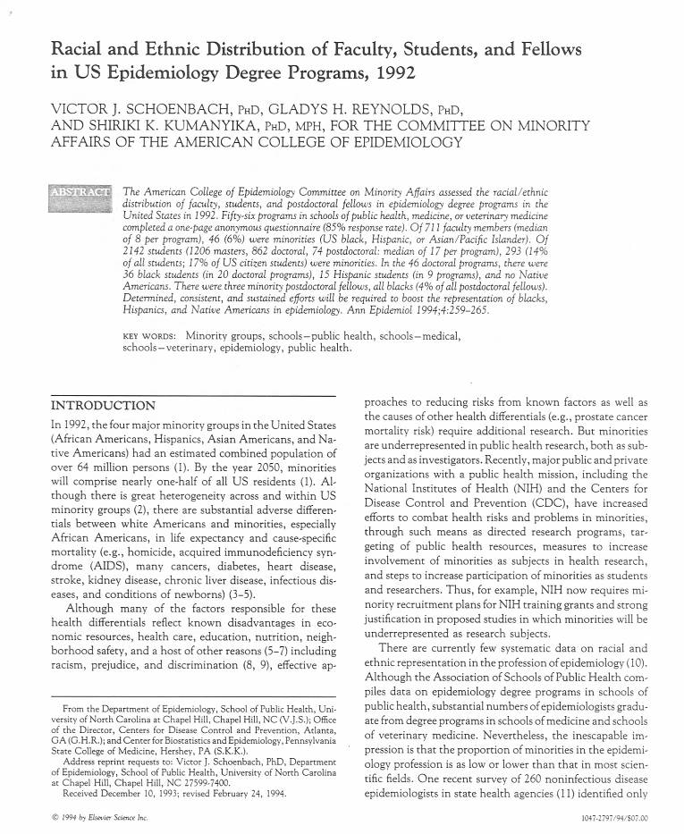
1992 survey of race and ethnicity in US epidemiology
56/66 epidemiology degree programs in US schools of public health, medicine, veterinary medicine
1 pg questionnaire
Full-time faculty, students as of 4/92
Notes:
The American College of Epidemiology Committee on Minority Affairs conducted a 1992 survey of racial/ethnic distribution in academic epidemiology, published in the Annals of Epidemiology in 1994 along with a commentary by the 1991 ACE President.

Slide 17
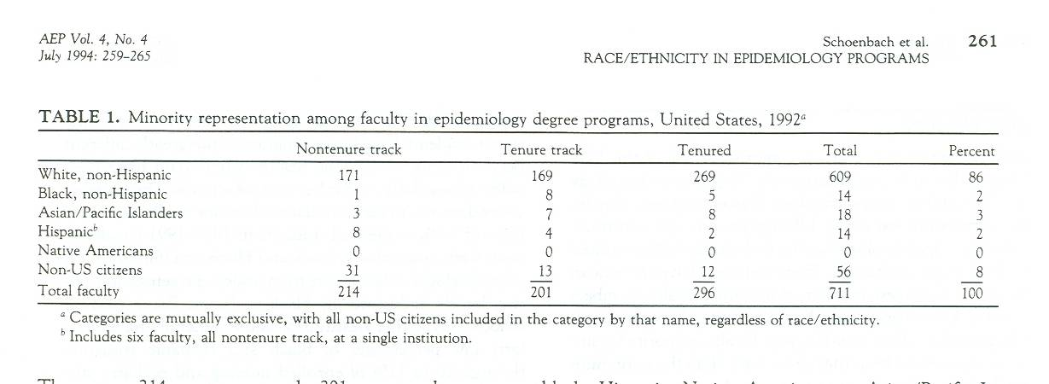
Results - faculty
711 total faculty
14 Black (non-Hispanic) (2%)
14 Hispanic (incl. 6 at one instit.) (2%)
0 American Indians / Native Americans
Notes:
The 711 total faculty included 56 non-US citizens, included in the denominator for the percentages. Of these totals, there were 296 tenured (5 black, 2 Hispanic), 201 tenure-track (8 black, 4 Hispanic), and 214 non-tenure-track (1 black, 8 Hispanic).

Slide 18
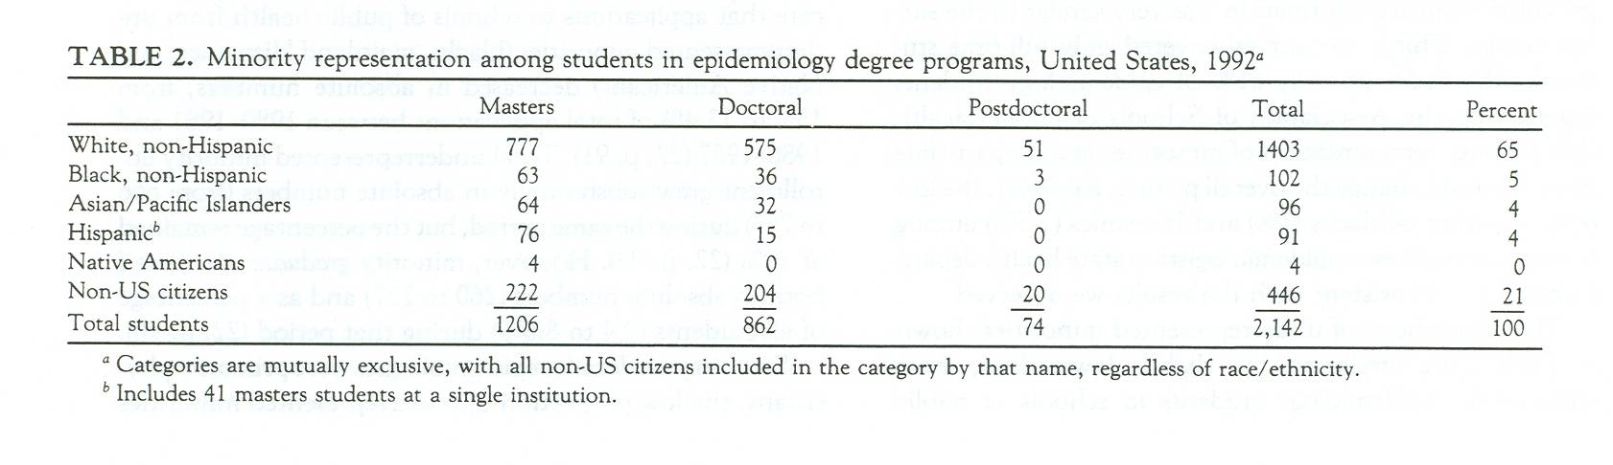
Results - students
2,142 students
102 Black (non-Hispanic) (5%)
91 Hispanic (incl. 41 at one instit.) (4%)
4 American Indians / Native Americans
Notes:
The 2142 total students included 446 non-US citizens, included in the denominator for the percentages. Of these totals, there were 1206 masters students ( tenured (63 black, 76 Hispanic, 4 American Indian), 862 doctoral (36 black, 15 Hispanic), and 74 postdoctoral fellows (3 black).

Slide 19
Recommendations in the article
Epidemiology’s mission should include advancement of minority health / minority epidemiologists.
Study minority health problems and solutions; study racism.
Conduct vigorous outreach to make epidemiology careers and financial aid opportunities more visible to minorities.
Provide ample, stable funding for minority training and supportive educational environments, plus networks of minority epidemiologists.
Federal programs (e.g., MARC, MBRS, HCOP) should expand their coverage of epidemiology research and training; more programs should be created like the CDC's Project IMHOTEP.
Professional development opportunities should include diversity training related to the review of applications for admission, applications for grants, submitted manuscripts, etc.
A body analogous to the AAMC Division of Minority Health, Education, and Prevention should be provided a mandate and resources to monitor progress in increasing the role of underrepresented minorities in epidemiology. Recognize/support/reward epidemiologists who make exceptional contributions.
Notes:
Recommendations:
1. The mission of epidemiology organizations should include advancement of minority health and of minority epidemiologists and trainees in professional, educational, corporate, and governmental settings. Institutional commitment should be expressed in the leadership provided by deans, directors, and chairs, in effective actions, in provision of resources, and in increased diversity.
2. Greater attention should be given in epidemiology journals and scientific meetings to studies that address minority health problems with insight and cultural sensitivity, and especially, that identify potential solutions to these problems. Epidemiology forums should also invite studies on the nature of, effects of, and interventions to reduce racism, both individual and institutional (8,9).
3. A vigorous outreach campaign is needed to make epidemiology careers, pathways to them, and financial aid opportunities more visible in minority educational institutions and minority communities. The potential of minority recruitment activities is illustrated by a program at the CDC EIS, where minority representation among trainees rose from 11 percent in the 1980's to 17 percent in the 1990 EIS class and 26 percent in the 1991 class (23).

Slide 20
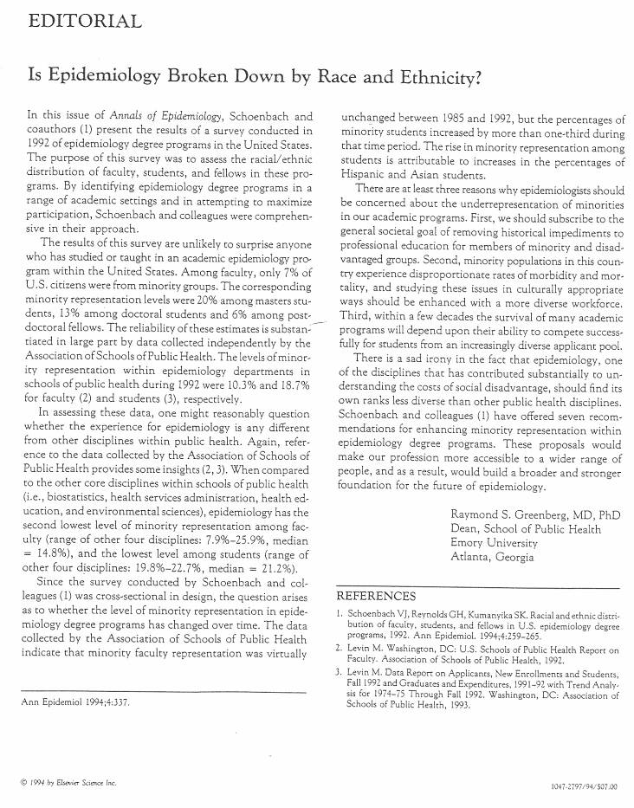
Annals of Epidemiology editorial by Ray Greenberg
“These proposals would make our profession more accessible to a wider range of people, and as a result, would build a broader and stronger foundation for the future of epidemiology.”

Slide 21
Recommendations to the ACE BOD
The Committee made a set of recommendations to the College’s Board of Directors. [“Vic, this is a very powerful statement. I never imagined (in my more than 20 yrs in epidemiology) that I would see such a powerful statement emerging from an Epid organization. It will be more than just a little interesting to see the Board's reactions.”]
  1. The Board of Directors should formally adopt a statement of principles and goals that recognizes (a) the importance of minority health for public health and (b) the need for racial, ethnic and cultural diversity in the profession of epidemiology and in the membership of the College, including the Board of Directors itself and all of its committees.
  . . .

Slide 22
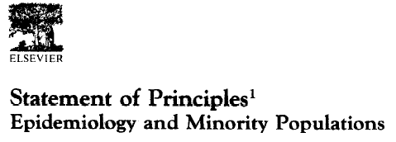
Declarations
The health of all racial and ethnic groups, is of critical importance.
The profession of epidemiology needs racial, ethnic and cultural diversity.
[Educational organizations] . . . have a special responsibility to seek out and support, diversity, inform.
Sponsors of public health should ensure that funding is available.
Organizations should work actively to sensitize their constituencies to the issues of racism, sexism, religious favoritism, homophobia, …
Notes:
At the September 1994 meeting the Board approved the proposed statement “in principle” and invited members to suggests. At its January 1995 meeting the Board approved the revised Statement “wholeheartedly” but requested a further comment period for editorial suggestions. These came principally from Board member and President=Elect Michael Bracken, who requested that the Statement be significantly shortened. Following these editorial changes the Board adopted the Statement at its May 1995 meeting and agreed to its publication in the College’s pages in the Annals of Epidemiology.
The final version begins with five declarations, followed by the background and rationale, and concludes with the actions to be taken by the College: The declarations are:
The health of all racial and ethnic groups, especially of their disadvantaged members, is of critical importance for public health.
The profession of epidemiology needs racial, ethnic and cultural diversity, at all levels, to contribute fully to public health for all populations.
[Educational organizations] . . . have a special responsibility to seek out and support students from disadvantaged backgrounds, particularly racial and ethnic minorities, to diversify faculties and research staff, and to disseminate information about minority health
Sponsors of public health and public health education should ensure that funding is available for students from disadvantaged backgrounds . . .
Organizations should work actively to sensitize their constituencies to the issues of racism, sexism, religious favoritism, homophobia, xenophobia, and classism and should present training and/or articles on the need for input, fairness, equal opportunity, and diversity at all levels.

Slide 23
Published commentary, Endorsements
Signed by 7 American College of Epidemiology presidents
Included action steps
Endorsements obtained from American Heart Association, American Teachers of Preventive Medicine, American Public Health Association, American Statistical Association - Section on Statistics in Epidemiology, Black Caucus of Health Workers, North American Association of Central Cancer Registries, and 12 academic departments

Slide 24
Outreach
“I've read the Statement, and I'm very impressed, both with it and the activities planned to implement it. It is remarkably consistent with a Statement on Discrimination in the Workplace, recently adopted by AAAS.” Mark S. Frankel, AAAS (5/23/1995 email)
“I have just been elected President-Elect of the Society for Pediatric Epidemiologic Research (SPER). My term as President will be from June 1996 to June 1997. I agree whole-heartedly with the ACE recommendations. One of my major concerns as SPER president will be affirmative action for the recruitment of minorities into reproductive, perinatal, and pediatric epidemiology.” John L. Kiely (5/26/1995 email)
“I read with interest the recommendation from ACE Committee on Minority Affairs. This is a huge important step foward. I would like to receive a copy of the Statement of Principles and also info on applying to the College.” Helene Gayle (6/28/1995 email)
Notes:
AAAS circulated the statement on various lists:
From: Gardenier, John S.
To: ALL-NCH07A/HYAT; ALL-NCH08A/HYAT; ALL-NCH09A/HYAT; ALL-NCH10A/HYAT;
All-NCH11A/HYAT
Subject: FW: FYI - work of the ACE Committee on Minority Affairs
Date: Friday, May 26, 1995 9:34AM
Priority: High
For those interested, the Committee on Minority Affairs of the American
College of Epidemiology has made recommendations to the Board of Directors
which are summarized below. This information was provided by the American
Association for the Advancement of Science. John G.
----------
Sender: AAAS Minority Perspectives on Ethics in Science and Technology
<AAASMSP@GWUVM.BITNET>
From: AFOWLER <afowler@AAAS.ORG>
Subject: FYI - work of the ACE Committee on Minority Affairs
X-To: aaasmsp@gwuvm.gwu.edu
To: Multiple recipients of list AAASMSP <AAASMSP@GWUVM.BITNET>
content-length: 6234
----------------------------------------------------------------------------
--
American College of Epidemiology
Committee on Minority Affairs
Policy Recommendations approved by the ACE Board of Directors
at their March 6, 1994 meeting

Slide 25



Healthy People – Overarching goals
Healthy People 2010:
Goal 1: Increase Quality and Years of Healthy Life
Goal 2: Eliminate Health Disparities
Healthy People 2020:
Attain high quality, longer lives free of preventable disease, disability, injury, and premature death.
Achieve health equity and eliminate disparities.
Create social and physical environments that promote good health for all.
Promote quality of life, healthy development, and healthy behaviors across all life stages.
Notes:
“Healthy People 2010 is designed to achieve two overarching goals:
Goal 1: Increase Quality and Years of Healthy Life
The first goal of Healthy People 2010 is to help individuals of all ages increase life expectancy and improve their quality of life.
Goal 2: Eliminate Health Disparities
The second goal of Healthy People 2010 is to eliminate health disparities among different segments of the population.”
http://www.healthypeople.gov/2010/About/goals.htm

Slide 26
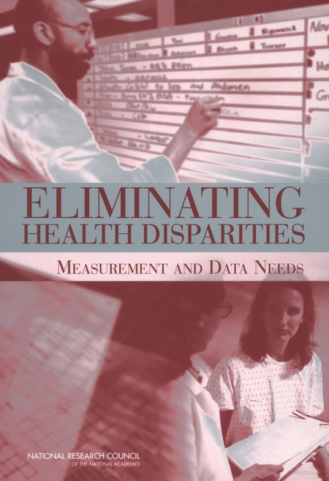


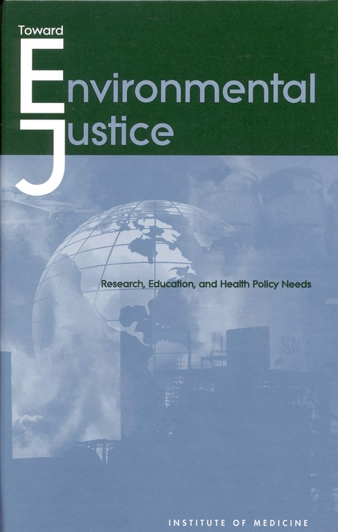

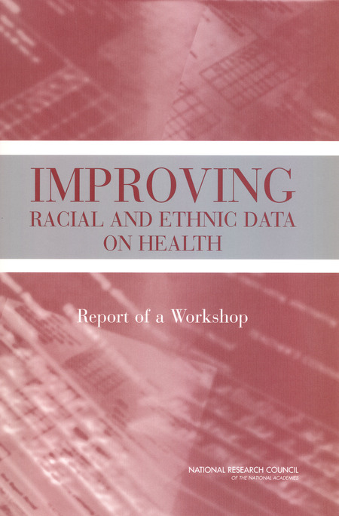


National Academy Press
Notes:
A sampling from the first 200 “hits” for a search for “health disparities”
https://www.nap.edu/catalog/10186/the-right-thing-to-do-the-smart-thing-to-do
https://www.nap.edu/catalog/10512/guidance-for-the-national-healthcare-disparities-report
https://www.nap.edu/catalog/10833/improving-racial-and-ethnic-data-on-health-report-of-a
https://www.nap.edu/catalog/9939/promoting-health-intervention-strategies-from-social-and-behavioral-research
https://www.nap.edu/catalog/6034/toward-environmental-justice-research-education-and-health-policy-needs
https://www.nap.edu/catalog/6259/leading-health-indicators-for-healthy-people-2010-first-interim-report
https://www.nap.edu/catalog/23541/advancing-the-science-to-improve-population-health-proceedings-of-a
https://www.nap.edu/catalog/24824/lessons-learned-from-diverse-efforts-to-change-social-norms-and-opportunities-and-strategies-to-promote-behavior-change-in-behavioral-health
https://www.nap.edu/catalog/10885/in-the-nations-compelling-interest-ensuring-diversity-in-the-health
https://www.nap.edu/catalog/11329/assessment-of-nih-minority-research-and-training-programs-phase-3
https://www.nap.edu/catalog/10979/eliminating-health-disparities-measurement-and-data-needs
https://www.nap.edu/catalog/13383/how-far-have-we-come-in-reducing-health-disparities-progress
https://www.nap.edu/catalog/12154/challenges-and-successes-in-reducing-health-disparities-workshop-summary
https://www.nap.edu/catalog/11602/examining-the-health-disparities-research-plan-of-the-national-institutes-of-health
https://www.nap.edu/catalog/10260/unequal-treatment-confronting-racial-and-ethnic-disparities-in-health-care
https://www.nap.edu/catalog/24624/communities-in-action-pathways-to-health-equity

Slide 27
Legislation, strategic plans, organizations, grants, …
Private organizations adopt strategic plans, etc.
Various federal and state agencies create offices of minority health; all NIH institutes formulate strategic plans.
NIH ORMH > NCMHD > NIMHD
“In fiscal year 2001, the NIH spent over $2 billion on research, research infrastructure, and public information and community outreach efforts to reduce health disparities. This provided a strong basis for further investments over the longer term – investments that promise substantial progress in reducing the incidence, prevalence, severity, and social and economic burdens of diseases and disabilities that affect racial and ethnic minorities and other health disparity populations.”
Notes:
Source for quote: NIH Strategic Research Plan and Budget to Reduce and Ultimately Eliminate Health Disparities: Foreward. (see TranslatingEpidIntoActionOnDisparities-201209.ppt

Slide 28
But counterveiling forces
War on Drugs
Private, for-profit prisons
Technology and automation
Globalization – outsourcing of jobs, immigration of low skilled workers
Genomics
Escalation in educational requirements vs. de-escalation in funding for public education = student debt
. . .

Slide 29
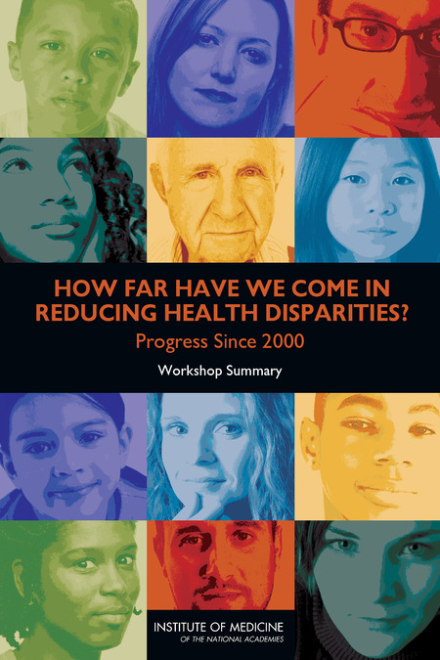

National Academy Press
Notes:
Selected from the first 200 “hits” for a search for “health disparities”

Slide 30
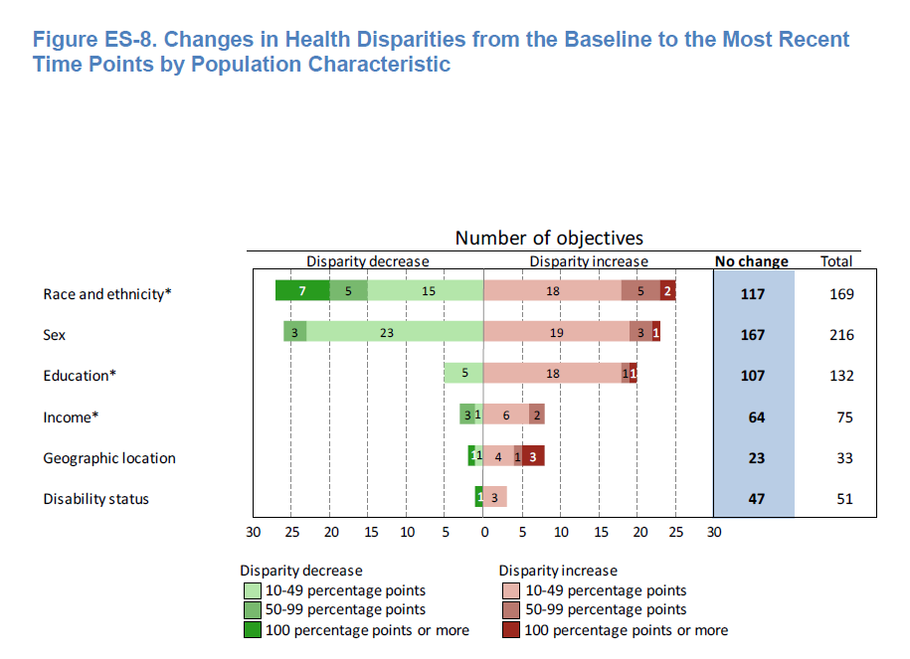
Healthy People 2010 Final Review: Changes in health disparities
(Healthy People 2010 Final Review)
“most of the population-based objectives with data to measure disparities had no change in health disparities.”
Notes:
Healthy People 2010 Final Review
Executive Summary Page ES-26
Figure ES-8. Changes in Health Disparities from the Baseline to the Most Recent Time Points by Population Characteristic
NOTES: Changes in disparity from the baseline to the most recent time points are only shown when they could be assessed. Changes could not be assessed for 54, 82, 4, 3, 10, and 17 objectives by race/ethnicity, sex, education, income, geographic location, and disability status, respectively. “No change” includes: changes of less than 10 percentage points, regardless of statistical significance; and all changes that were not statistically significant, when estimates of variability were available. See Technical Appendix.
* Number of objectives with changes in the summary index as a measure of disparity. Health disparities by income were not included for Focus Area 19 due to data limitations.
http://www.cdc.gov/nchs/data/hpdata2010/hp2010_final_review_executive_summary.pdf
See also Technical Appendix: http://www.cdc.gov/nchs/data/hpdata2010/hp2010_final_review_technical_appendix.pdf

Slide 31
ASPPH – 32 years after Heckler
Despite great strides in the advancement of public health, health disparities – based on ethnicity, race, or socioeconomic class – still exist, leading to populations that are disproportionately affected by disease and have limited access to health care. Disadvantaged populations often find affordable health care to be inaccessible, and more prominent incidences of chronic diseases, like obesity and heart disease, are common. Professionals in the public health field are committed to making health care accessible to all sectors of society and discovering how to serve diverse individuals and populations, which may be at greater risk.
http://www.aspph.org/discover/#addressing-health-disparities
Notes:
Selected from the first 200 “hits” for a search for “health disparities”

Slide 32
Hookworm in Lowndes County, AL
“The parasite, better known as hookworm, enters the body through the skin, usually through the soles of bare feet, and travels around the body until it attaches itself to the small intestine where it proceeds to suck the blood of its host. Over months or years it causes iron deficiency and anemia, weight loss, tiredness and impaired mental function, especially in children, helping to trap them into the poverty in which the disease flourishes.
“Hookworm was rampant in the deep south of the US in the earlier 20th century, sapping the energy and educational achievements of both white and black kids and helping to create the stereotype of the lazy and lethargic southern redneck. As public health improved, most experts assumed it had disappeared altogether by the 1980s.”
Quoted from Ed Pilkington, “Hookworm, a disease of extreme poverty, is thriving in the US south. Why?”, The Guardian, Sept 5, 2017
https://www.theguardian.com/us-news/2017/sep/05/hookworm-lowndes-county-alabama-water-waste-treatment-poverty
Based on “Human Intestinal Parasite Burden and Poor Sanitation in Rural Alabama”, Megan L. McKenna et al. American Journal of Tropical Medicine and Hygiene, 05 Sept 2017; https://doi.org/10.4269/ajtmh.17-0396

Slide 33
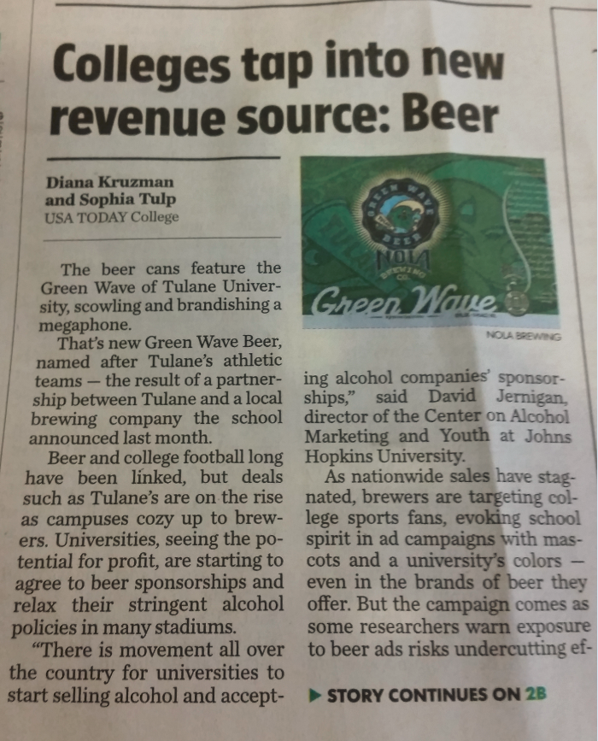
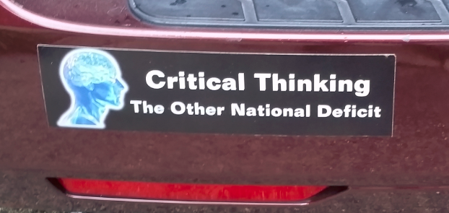
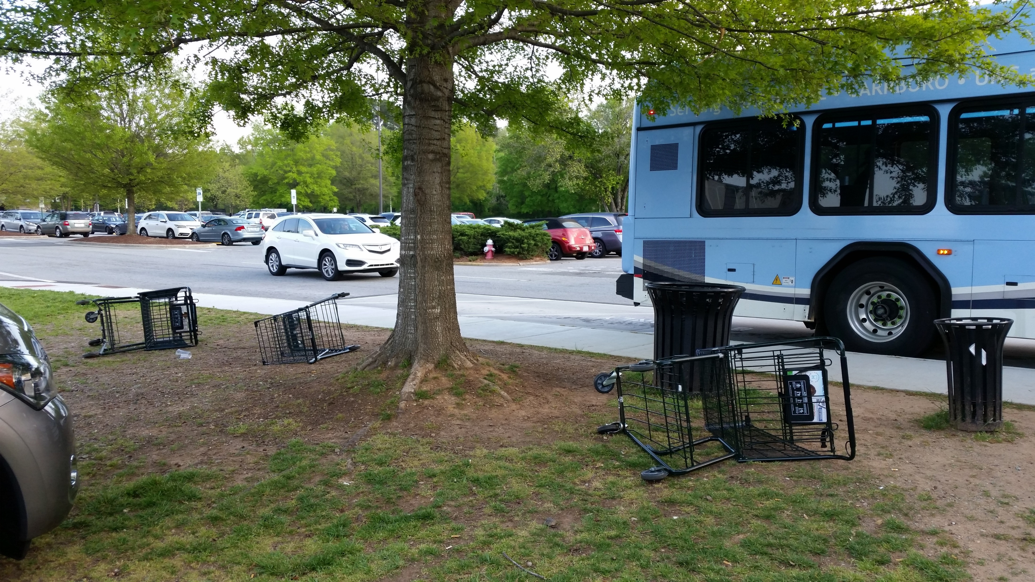

Can we make epidemiology great again?

Slide 34
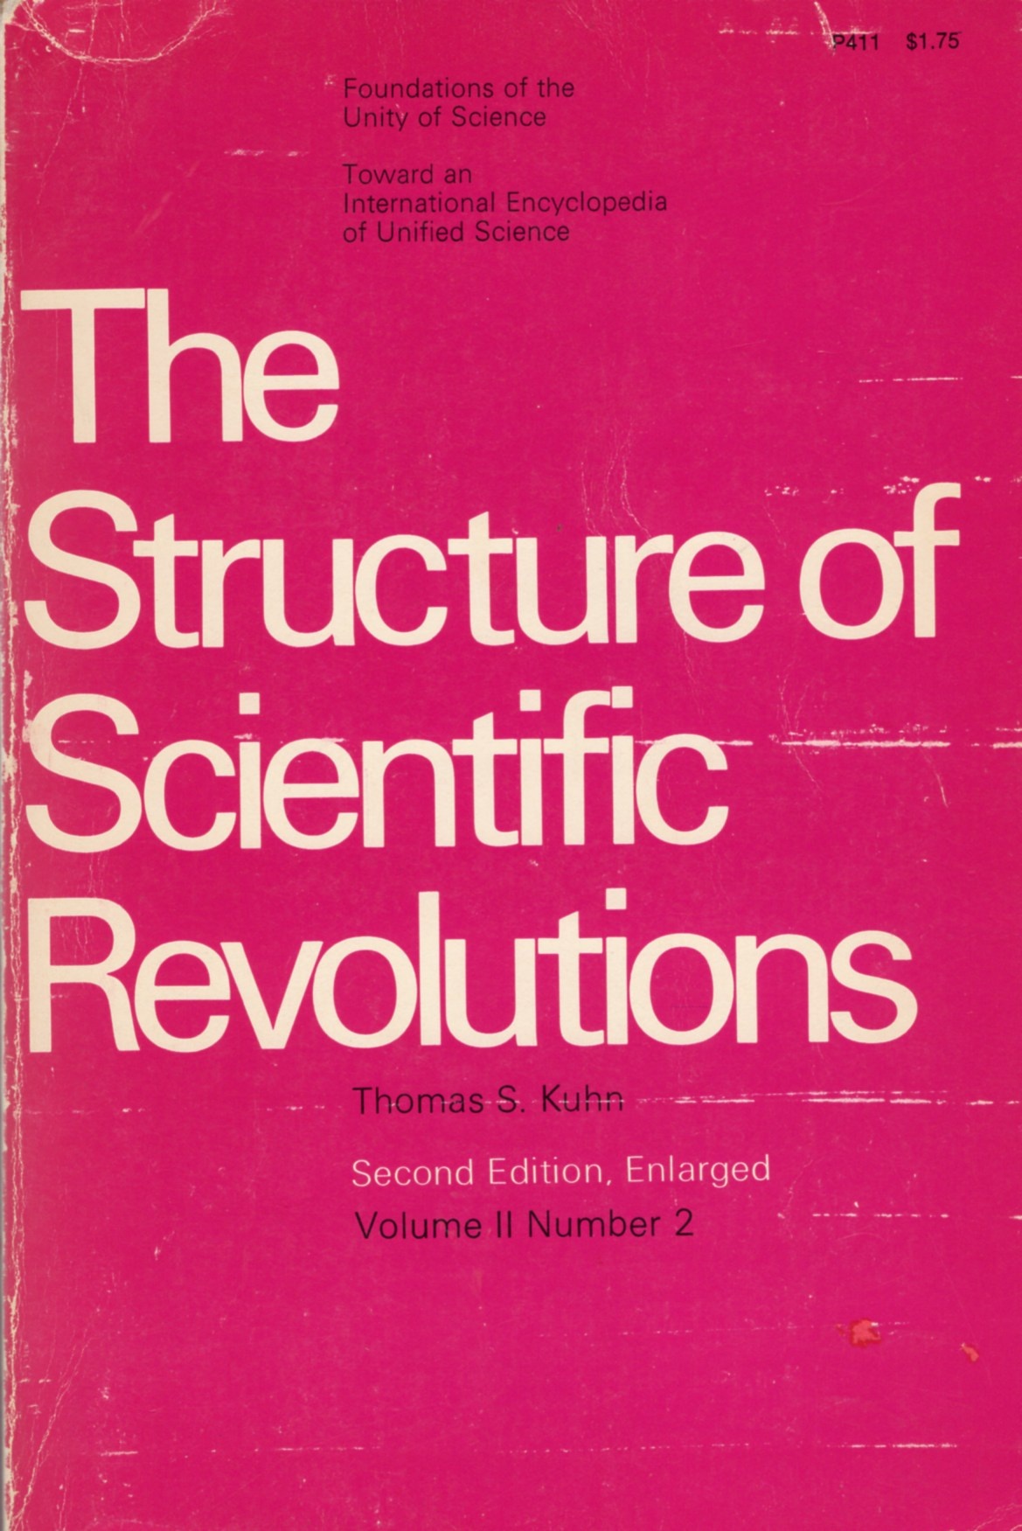
Thomas Kuhn’s The Structure of Scientific Revolutions
“Where the standard account saw steady, cumulative "progress", Kuhn saw discontinuities – a set of alternating ‘normal’ and ‘revolutionary’ phases in which communities of specialists in particular fields are plunged into periods of turmoil, uncertainty and angst. These revolutionary phases – for example the transition from Newtonian mechanics to quantum physics – correspond to great conceptual breakthroughs and lay the basis for a succeeding phase of business as usual.”
Quoted from “Thomas Kuhn: the man who changed the way the world looked at science”, John Naughton, The Guardian, 18 August 2012
https://www.theguardian.com/science/2012/aug/19/thomas-kuhn-structure-scientific-revolutions

Slide 35
20 years ago –The Failure of Academic Epidemiology: Witness for the Prosecution
As a basic science of public health, epidemiology should attempt to understand health and disease from a community and ecologic perspective as a consequence of how society is organized and behaves, what impact social and economic forces have on disease incidence rates, and what community actions will be effective in altering incidence rates.
Epidemiology must cross the boundaries of other population sciences and add to its scope a macro-epidemiology, a study of causes from a truly population perspective, considering health and disease within the context of the total human environment
Quoted from Carl M. Shy, Am J Epidemiol 15 March 1997; 145(6):479-484
https://academic.oup.com/aje/article-lookup/doi/10.1093/oxfordjournals.aje.a009133

Slide 36
Epidemiology, Equity, Economics, Evolution, and Enlightenment
Victor J. Schoenbach, http://go.unc.edu/vjs
August 24, 2016
Social Epidemiology Seminar
UNC Department of Epidemiology
(audio recording available at https://sakai.unc.edu/x/Cc8ln3)

Slide 37
Epidemiology, Equity, Economics, Evolution, and Enlightenment
Epidemiology – for understanding and improving health of all people
Equity – equity / social justice reflects the distribution of power
Economics – economic resources are fundamental to public health, and their distribution depends on social forces
Evolution – fundamentally, we and our societies are expressions of biology, evolving through time as an emergent phenomenon
Enlightenment – broader and deeper understanding of our nature and our environment may help humanity manage our collective lives better, advancing public health in the present and future
From Social Epidemiology Seminar, UNC Dept of Epidemiology, Aug. 24, 2016
(See notes page for links to slides and audio.)
Notes:
Slides: https://sakai.unc.edu/access/content/user/vschoenb/Public%20Library/People/People/Victor%20Schoenbach/Presentations/SocialEPIDseminar20160824live.pptx
Audio (40 minutes):
https://sakai.unc.edu/access/content/user/vschoenb/Public%20Library/People/People/Victor%20Schoenbach/Presentations/SocialEPIDseminar-20160824noQuestions.mp3

Slide 38
Seeing ourselves in context – 1
Complexity: Life is an “emergent phenomenon” that arises from the actions of innumerable agents – organizations, individuals, neurons, macromolecules, etc. (Examples of emergent phenomena are at http://www.evolutionofcomputing.org/Multicellular/Emergence.html ).

Slide 39
Seeing ourselves in context – 2
In attempting to cope with the complexity of life, we (humans and other animals that employ reasoning) create simplified representations for our perceptions, reasoning, and understanding, and simplified maxims to live by (“significant results”, “evidence-based”, “treat thy neighbor as one would be treated”, etc.). Such reductionism has been extremely effective in successfully navigating the challenges of living and interacting, enabling species to flourish – and also occasioning major problems where important elements of a situation are overlooked.

Slide 40
Seeing ourselves in context – 3
Simplifications – models – are evaluated and declared useful, effective, accurate, etc., based on what we regard as important though inevitably incomplete criteria. For obvious practical reasons, the criteria must be observable (“measurable objectives”), relatively near-term, not too subtle, and “relevant” to what we regard as important. For example, we will declare a teaching innovation to be effective if it appears to improve student performance on examinations. If it also hastens the onset of dementia by two decades, we cannot know that.

Slide 41
Seeing ourselves in context – 4
Scientific research is a broad conversation in which different investigator communities explore, present, critique, debate, persuade (or not) others until some kind of consensus is reached, possibly to be upset when a new discovery is accepted. The process of science involves persuading peers and gatekeepers that one has an idea worth pursuing (and being funded), publishable (because editors and reviewers think it’s worthy), and accurate (because serious criticisms do not arise). How else could the search for truth work? There are no available authorities except humans. Some regard God as the ultimate authority, but in any case humans are the channels for God's communications and enforcement.

Slide 42
Seeing ourselves in context – 5
In addition, most actions have multiple effects - some “good” and others “bad”, some in the present and others only later on, some local and others distant. Because of diversity, a given phenomenon affects different people differently – “one size fits all” never completely applies. So actions affect some individuals and groups in one way and other individuals and groups in other ways. Thus, most important policy questions do not have “right” answers, but rather answers that are “right” for some and “wrong” for others (e.g., should we tax gasoline to bring its price back to $3/gallon?). There must always be trade-offs, typically without knowing the full accounting, and not on an abstract scale but in relation to different people's interests.

Slide 43
Seeing ourselves in context – 6
In a sense, it doesn’t matter that there may not be right answers, because there would be no way to recognize them even if there are, and people would not believe them unless they regarded the likely results as visibly favorable for their interests. The policies that actually emerge and are implemented will be the outcome of a competition (and cooperation) among the various agents.

Slide 44
Seeing ourselves in context – 7
Humans for the most part advocate and pursue what we regard (including unconsciousness influences) as in our interests (I’m using broad definitions of "regard" and “interests”). And that pursuit affects our very perceptions (partly via what we pay attention to), judgment, and what we devote our energies to.

Slide 45
Seeing ourselves in context – 8
It may be useful to be aware of this reality that underlies our daily activities, both scholarly and otherwise, even though for practical living one does well to follow the rules and guides that have appeared to lead to success. From the standpoint of evolution, for most of us the near-term needs to be the most salient, since if we don’t survive the short-term we won’t get a chance to survive the long-term!

Slide 46

Systems thinking and agent-based models
Complex systems approaches needed to study multiple interacting factors with dense, nonlinear feedbacks
NIH OBSSR-funded Network on Inequalities, Complex Systems, and Health (NICH) representing 18 academic fields
Many challenges regarding the questions, interdisciplinary communication, data availability, calibrating model complexity
Can explore what if scenarios, may clarify what we need to know and move conversations forward

Slide 47
How are we changing?
What effect on mental and psychological functioning from proliferation of screen time
“Bored and Brilliant: Rediscovering the Lost Art of Spacing Out” (St. Martin’s Press/2017). Host Frank Stasio talks with Manoush Zomorodi about the neuroscience and psychology of mind wandering. http://wunc.org/post/science-spacing-out

Slide 48
Election manipulation by Russia
On Twitter, as on Facebook, Russian fingerprints are on hundreds or thousands of fake accounts that regularly posted anti-Clinton messages. Many were automated Twitter accounts, called bots, that sometimes fired off identical messages seconds apart — and in the exact alphabetical order of their made-up names, according to the FireEye researchers. On Election Day, for instance, they found that one group of Twitter bots sent out the hashtag #WarAgainstDemocrats more than 1,700 times.
Quoted from “The Fake Americans Russia Created to Influence the Election”,
Scott Shanes, NY Times, Sept 7, 2017
https://www.nytimes.com/2017/09/07/us/politics/russia-facebook-twitter-election.html

Slide 49
Election manipulation by Russia
Critics say that because shareholders judge the companies partly based on a crucial data point — “monthly active users” — they are reluctant to police their sites too aggressively for fear of reducing that number. The companies use technical tools and teams of analysts to detect bogus accounts, but the scale of the sites — 328 million users on Twitter, nearly two billion on Facebook — means they often remove impostors only in response to complaints.
Quoted from “The Fake Americans Russia Created to Influence the Election”,
Scott Shanes, NY Times, Sept 7, 2017
https://www.nytimes.com/2017/09/07/us/politics/russia-facebook-twitter-election.html

Slide 50
Election manipulation by Russia
Twitter, unlike Facebook, does not require the use of a real name and does not prohibit automated accounts, arguing that it seeks to be a forum for open debate. But it constantly updates a “trends” list of most-discussed topics or hashtags, and it says it tries to foil attempts to use bots to create fake trends. However, FireEye found that the suspected Russian bots sometimes managed to do just that, in one case causing the hashtag #HillaryDown to be listed as a trend.
Quoted from “The Fake Americans Russia Created to Influence the Election”,
Scott Shanes, NY Times, Sept 7, 2017
https://www.nytimes.com/2017/09/07/us/politics/russia-facebook-twitter-election.html

Slide 51
Grumpiness and lack of sleep
“When people have slept less, it’s a little like looking at the world through dark glasses,” said Janice Kiecolt-Glaser, a longtime relationship scientist and director of the Ohio State Institute for Behavioral Medicine Research. “Their moods are poorer. We’re grumpier. Lack of sleep hurts the relationship.”
Quoted from “Relationship Problems? Try Getting More Sleep”,
Tara Parker-Pope, NY Times, Sept. 4, 2017
https://www.nytimes.com/2017/09/04/well/family/relationship-problems-try-getting-more-sleep.html

Slide 52
Grumpiness and lack of sleep
Couples’ shorter sleep duration related to higher stimulated cytokine production after marital conflict.
People who slept less behaved more negatively and less positively only when their partner had also slept less.
One’s own and one’s partner’s use of emotion regulation strategies during conflict buffered short-sleep-related inflammatory reactivity.
Stephanie J. Wilson, et al. Shortened sleep fuels inflammatory responses to marital conflict: Emotion regulation matters. Psychoneuroendocrinology. May 2017; 79: 74-83
http://www.sciencedirect.com/science/article/pii/S0306453016305169

Slide 53
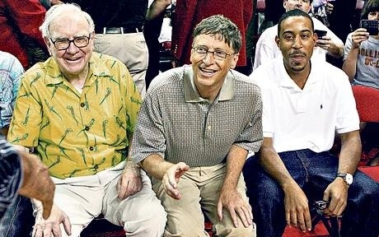
The dinner that cost Bill Gates, Warren Buffett and other celebrities billions
Warren Buffett and Bill Gates. Photo: Getty
Notes:
Tom Leonard, The Telegraph, 06 Aug 2010
http://www.telegraph.co.uk/news/worldnews/northamerica/usa/7929657/The-dinner-that-cost-Bill-Gates-Warren-Buffett-and-other-celebrities-billions.html

Slide 54
It could happen?
“This week … 40 billionaires – worth a combined $230 billion (£145 billion) – signed a "giving pledge" to donate at least 50 per cent of their wealth to good causes. It is a remarkable act of noblesse oblige, even in a country whose tradition of philanthropy is the strongest in the industrialised world.”
www.telegraph.co.uk/news/worldnews/northamerica/usa/7929657/The-dinner-that-cost-Bill-Gates-Warren-Buffett-and-other-celebrities-billions.html

Slide 55
“it all started with a dinner”
“… it all started with a dinner – a secret one envisaged by Warren Buffett, organised by Bill and Melinda Gates, and hosted by David Rockefeller … at the elegant and discreet President's House at Rockefeller University in New York on May 5 last year.” By Tom Leonard
www.telegraph.co.uk/news/worldnews/northamerica/usa/7929657/The-dinner-that-cost-Bill-Gates-Warren-Buffett-and-other-celebrities-billions.html
Notes:
Downloaded 9/10/2010

Slide 57
UNC conferences/webcasts
Coming Sept 29th: The Courage to Lead: Scholar-Activism and Health Equity in Turbulent Times, 23rd National Health Equity Research Webcast. http://go.unc.edu/nherw
Camara Jones, Andrew Curley, Paul Cuadros,
Moderator: Wizdom Powell
Coming Feb 23: Reclaiming the Narrative, 39th Annual Minority Health Conference with interactive webcast of keynote lecture.
Past webcasts at www.minority.unc.edu/resources/webcasts/

Slide 58
Thank you!
Please visit my “virtual library” at http://go.unc.edu/sjae
and my other pages at
http://go.unc.edu/vjs

