Slide 1
Global health ideas and reflections
For Global Health Lunch and Learn, November 14, 2017 UNC Gillings School of Global Public Health
Victor J. Schoenbach, Ph.D., http://go.unc.edu/vjs
Department of Epidemiology (and Minority Health Project)
UNC Gillings School of Global Public Health
Notes:
Last updated 9/23/2017

Slide 2
UNC conferences/webcasts
Broadcast Sept 29th: The Courage to Lead: Scholar-Activism and Health Equity in Turbulent Times, 23rd National Health Equity Research Webcast. Online at http://go.unc.edu/nherw
Andrew Curley, Paul Cuadros, Camara Jones Moderator: Wizdom Powell
Coming Feb 23: Reclaiming the Narrative, 39th Annual Minority Health Conference with interactive webcast of keynote lecture. http://go.unc.edu/mhc (also has links to 2017 recordings)
More past webcasts at www.minority.unc.edu/resources/webcasts/

Slide 3
Outline
Sources for ideas
Perspectives
Transcendental Meditation – worth a look
Must inequality necessarily be harmful?

Slide 4
I. Sources for ideas (a few)

Slide 5
Read Science and perhaps join AAAS – a few example articles from recent issues
“One in three Chinese children faces an education apocalypse. An ambitious experiment hopes to save them,” http://www.sciencemag.org/news/2017/09/one-three-chinese-children-faces-education-apocalypse-ambitious-experiment-hopes-save
“Sociotechnical transitions for deep decarbonization,” http://science.sciencemag.org/content/357/6357/1242.full
“Teaching personal initiative beats traditional training in boosting small business in West Africa,” http://science.sciencemag.org/content/357/6357/1287
“Infants make more attempts to achieve a goal when they see adults persist,” http://science.sciencemag.org/content/357/6357/1290

Slide 6
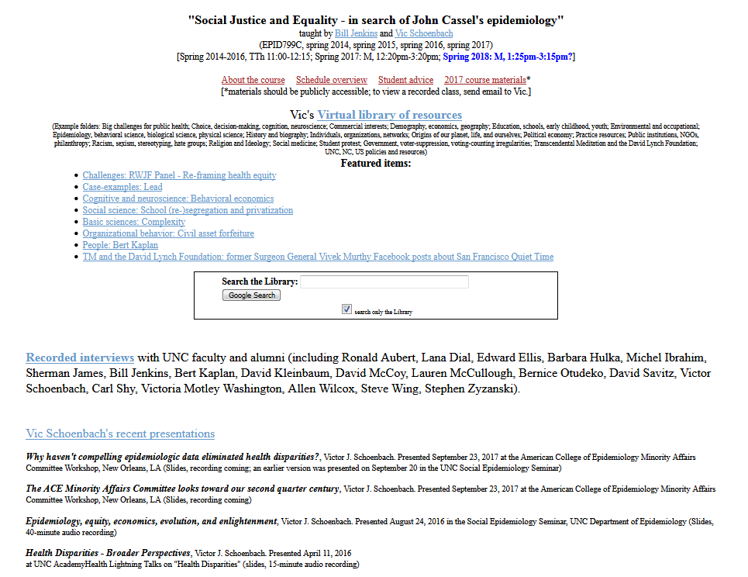
Browse my “virtual library” – go.unc.edu/sjae

Slide 7
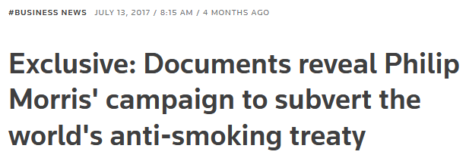
Browse my “virtual library” – go.unc.edu/sjae
Search the Library
Accessing UNC resources and navigating the UNC proxy server
This item has several UNC resources and also explains that many of the links to articles and journals in the virtual library include the UNC proxy server component, to facilitate access to full text articles by persons affiliated with UNC. If you do not have a UNC Onyen or NC AHEC authentication, or you do not wish to log in, read the instructions here for removing the proxy server component of the URL to avoid authentication screen.
Big challenges for public health
Case examples
Choice behavior, decision-making, perception, cognition, emotion, neuroscience
Demography, economics, education, epidemiology, geography, history, law, policy, political economy, sociology
Behavioral, biological, epidemiological, mathematical, and physical sciences, evolution, history of science, science policy
Organizations and organizational behavior
People - specific individuals and populations
To be filed
Transcendental Meditation and the David Lynch Foundation

Slide 8
II. Perspectives

Slide 9
National Academy Press
Notes:
A sampling from the first 200 “hits” for a search for “health disparities”
https://www.nap.edu/catalog/10186/the-right-thing-to-do-the-smart-thing-to-do
https://www.nap.edu/catalog/10512/guidance-for-the-national-healthcare-disparities-report
https://www.nap.edu/catalog/10833/improving-racial-and-ethnic-data-on-health-report-of-a
https://www.nap.edu/catalog/9939/promoting-health-intervention-strategies-from-social-and-behavioral-research
https://www.nap.edu/catalog/6034/toward-environmental-justice-research-education-and-health-policy-needs
https://www.nap.edu/catalog/6259/leading-health-indicators-for-healthy-people-2010-first-interim-report
https://www.nap.edu/catalog/23541/advancing-the-science-to-improve-population-health-proceedings-of-a
https://www.nap.edu/catalog/24824/lessons-learned-from-diverse-efforts-to-change-social-norms-and-opportunities-and-strategies-to-promote-behavior-change-in-behavioral-health
https://www.nap.edu/catalog/10885/in-the-nations-compelling-interest-ensuring-diversity-in-the-health
https://www.nap.edu/catalog/11329/assessment-of-nih-minority-research-and-training-programs-phase-3
https://www.nap.edu/catalog/10979/eliminating-health-disparities-measurement-and-data-needs
https://www.nap.edu/catalog/13383/how-far-have-we-come-in-reducing-health-disparities-progress
https://www.nap.edu/catalog/12154/challenges-and-successes-in-reducing-health-disparities-workshop-summary
https://www.nap.edu/catalog/11602/examining-the-health-disparities-research-plan-of-the-national-institutes-of-health
https://www.nap.edu/catalog/10260/unequal-treatment-confronting-racial-and-ethnic-disparities-in-health-care
https://www.nap.edu/catalog/24624/communities-in-action-pathways-to-health-equity

Slide 10
But counterveiling forces
War on Drugs
War on Crime
Our “Carceral Society”
Private, for-profit prisons
Technology and automation
Globalization – outsourcing of jobs, immigration of low skilled workers
Genomics and biotechnology
Escalation in educational requirements vs. de-escalation in funding for public education = student debt
. . .

Slide 11
Social determinants of health – epidemiology as a population science: examples
Leonard Syme ─ Historical perspective
Nancy Krieger – Epidemiology and the web of causation: Has any one seen the spider? and Epidemiology and the People’s Health. Theory and Context
Anthony McMichael ─ Globalization, Climate Change, and Human Health
Carl Shy – The failure of academic epidemiology: Witness for the prosecution
David Williams ─ Social and Behavioral Determinants of Toxic Stress
David Satcher ─ Social Determinants of Health and Their
Implications for Public Health
Moyses Szklo – Epidemiology for public health: Are we missing the boat?
Sandro Galea – The social in context: On rational directions in quantitative population health science
Sir Michael Marmot ─ Social Determinants of Health

Slide 12
Epidemiology, Equity, Economics, Evolution, and Enlightenment
Victor J. Schoenbach, http://go.unc.edu/vjs
August 24, 2016
Social Epidemiology Seminar
UNC Department of Epidemiology
(audio recording available at https://sakai.unc.edu/x/Cc8ln3)

Slide 13
Epidemiology, Equity, Economics, Evolution, and Enlightenment
Epidemiology – for understanding and improving health of all people
Equity – equity / social justice reflects the distribution of power
Economics – economic resources are fundamental to public health, and their distribution depends on social forces
Evolution – fundamentally, we and our societies are expressions of biology, evolving through time as an emergent phenomenon
Enlightenment – broader and deeper understanding of our nature and our environment may help humanity manage our collective lives better, advancing public health in the present and future
From Social Epidemiology Seminar, UNC Dept of Epidemiology, Aug. 24, 2016 (See notes page for links to slides and audio.)
Notes:
Slides: https://sakai.unc.edu/access/content/user/vschoenb/Public%20Library/People/People/Victor%20Schoenbach/Presentations/SocialEPIDseminar20160824live.pptx
Audio (40 minutes):
https://sakai.unc.edu/access/content/user/vschoenb/Public%20Library/People/People/Victor%20Schoenbach/Presentations/SocialEPIDseminar-20160824noQuestions.mp3

Slide 14
We are systems within systems
Complexity: Life is an “emergent phenomenon” that arises from the actions of innumerable agents – organizations, individuals, neurons, macromolecules, etc. (Examples of emergent phenomena are at http://www.evolutionofcomputing.org/Multicellular/Emergence.html ).

Slide 15
We have evolved to cope with complexity
In attempting to cope with the complexity of life, we (humans and other animals that employ reasoning) create simplified representations for our perceptions, reasoning, and understanding, and simplified maxims to live by (“significant results”, “evidence-based”, “treat thy neighbor as one would be treated”, etc.). Such reductionism has been extremely effective in successfully navigating the challenges of living and interacting, enabling species to flourish – and also occasioning major problems where important elements of a situation are overlooked.

Slide 16
But that entails being selective, simplifying, and probably oversimplifying
Simplifications – models – are evaluated and declared useful, effective, accurate, etc., based on what we regard as important though inevitably incomplete criteria. For obvious practical reasons, the criteria must be observable (“measurable objectives”), relatively near-term, not too subtle, and “relevant” to what we regard as important. For example, we will declare a teaching innovation to be effective if it appears to improve student performance on examinations. If it also hastens the onset of dementia by two decades, we cannot know that.

Slide 17
Science is also a system within systems
Scientific research is a broad conversation in which different investigator communities explore, present, critique, debate, persuade (or not) others until some kind of consensus is reached, possibly to be upset when a new discovery is accepted. The process of science involves persuading peers and gatekeepers that one has an idea worth pursuing (and being funded), publishable (because editors and reviewers think it’s worthy), and accurate (because serious criticisms do not arise). How else could the search for truth work? There are no available authorities except humans. Some regard God as the ultimate authority, but in any case humans are the channels for God's communications and enforcement.

Slide 18
Right choices are elusive
In addition, most actions have multiple effects - some “good” and others “bad”, some in the present and others only later on, some local and others distant. Because of diversity, a given phenomenon affects different people differently – “one size fits all” never completely applies. So actions affect some individuals and groups in one way and other individuals and groups in other ways. Thus, most important policy questions do not have “right” answers, but rather answers that are “right” for some and “wrong” for others (e.g., should we tax gasoline to bring its price back to $3/gallon?). There must always be trade-offs, typically without knowing the full accounting, and not on an abstract scale but in relation to different people's interests.

Slide 19
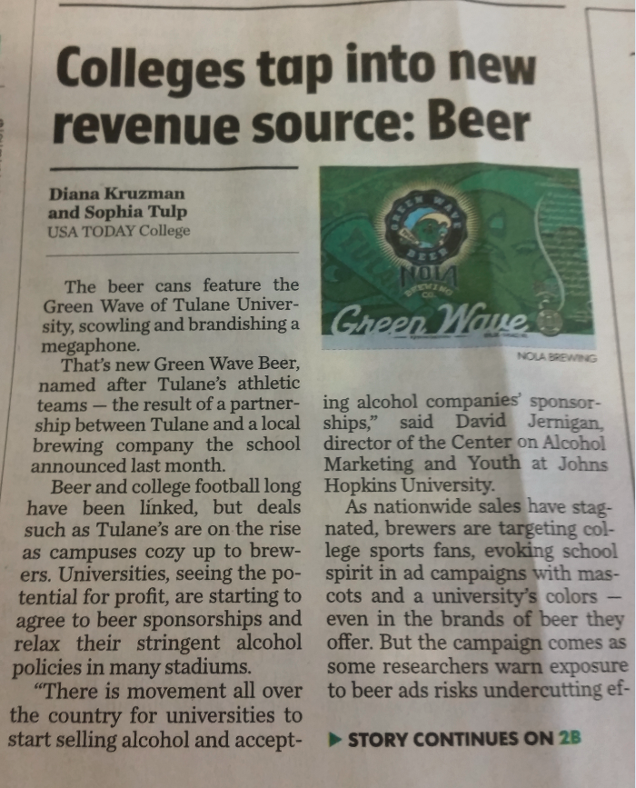
But people see things their own way, anyway
In a sense, it doesn’t matter that there may not be right answers, because there would be no way to recognize them even if there are, and people would not believe them unless they regarded the likely results as visibly favorable for their interests. The policies that actually emerge and are implemented will be the outcome of a competition (and cooperation) among the various agents.

Slide 20
We are not as rational or “evidence-based” as we think
Humans for the most part advocate and pursue what we regard (including unconsciousness influences) as in our interests (I’m using broad definitions of "regard" and “interests”). And that pursuit affects our very perceptions (partly via what we pay attention to), judgment, and what we devote our energies to.

Slide 21
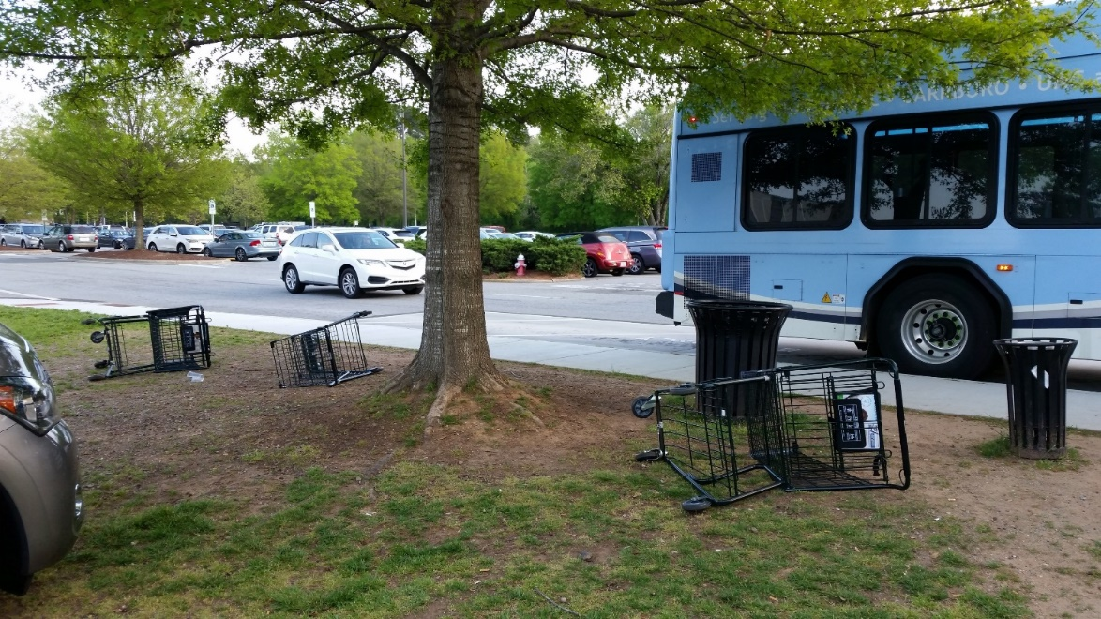
Implications
If society is emergent behavior, we need better agents – intelligent, cooperative, rested, content!
Discontent causes friction and is contagious.
Question: Does an emphasis on disparities / equality, rather than overall public health, generate friction and resistance?

Slide 22
Observing society through the media and daily interactions
Random examples of behavior and public health
Cooperativeness, helpfulness vs corruption, anger, etc.
Rationality, irrationality
Religion
Houston volunteers
Flood insurance
Muncie, IA – opioid use

Slide 23
Grumpiness and lack of sleep
“When people have slept less, it’s a little like looking at the world through dark glasses,” said Janice Kiecolt-Glaser, a longtime relationship scientist and director of the Ohio State Institute for Behavioral Medicine Research. “Their moods are poorer. We’re grumpier. Lack of sleep hurts the relationship.”
Quoted from “Relationship Problems? Try Getting More Sleep”,
Tara Parker-Pope, NY Times, Sept. 4, 2017
https://www.nytimes.com/2017/09/04/well/family/relationship-problems-try-getting-more-sleep.html

Slide 24
Grumpiness and lack of sleep
Couples’ shorter sleep duration related to higher stimulated cytokine production after marital conflict.
People who slept less behaved more negatively and less positively only when their partner had also slept less.
One’s own and one’s partner’s use of emotion regulation strategies during conflict buffered short-sleep-related inflammatory reactivity.
Stephanie J. Wilson, et al. Shortened sleep fuels inflammatory responses to marital conflict: Emotion regulation matters. Psychoneuroendocrinology. May 2017; 79: 74-83
http://www.sciencedirect.com/science/article/pii/S0306453016305169

Slide 25
III. Transcendental Meditation – worth a look

Slide 26
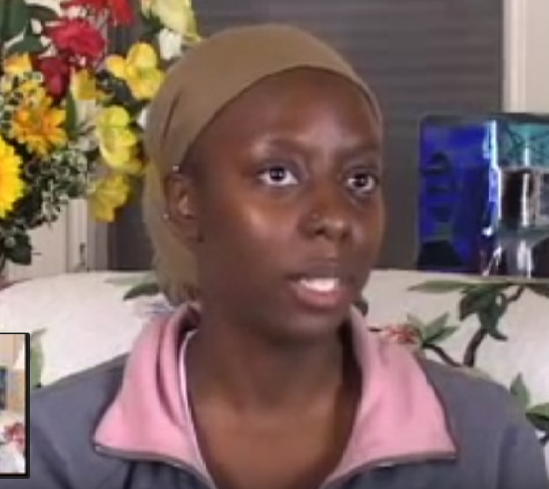
Tasha Daniels describes her experience of the Transcendental Meditation technique and how it helps her deal with stress
(click photo for video)
"Things still happen and don't go as perfectly as I wish they would, it's just the way I respond to it is different. I can be calmer and react to [stress] in a better way."
Notes:
Tasha: The oddest thing for me is that stress still happens it's just the way I deal with it changes. Because I think when I first started Transcendental Meditation I thought, stress will just disappear - no more stress in my life ever again! It's not that stress doesn't happen, things still happen and don't go as perfectly as I wish they would it's just the way I respond to it is different. I have a split second where I stop and can step back from the situation and realize I don't need to, that I can be calmer and react to it in a better way. I think that has probably been the best thing. I mean there is also the whole like, I just feel better, your body just feels better and your sleep is better. All that is good too but for me the biggest thing is that I can handle stress a lot better."

Slide 27
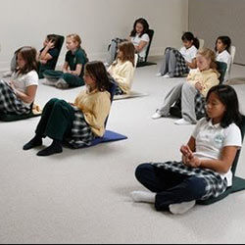
Meditation in the Classroom – The Maharishi School, Fairfield IA (Ken Chawkin, The Edge, Aug 1, 2004)
Dr. Charles Matthews, chairman and former professor of science education at Florida State University: “The students … have the longest attention span of any I have seen in the 30 years of teaching and educational research in public and private schools.”
Julia Herbert, Ed.S., reading consultant in the Washington, D.C., area schools: “… I have never felt such a calm and silent atmosphere in a school of bright, lively, alert children…”
Jill Olsen-Virlee, Iowa Teacher of the Year for 1996 from Marion, Iowa: “Your school was truly an inspiration. The inner peace, the concern for one another, the respect and thirst for wisdom and a holistic approach to children are awesome.”
Notes:
Ken Chawkin, August 1, 2004 http://www.edgemagazine.net/2004/08/meditation-in-the-classroom/

Slide 28
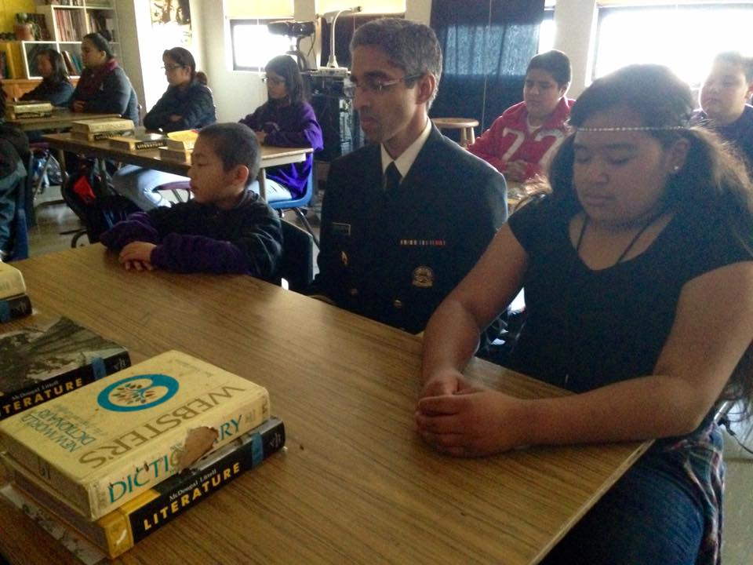
Former Surgeon General Vivek Murthy visits the TM Quiet Time program in San Francisco
Murthy: The "Quiet Time" program has revolutionized schools in San Francisco. Grades are up, detentions/suspensions down, happiness on the rise, violence on the decline. These student and faculty practitioners are teaching us about more than stress management. They are teaching us how to love ourselves and one another.
Notes:
Copied 11/5/2016 from Surgeon General Vivek Murthy's Facebook posts on the Transcendental Meditation Quiet Time program in San Francisco schools (link)
More about the TM/Quiet Time program in Northern California schools:
https://sakai.unc.edu/access/content/user/vschoenb/Public%20Library/Transcendental%20Meditation%20and%20the%20David%20Lynch%20Foundation/TM%20in%20education/Quiet%20Time%20program%20_schools_/San%20Francisco%20schools/

Slide 29
Ntwananu Elementary School, Maputo
All students meditating after the school’s morning assembly
Notes:
Slide from Antonio Gonçalves

Slide 30
IEBO Ocotepec, Mixteca, Oaxaca
Notes:
Slide from Antonio Gonçalves

Slide 31
Santa Maria Tepantlali, Sierra Norte, Oaxaca

Slide 32
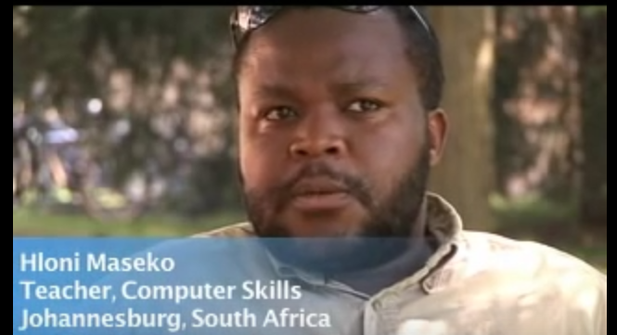
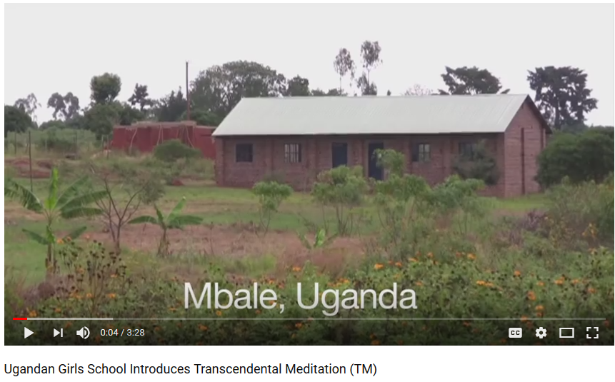
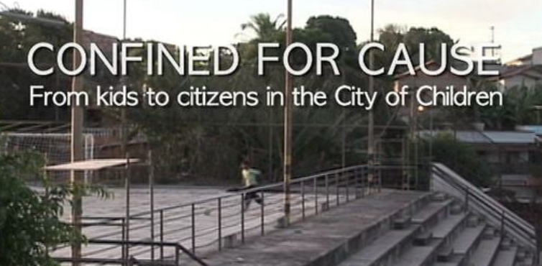
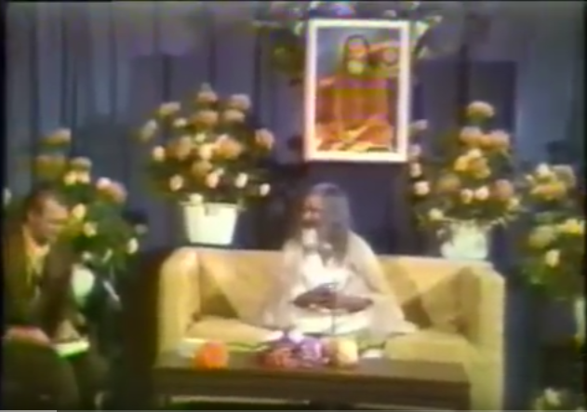
Transcendental Meditation around the world - examples
(click photos for video – more in Virtual Library)

Slide 33
The Maharishi Effect
Among the hundreds of studies of the practice of Transcendental Meditation (TM), there are over 50 studies of individuals or groups practicing the TM and/or TM-Sidhi programs and association with indicators of the larger society’s quality of life, such as indicators of conflict (the Maharishi Effect).

Slide 34
Mozambique President Joachim Chissano credits TM with ending the civil war in that country.
From left to right: Richard Robertson, President Joaquim Chissano, Janine Decot Robertson and Antonio Gonçalves at the Fundaçao Joaquim Chissano in Maputo
http://www.bienfaits-meditation.com/en/the_beatles_and_tm/celebrities/joachim-chissano_en
Notes:
Slide from Antonio Gonçalves

Slide 35
The Maharishi Effect – Example papers
Orme-Johnson, D. W., C. N. Alexander, J. L. Davies, H. M. Chandler, and W. E. Larimore. “International peace project in the Middle East: The effect of the Maharishi Technology of the Unified Field.” Journal of Conflict Resolution 1988; 32(4):776–812.
Dillbeck, M. C. "Test of a field theory of consciousness and social change: Time series analysis of participation in the TM-Sidhi program and reduction of violent death in the U.S." Social Indicators Research 1990; 22:399–418.
Dillbeck, M. C., and M. V. Rainforth. "Impact assessment analysis of behavioral quality of life indices: Effects of group practice of the Transcendental Meditation and TM-Sidhi program." Proceedings of the American Statistical Association, Social Statistics Section 1996:38–43.
Walton, K. G., K. L. Cavanaugh, and N. D. Pugh. “Effect of group practice of the Transcendental Meditation program on biochemical indicators of stress in non-meditators: A prospective time series study.” Journal of Social Behavior and Personality 2005;17(1):339-376.
See full list and discussion at:
www.truthabouttm.org/documentFiles/20.doc
http://www.truthabouttm.org/truth/societaleffects/critics-rebuttals/

Slide 36
The Maharishi Effect – Invincible Military
Nepal, Ukraine, and several militaries in Latin America are participating
(left: Ecuador: http://www.davidleffler.com/enewsletter/20100703_IDT_News.html)

Slide 37
Thomas Kuhn’s The Structure of Scientific Revolutions
“Where the standard account saw steady, cumulative "progress", Kuhn saw discontinuities – a set of alternating ‘normal’ and ‘revolutionary’ phases in which communities of specialists in particular fields are plunged into periods of turmoil, uncertainty and angst. These revolutionary phases – for example the transition from Newtonian mechanics to quantum physics – correspond to great conceptual breakthroughs and lay the basis for a succeeding phase of business as usual.”
Quoted from “Thomas Kuhn: the man who changed the way the world looked at science”, John Naughton, The Guardian, 18 August 2012
https://www.theguardian.com/science/2012/aug/19/thomas-kuhn-structure-scientific-revolutions

Slide 38
IV. Must inequality necessarily be harmful?

Slide 39
The dinner that cost Bill Gates, Warren Buffett and other celebrities billions
Warren Buffett and Bill Gates. Photo: Getty
Notes:
Tom Leonard, The Telegraph, 06 Aug 2010
http://www.telegraph.co.uk/news/worldnews/northamerica/usa/7929657/The-dinner-that-cost-Bill-Gates-Warren-Buffett-and-other-celebrities-billions.html

Slide 40
It could happen?
“This week … 40 billionaires – worth a combined $230 billion (£145 billion) – signed a "giving pledge" to donate at least 50 per cent of their wealth to good causes. It is a remarkable act of noblesse oblige, even in a country whose tradition of philanthropy is the strongest in the industrialised world.”
www.telegraph.co.uk/news/worldnews/northamerica/usa/7929657/The-dinner-that-cost-Bill-Gates-Warren-Buffett-and-other-celebrities-billions.html

Slide 41
“it all started with a dinner”
“… it all started with a dinner – a secret one envisaged by Warren Buffett, organised by Bill and Melinda Gates, and hosted by David Rockefeller … at the elegant and discreet President's House at Rockefeller University in New York on May 5 last year.” By Tom Leonard
www.telegraph.co.uk/news/worldnews/northamerica/usa/7929657/The-dinner-that-cost-Bill-Gates-Warren-Buffett-and-other-celebrities-billions.html
Notes:
Downloaded 9/10/2010

Slide 42
Thank you!
Please visit my “virtual library” at http://go.unc.edu/sjae
and my other pages at http://go.unc.edu/vjs

