Slide 1

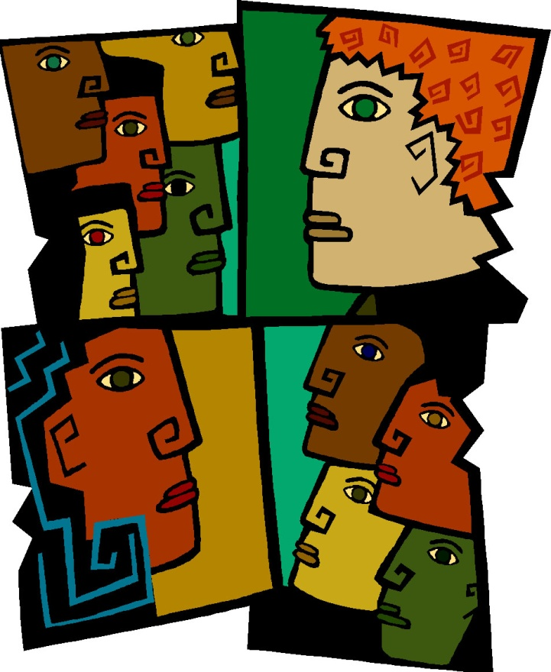
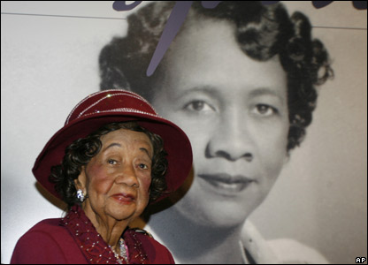

Dorothy I. Height Center for Health Equity &
Evaluation Research
Town Hall
Meeting
CHEER
Center for Health Equity & Evaluation Research
The University of Houston/
The University of Texas
MD Anderson Cancer Center
Notes:
I want to thank the organizers of the National Comprehensive Cancer Control Branch, especially Dr. Brookes, for the invitation to present to you today on Addressing Health Disparities in the 21st Center. Let me first say that contrary to popular belief health disparities in this nation is increasing rather than decreasing. And although the recent Health Reform legislation may help address this issue, it also has the potential to make it worse if we don’t consider taking a different approach to addressing it. Several weeks ago, I was asked to be the speaker for the Office on Minority Health in Region Six as its announced it strategic plan for achieving health equity. As I was preparing this talk, I was torn between given you a new one or taking what I presented an giving it to you today. I believe that I don’t have the same time as I did then, so my decision will force me to rush a little.

Slide 2
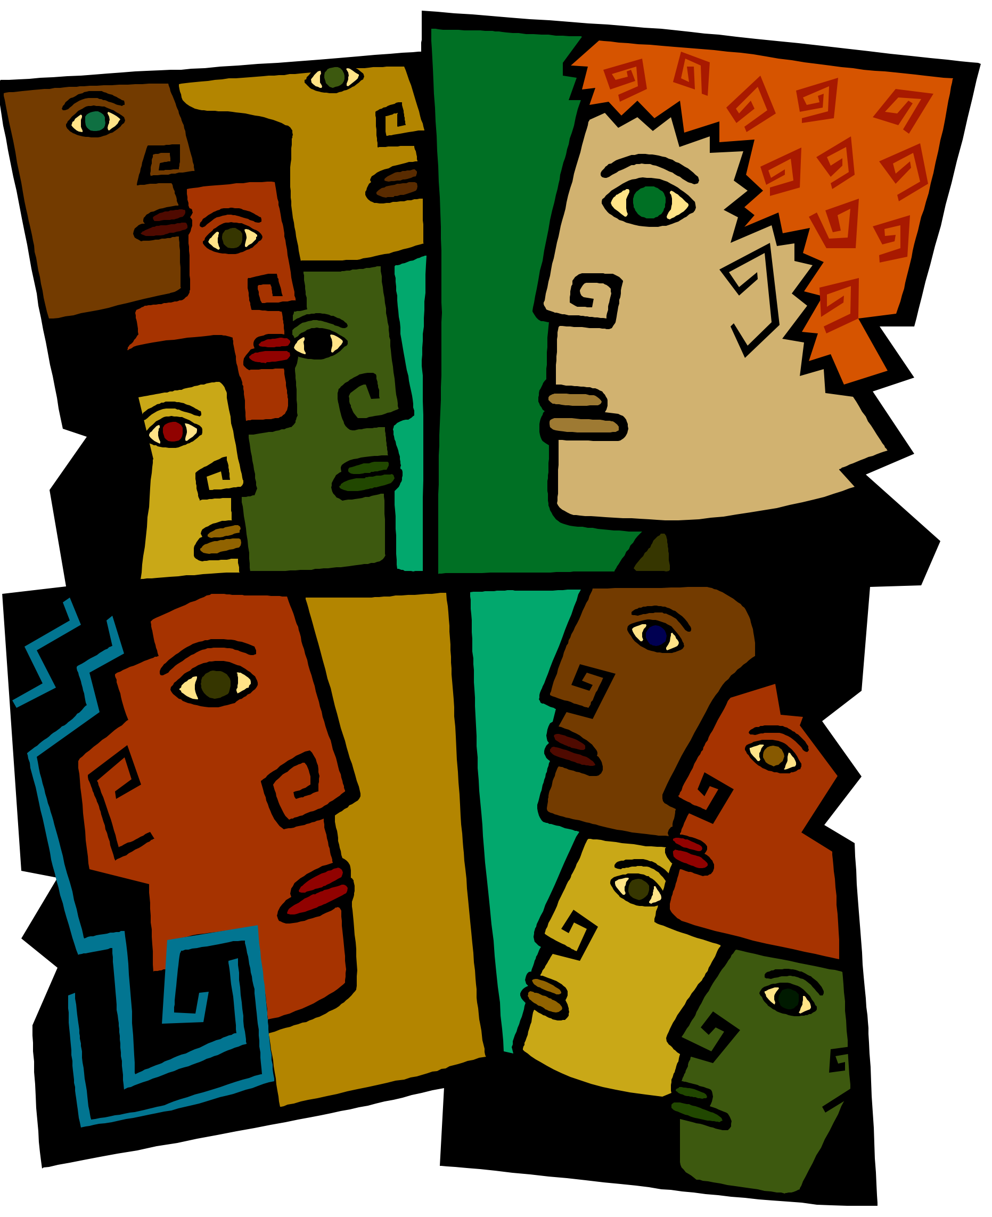
CHEER
Respect, Trust, & Partnership
Dorothy I. Health Center for Health Equity & Evaluation Research
EDUCATION, HEALTH POLICY & RESEARCH
EDUCATION
HEALTH POLICY
collaboration
RESEARCH

Slide 3
EDUCATION, HEALTH POLICY & RESEARCH
Biennial Symposium
Series on
Minorities, the
Medically Underserved
& Cancer
1987
Intercultural Cancer
Council
1995
HDEART
Consortium
2002
Center for Research
On
Minority Health
1999
Notes:
Let me also not be remiss in mentioning some others, the members of the original National Black Leadership Initiative on Cancer (NBLIC) the first community outreach program focused on minorities and cancer, which led to the National Hispanic Leader and the Applilachian Leadership, which led to the Special Populations Network which led to the creation of the Center for Research on Cancer Health Disparities at NCI. It was these individuals the late Clyde Phillips, LaSalle D. Leffall, Jr., Harold Freeman, Dezra White, Louis Bernard ad myself, who stated a sit in in the office of the NCI Director demanding the creating of a program to address cancer in African Americans. To often we forget whose shoulders we stand on. This slide is just a brief overview of the past thirty years. Much more can be said, but let me provide you with a little more background on the biopsychosocial approach who efforts the Center for Research on Minority Health’s efforts has been build up on and why a change in how we address health disparities is needed.

Slide 4


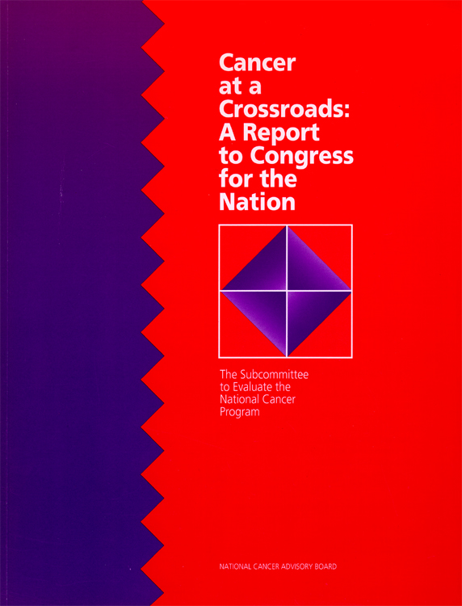

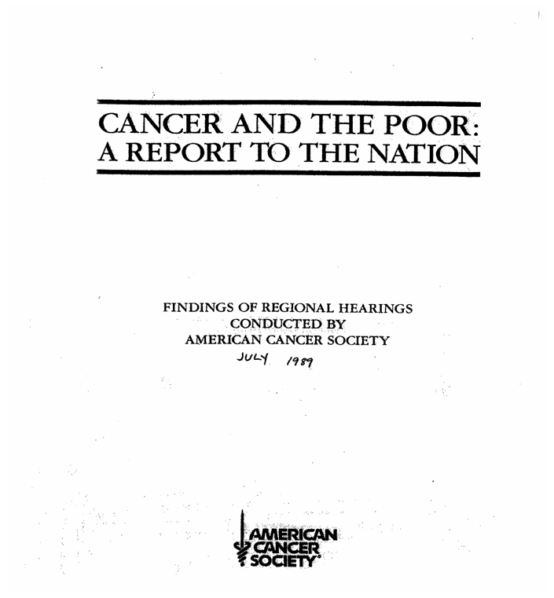
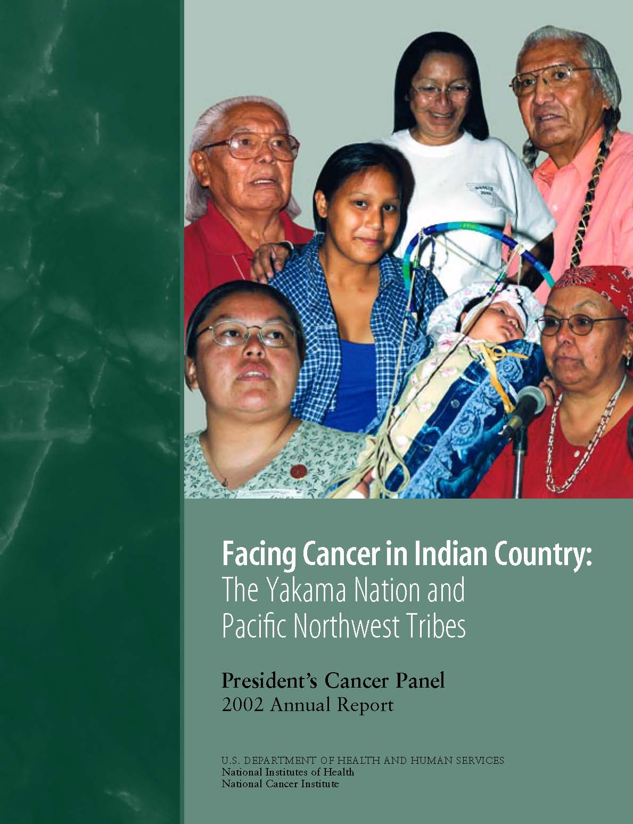
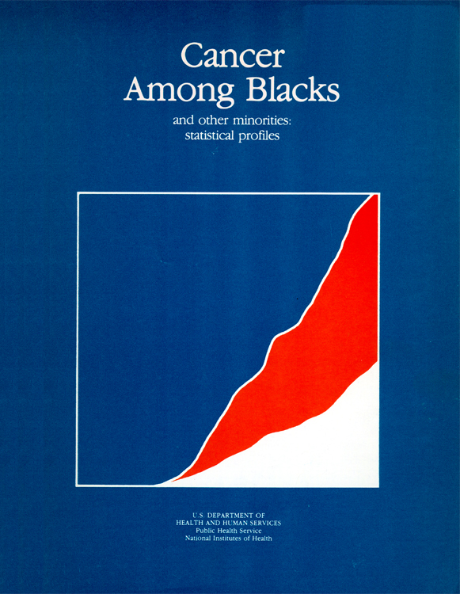

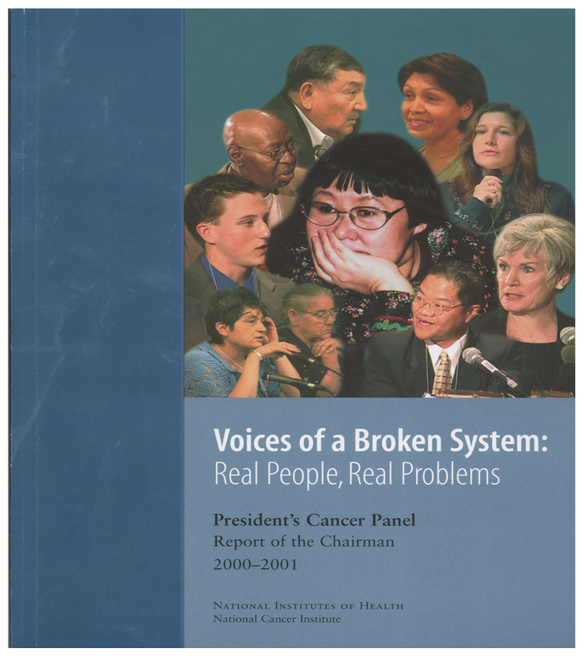
National Landmark Reports Highlighting Cancer Disparities Problem
NATIONALMINORITY CANCER AWARENESS WEEK
BIENNIAL SYMPOSIUM 1987
INTERCULTURAL CANCER COUNCIL 1995
Pre - 1980
1986
1989
1996
1999
2001
2002
2003
1985 Malone-Heckler Report on Black and Minority Health

Slide 5
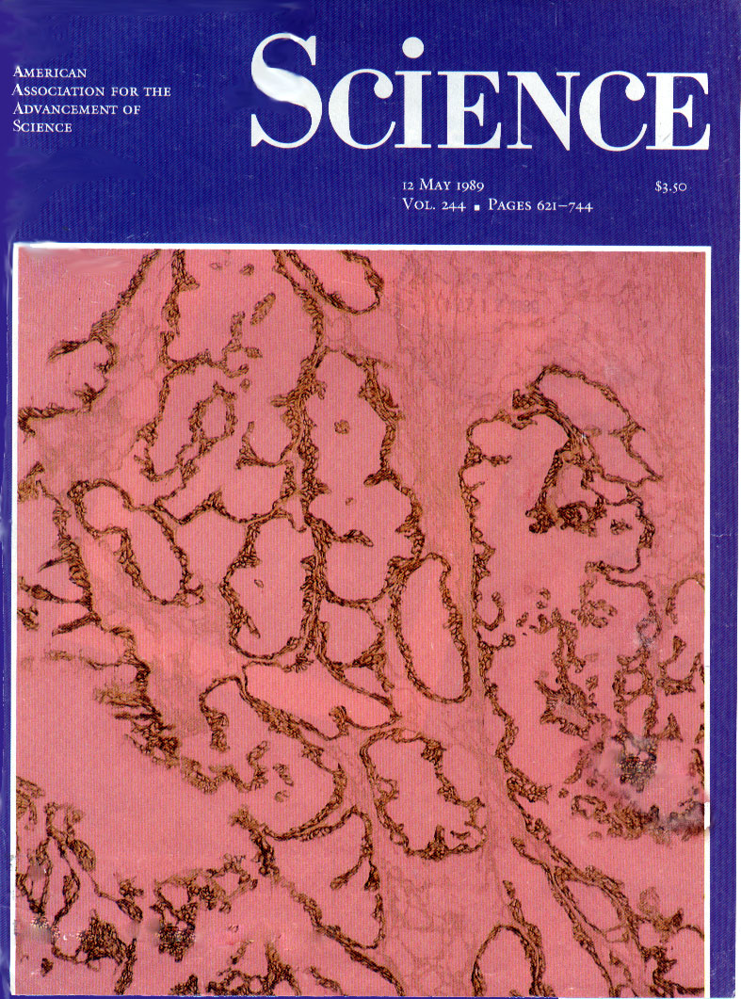
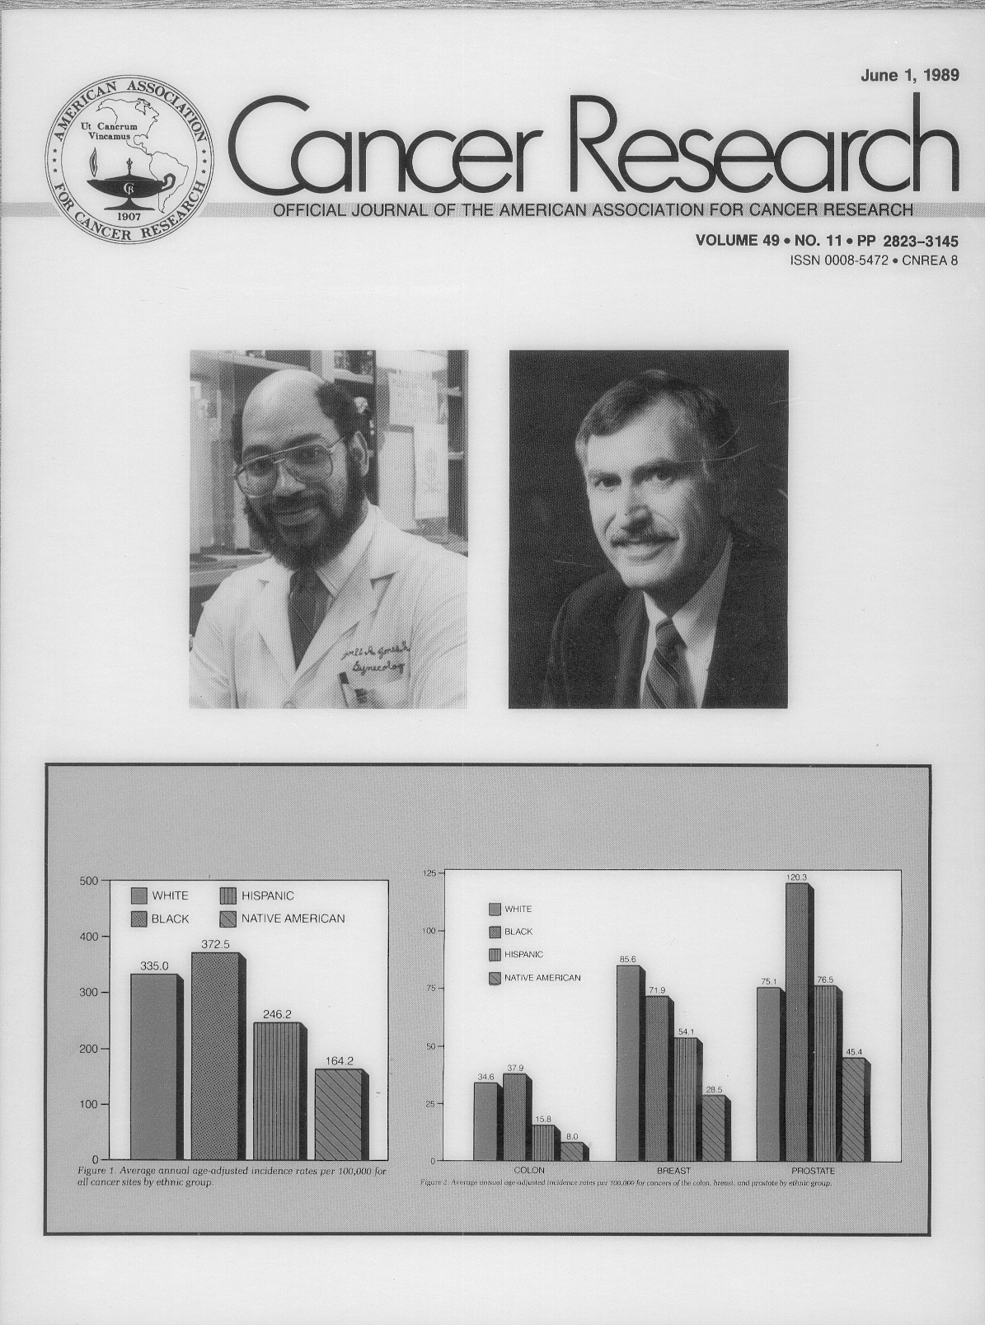
CHEER
Respect, Trust, & Partnership
Dorothy I. Health Center for Health Equity & Evaluation Research
May 12, 1989
June 1, 1989
Notes:
.

Slide 6
The Persistence of Racial Disparities
We have FAILED!
In spite of:
-- a War on Poverty
-- a Civil Rights revolution
-- Medicare & Medicaid
-- the Hill-Burton Act
-- Major advances in medical research & technology
We have made little progress in reducing the elevated death rates of blacks and American Indians relative to whites.
DAVID WILLIAMS, 2009

Slide 7
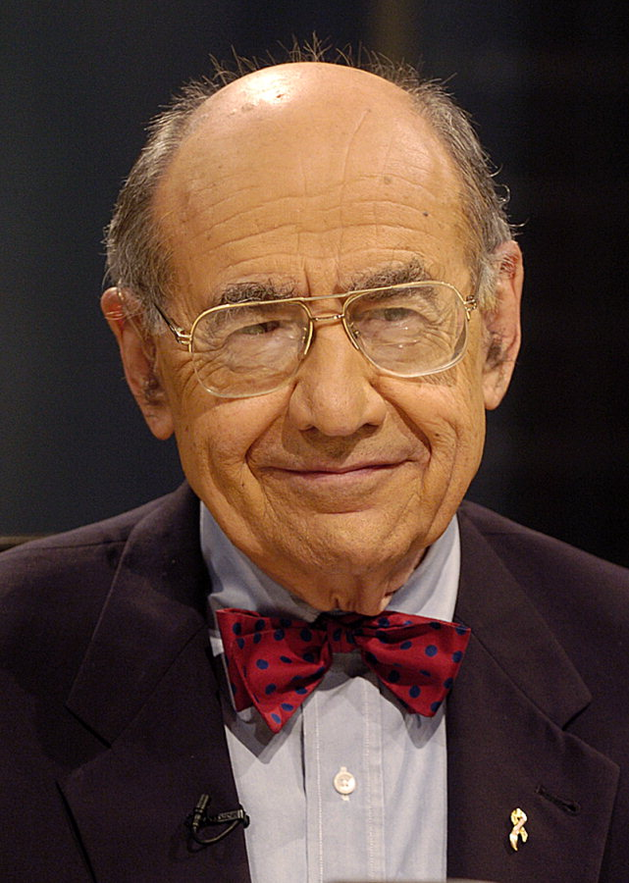
CHEER
Respect, Trust, & Partnership
Dorothy I. Health Center for Health Equity & Evaluation Research
IF THE PROBLEMS ARE IN THE COMMUNITY, THEN COMMUNITIES MUST BE INVOLVED IN DETERMINING THE SOLUTIONS
Gilism #101
Gibert Friedell, M.D.

Slide 8
CHEER
Respect, Trust, & Partnership
Dorothy I. Health Center for Health Equity & Evaluation Research
“Health in minority
communities and
underserved communities
cannot be approached as
a single issue. It has to be
done in a holistic manner”
Lovell A. Jones, 1985

Slide 9
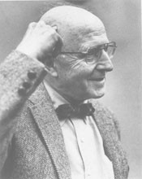
CHEER
Respect, Trust, & Partnership
Dorothy I. Health Center for Health Equity & Evaluation Research
BioPsychoSocial Model of Health and Illness
Psychological
Sociological
Health
Biological
In 1977, George Engel eloquently stated:"To provide a basis for understanding the determinants of disease and arriving at a rational treatments and patterns of health care, a medical model must also take into account the patient, the social context in which he lives and the complementary system devised by society to deal with the disruptive effects of illness, that is, the physician role and the health care system. This requires a BioPsychoSocial model."

Slide 10
CHEER
Respect, Trust, & Partnership
Dorothy I. Health Center for Health Equity & Evaluation Research
BioPsychoSocial Model of Health and Illness
Psychological
Sociological
Health
Biological
In 1999, I changed Dr. Engel statement to reflect a more multidisciplinary approach to health disparities, a medical model that must take into account the complex nature of health disparities that involves more than problems with access. It takes into account community, the social context in which they live and the complementary system devised by society to deal with the disruptive effects of illness on their lives. That is a problem that can’t just be solved at the bench or in the clinic or by analyzing national datasets.

Slide 11
CHEER
Respect, Trust, & Partnership
Center for Research on Minority Health
BIOPSYCHOSOCIAL APPROACH
A RESEARCH VISION that is INCLUSIVE and has a CONTEXTUAL FRAMEWORK that Integrates MOLECULAR/CELLULAR BIOLOGY,
BEHAVIORIAL SCIENCES as well as SOCIAL SCIENCES.
Holistic = Biopsychosocial = Powerful
Acknowledges all possible influences that might affect health and quality of life, both positive and negative. It is the understanding that health cannot be addressed as a single issue. That it has to take into account other factors that influence the perceived need for health care and the attention to health concerns:
Housing
Education
Economics
Co-morbidities, other existing diseases/illness
Adequate access or lack of access to healthcare
Etc...
BIOLOGY (MOLECULAR, CELLULAR and PHYSIOLOGICAL) +
PSYCHOLOGY (BEHAVORIAL SCIENCES) +
SOCIOLOGY (SOCIAL SCIENCES) = A BIOPYSCHOSOCIAL APPROACH
Notes:
Simply stated, a research vision should be inclusive and have a contextual framework that integrates molecular/cellular biology, behavioral sciences as well as the social sciences. It acknowledges all possible influences that might affect health and quality of life, both positive and negative. It is the understanding that health cannot be addressed as a single issue. That such has to take into account other factors that influence the PERCEIVED need of health care and the attention to health concerns. What we referred to as a Biopsychosocial approach to addressing health disparities.

Slide 12
CHEER
Respect, Trust, & Partnership
Center for Research on Minority Health
GUIDING PRINCIPLES
A coordinated effort is needed to improve the collection and coordination of health information and to better link this to specific populations and communities of color.
Research related to health disparities should engender three principles: improve the science base, involve the affected populations, and communicate the findings to all stakeholders
In instances in which the science is incomplete with respect to health disparity issues, it is urged that those involved in such research exercise caution on behalf of the affected communities, particularly those that have the least access to medical, political, and economic resources, taking reasonable precaution to safeguard against or minimize adverse health outcomes.

Slide 13
CHEER
Respect, Trust, & Partnership
Center for Research on Minority Health
“New” Model for Research Design
Community Organizations
&/or
Individuals
Health
Care
Researchers
Community
Populations
Project
Advocate
Leaders
Funds
Data
Publications

Slide 14
CHEER
Respect, Trust, & Partnership
Center for Research on Minority Health
“Traditional” Model Research Design
Researchers
Project
Community
Contact
Funds
Publications
Data
Notes:
Housed at MDACC, the CRMH has been able to implement a new research paradigm, one that utilizes years of community work and numerous relationship established with a variety of organizations and entities. What is different the CRMH. The Science of the 20th Century has been based on a transitional approach to populations studies where involving communities of color meant just involving the church. How many researchers have worked in collaboration with a community prior to submitting a grant an not just contacting them for letter of support. How many have included in their budges support for community activities, including funding for community workers, even those from the community?

Slide 15
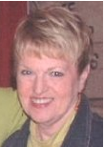
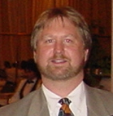

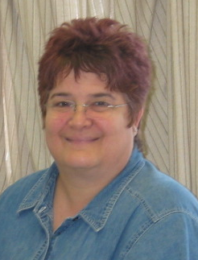
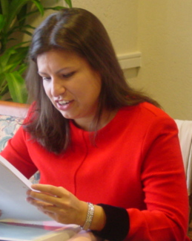
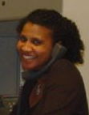
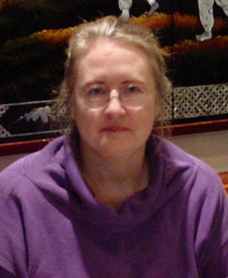



Founding Members
Center for Research on Minority Health
Caren Blinka, J.D.
Janice Chilton, Dr.PH
Angelina Esparza, B.S., MSN
Richard Hajek, Ph.D.
Maria Hernandez-Valero, Dr. PH
Gayle Harper, MSW
Cayla Teal, Ph.D.
Sherry Wunsch
Michele Detry (not shown)

Slide 16
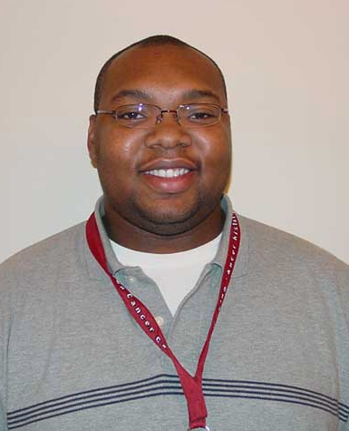
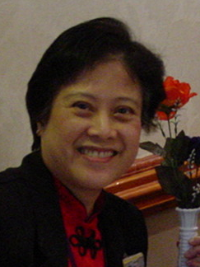
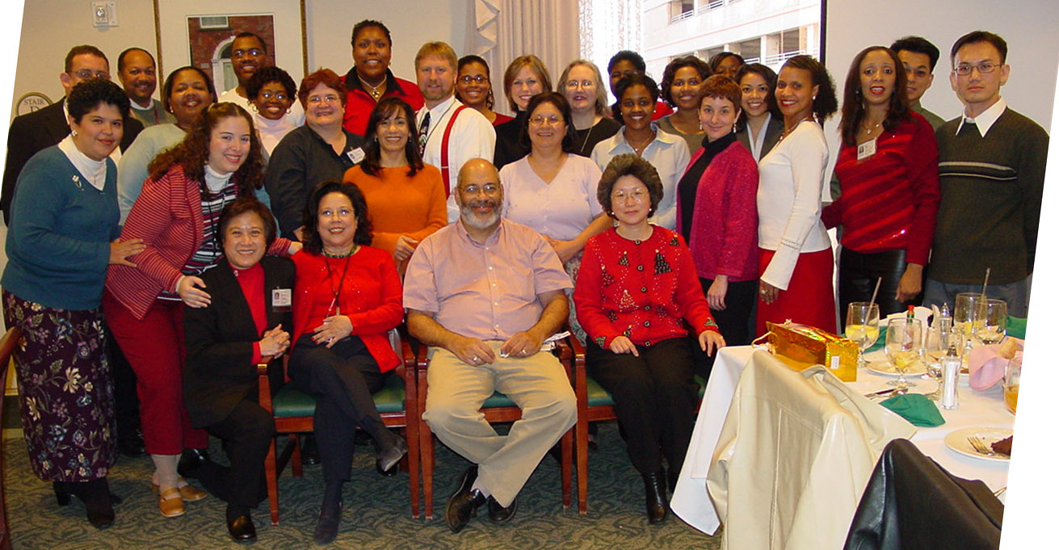
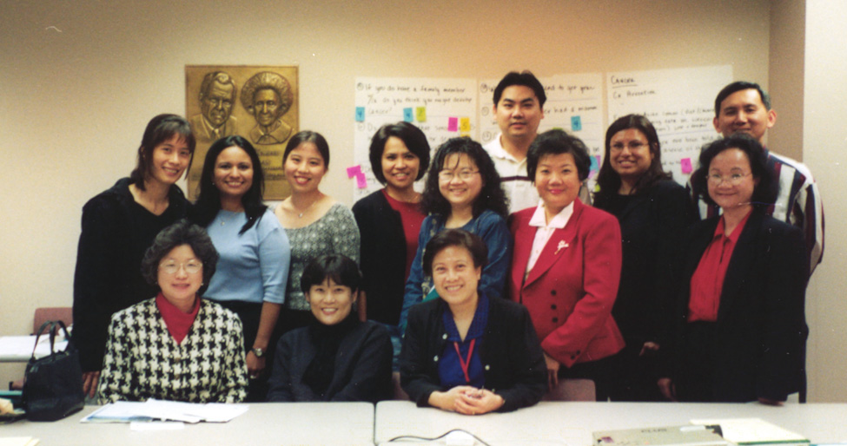
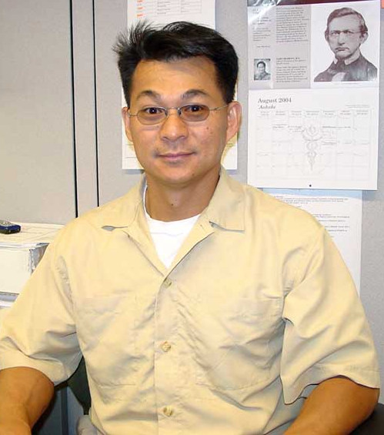
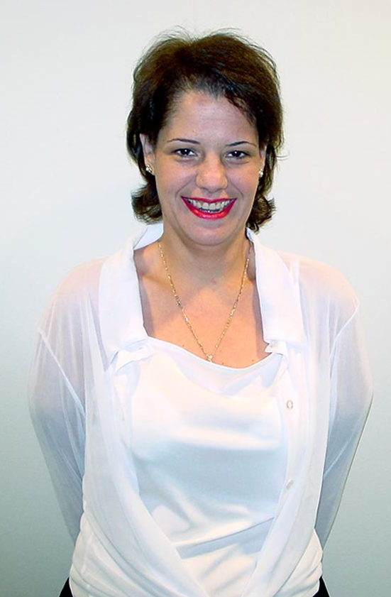

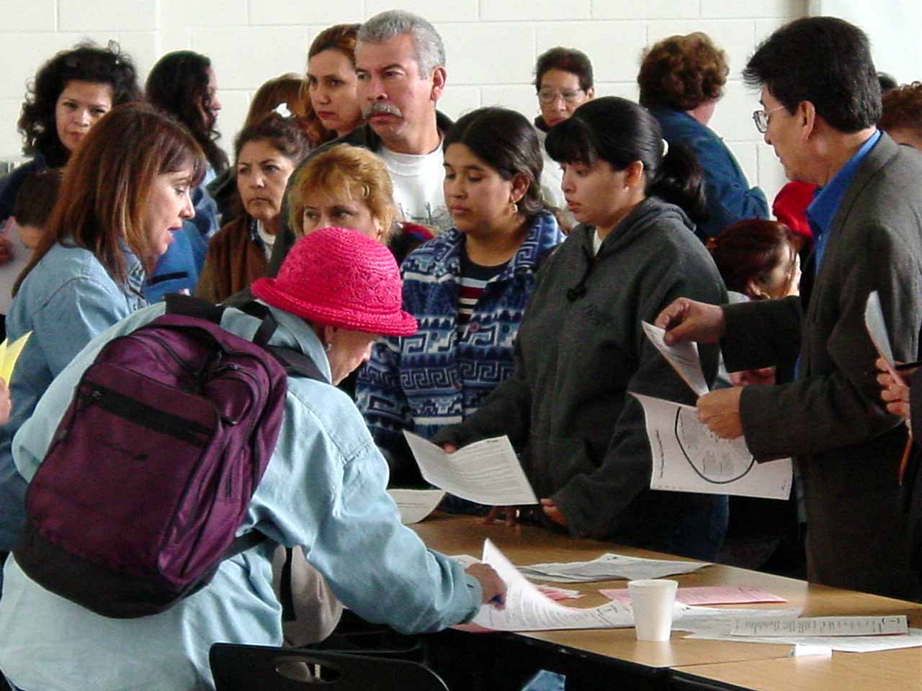
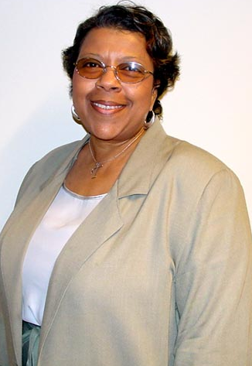
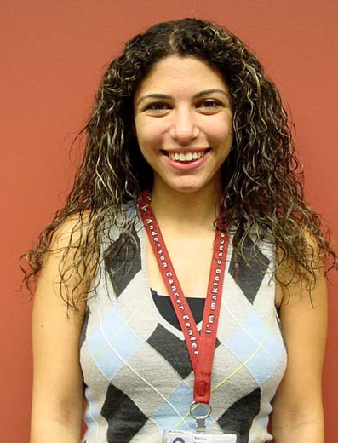

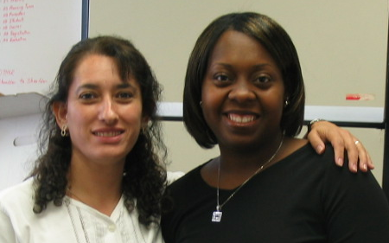
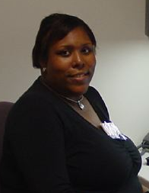
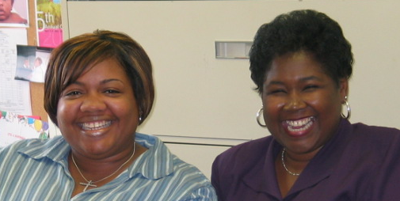
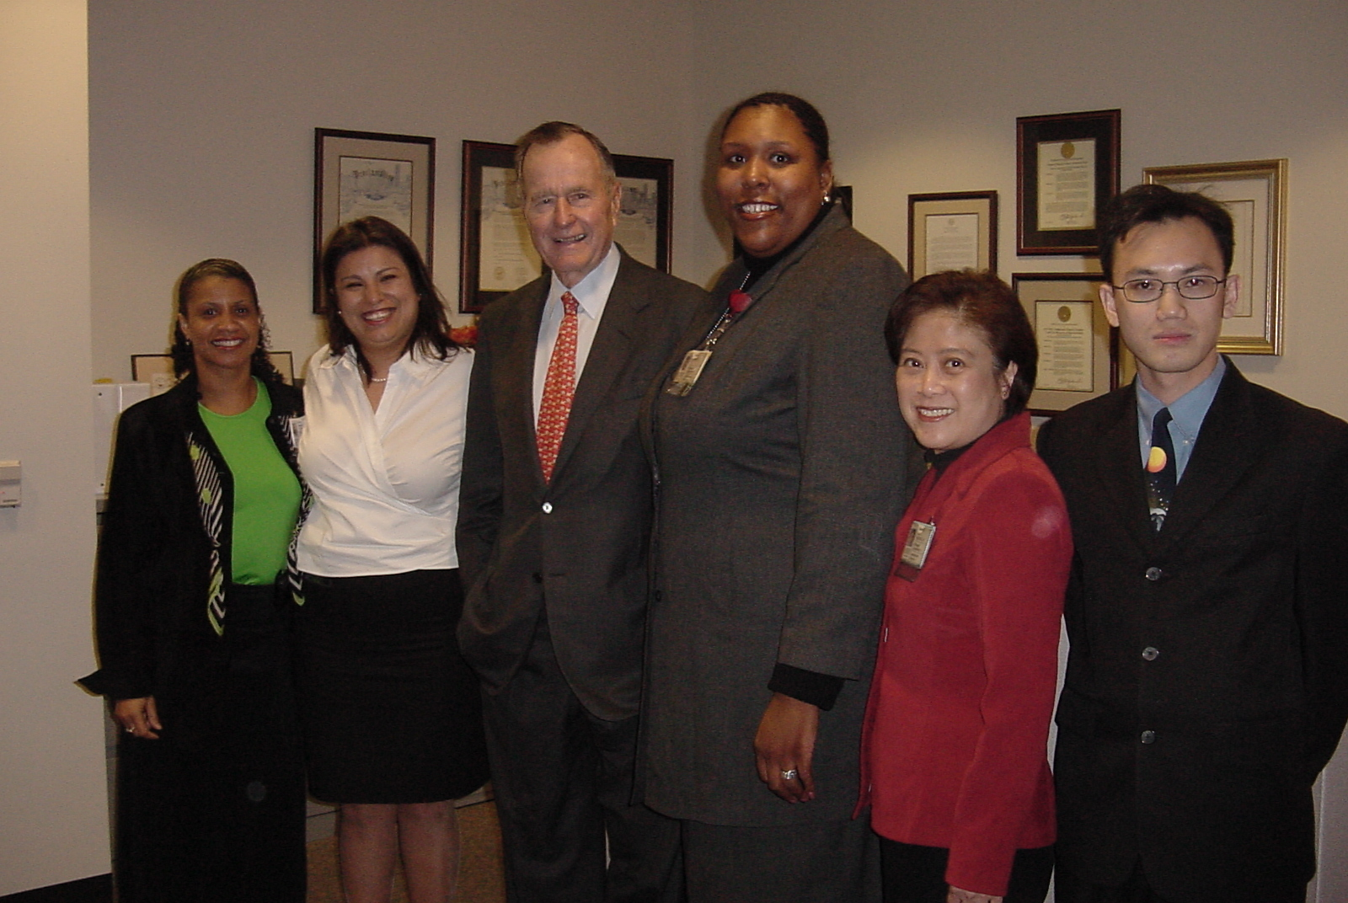
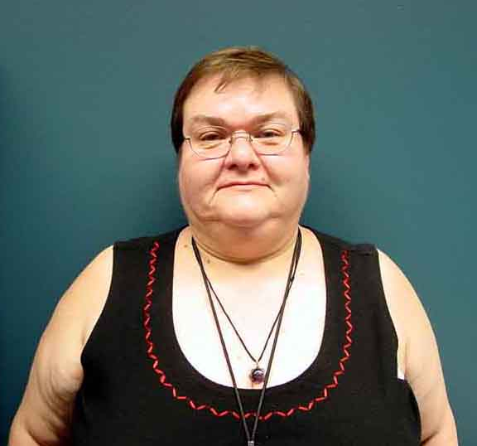
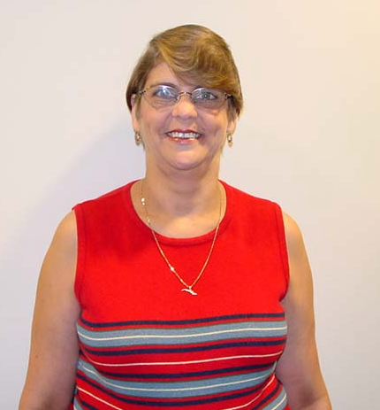
The University of Texas MD Anderson Cancer Center
Center for Research on Minority Health
CHEER
Respect, Trust, & Partnership
Dorothy I. Health Center for Health Equity & Evaluation Research

Slide 17
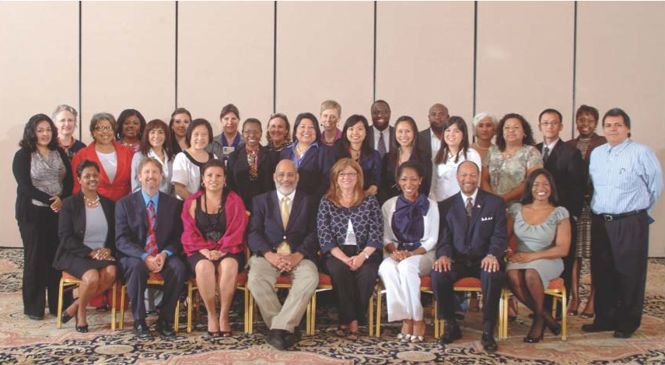
The University of Texas MD Anderson Cancer Center
Congressionally Mandated Center for Research on Minority Health
CRMH
CHEER
Respect, Trust, & Partnership
Dorothy I. Health Center for Health Equity & Evaluation Research
Notes:
However, you can have the best strategic plan possible. But without outstanding people to implement the plan, it would not occur.

Slide 18
CHEER
Respect, Trust, & Partnership
Center for Research on Minority Health
THE RESEARCH VISION OF THE CRMH IS ALL
ENCLUSIVE, INVOLVING MOLECULAR BIOLOGY,
BEHAVIORIAL SCIENCES AS WELL SOCIAL SCIENCES.
Holistic/Biopsychosocial
Acknowledges all possible influences that might affect health and quality of life, both positive and negative. It is the understanding that health cannot be addressed as a single issue. It take into account other factors that influence the perceived need for health care and the attention to health concerns
Housing
Education
Economics
Co-morbidities, other existing diseases/illness
Adequate access or lack of access to healthcare
Etc...
BIOLOGY (MOLECULAR) + PSYCHOLOGY (BEHAVORIAL SCIENCES) +
SOCIOLOGY (SOCIAL SCIENCES) =
BIOPSYCHOSOCIAL RESEARCH
“A HOLISTIC APPROACH”
Knowledge
Attitudes
and Practices

Slide 19
CHEER
Respect, Trust, & Partnership
Dorothy I. Health Center for Health Equity & Evaluation Research
Our Approach
Racism 30%
Quality Care &
Biology 10%
Socio-economic
Status
30%
+
+
Culture 30%
+
EQUALS
African American Health disparities
William (Bill) Jenkins

Slide 20
CHEER
Respect, Trust, & Partnership
Center for Research on Minority Health
SCIENCE
Behavioral Sciences
Psychosocial
aspects of health
Biostatistics
Economics
Prevention and Health Education
Health Outcomes
Political
Science
Molecular
Biology
Anthropology
Epidemiology
Clinical Sciences

Slide 21
CHEER
Respect, Trust, & Partnership
Center for Research on Minority Health
Research
Core
Data Support
Core
Data/Statistical
Core
Community Based
Participatory
Research &
Outreach
Clinical
Core
Administrative
Core
Education
Core

Slide 22
Health Disparities Consortium Members
University of Houston
Department of Health & Human Performance
College of Law
Texas Southern University
College of Pharmacy & Health Sciences
Rice University
Department of Kinesiology
Prairie View A & M University
College of Nursing
Department of Biology
Baylor College of Medicine
Center for Chronic Disease Research
Human Genome Sequencing Center
Office of the Dean of Medicine
UT Health Sciences Center at Houston
School of Public Health
School of Medicine
School of Nursing
University of Texas Health Science Center
San Antonio
Veteran Administration Hospital- Houston
University of Texas Health Center at Tyler
Texas Woman’s University
UT MD Anderson Cancer Center
Center for Research on Minority Health
University of Texas Medical Branch
Office of the President
Texas A & M University
Center for Health Disparities Research
Texas A & M University Health Science Center
School of Rural Public Health
Texas A & M University Corpus Christi
Florida A & M University
University of Houston - Downtown
Lee College
San Jacinto College - South
City of Houston Department of Health
& Human Service
Texas Department of State Health Services

Slide 23
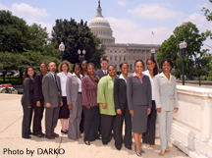


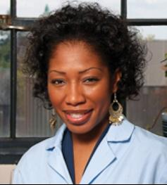
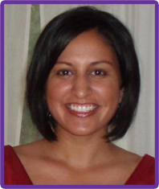
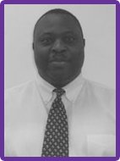
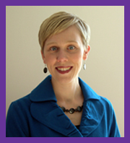
CHEER
Respect, Trust, & Partnership
Dorothy I. Health Center for Health Equity & Evaluation Research
CRMH Kellogg Alumni
KELLOGG SCHOLARS IN
HEALTH DISPARITIES
MDACC TRAINING SITE
ALUMNI
Fall 2008 Cohort
Fall 2009 Cohort

Slide 24
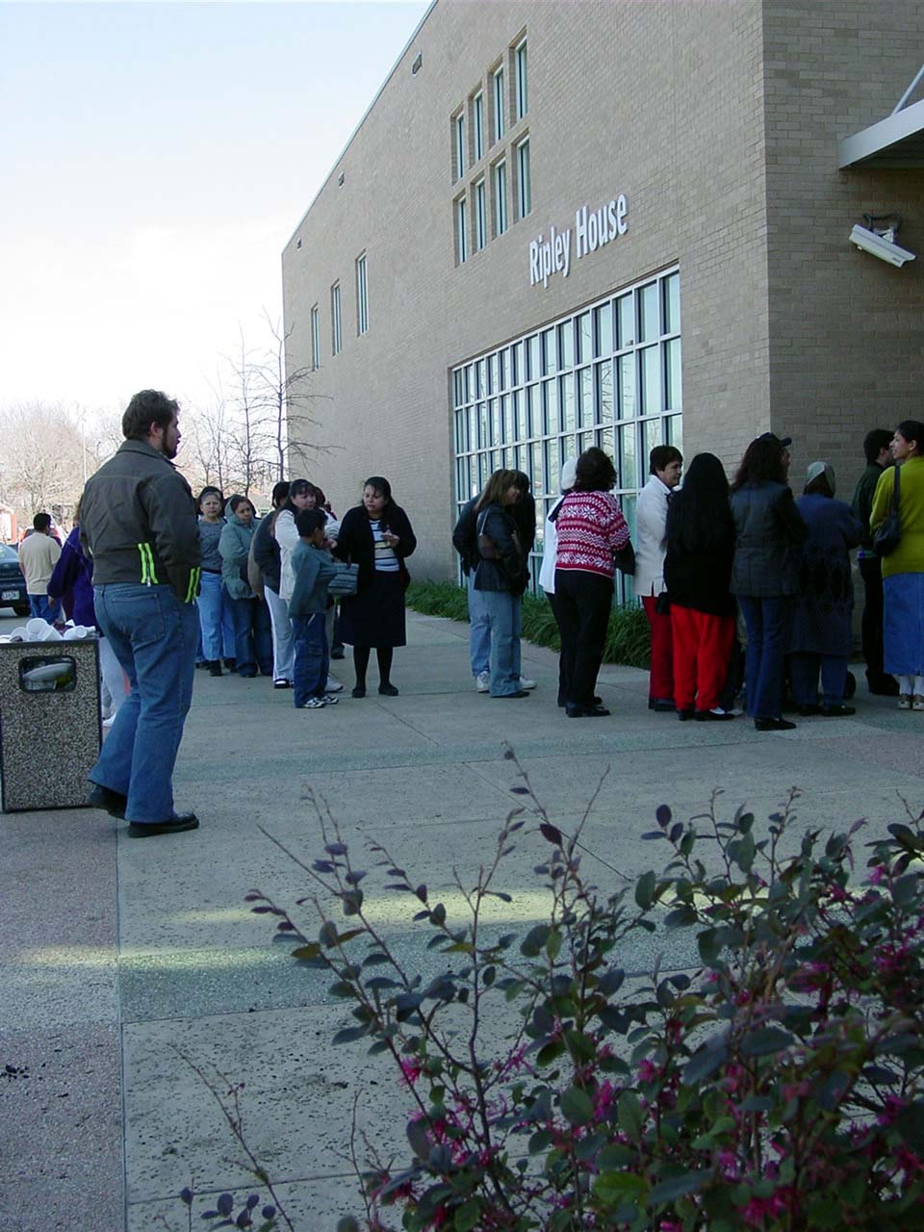
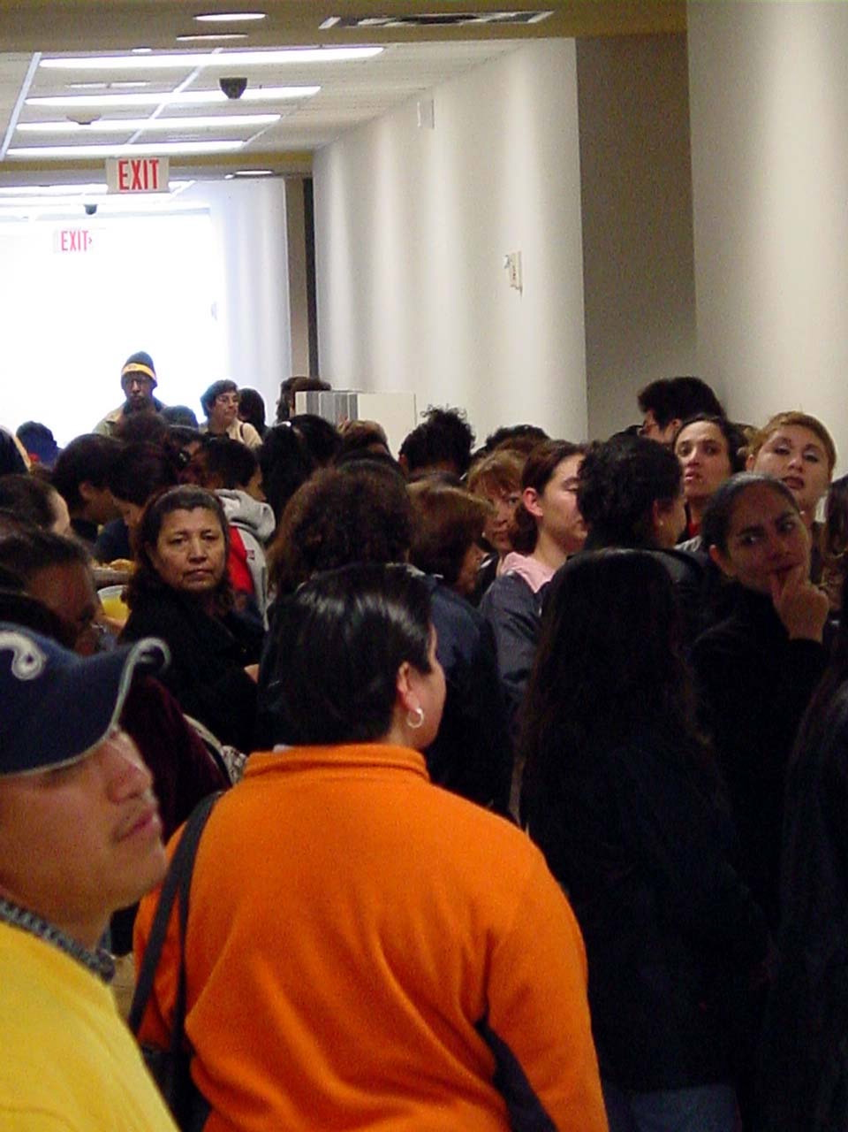
CHEER
Respect, Trust, & Partnership
Dorothy I. Health Center for Health Equity & Evaluation Research
If you TRULY show that you care as much about
their health as they care about their health
they will come

Slide 25
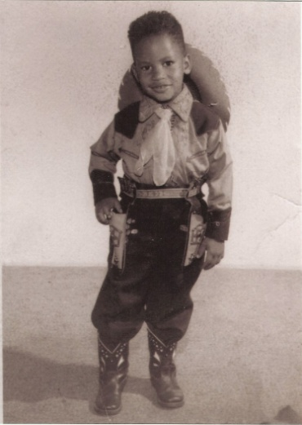
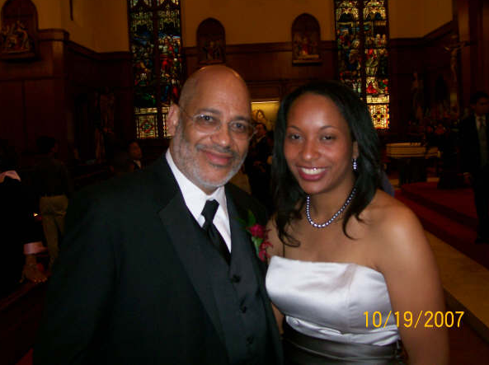
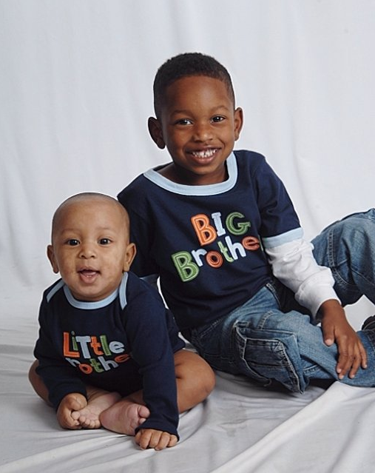

CHEER
Respect, Trust, & Partnership
Dorothy I. Health Center for Health Equity & Evaluation Research
The past generation
The next generation
Everyone Needs……
An ENVISIONED FUTURE
The future generation
Notes:
Finally, I continue in this battle for the people in these pictures, my daughter and my grandsons.

Slide 26
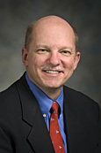
CHEER
Respect, Trust, & Partnership
Dorothy I. Health Center for Health Equity & Evaluation Research
Purpose of Town Hall Meeting
Ernest Hawk, M.D., MPH
Vice President of Cancer Prevention
& Population Sciences
University of Texas
MD Anderson Cancer Center

Slide 27
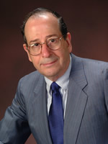
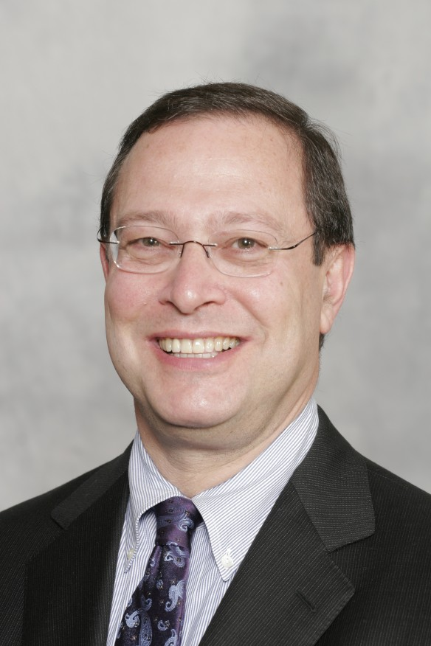
CHEER
Respect, Trust, & Partnership
Dorothy I. Health Center for Health Equity & Evaluation Research
Ronald B. Herberman, MD
Raphael Pollock, M.D, Ph.D.
Ernest Hawk, M.D., MPH

Slide 28
CHEER
Respect, Trust, & Partnership
Dorothy I. Health Center for Health Equity & Evaluation Research
Ronald B. Herberman, MD
Chairman, CRMH/CHEER EAB

