Slide 1
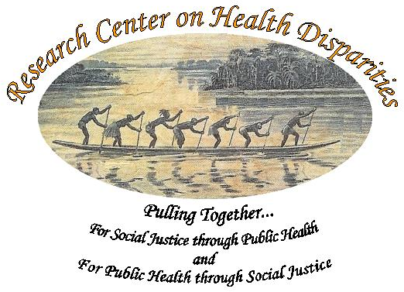
observations on African American Health Disparities :
Implications from Tuskegee
Bill Jenkins, MS, PhD, MPH
CEO, Community Health Analytics
Morehouse College
UNC-Chapel Hill

Slide 2
WEB Dubois “The Philadelphia Negro”
The Negro Death rate indicates how far this race is behind…It should then act as a spur for increased effort and sound up-building … and not …increased discrimination
With support from many academic Americans many legal suits were developed to end segregation

Slide 3
BT Washington “The Atlanta Compromise”
We can live as the hand separate in all things social and together in all things economic.
With support from wealthy Americans , the Tuskegee Experiment created the infrastructure for the economic development of the African American Community.

Slide 4
The Tuskegee Experiment
The Tuskegee Experiment was the most important and successful economic development program in the history of African Americans.
And yet this history is unknown even among most African Americans

Slide 5
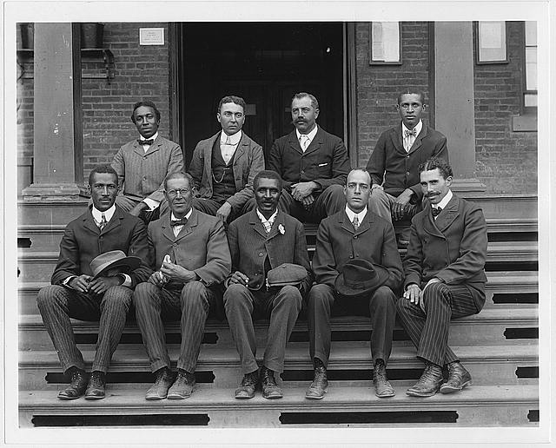
Agriculture

Slide 6
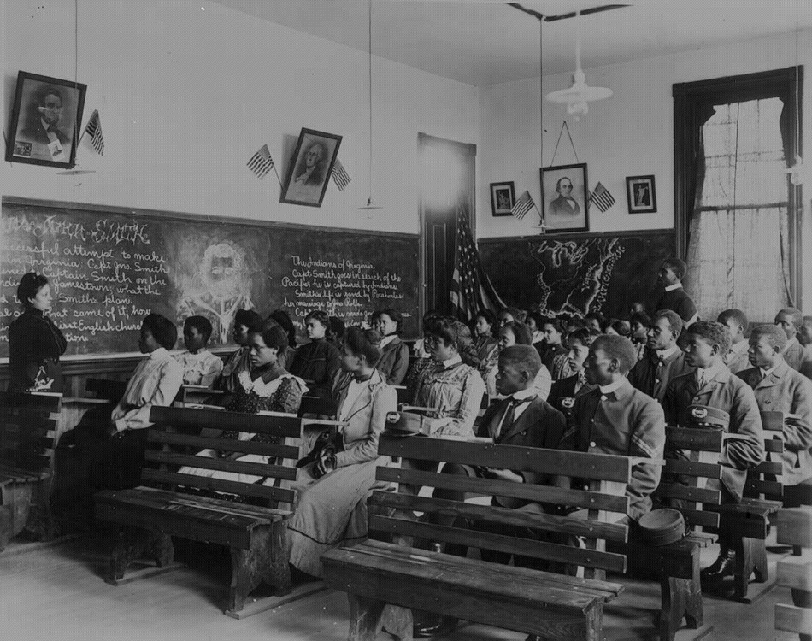
Education

Slide 7

Heading to the Largest Black Medical School…Where?

Slide 8
The History of the Negro Health Movement
Recognizing the link between health, and social and economic well being, Dr. Booker T. Washington initiated the Negro Health Movement
Starts the National Medical Association, National Bar Association, National Nurses Association, and initiated a number of community based health interventions.

Slide 9
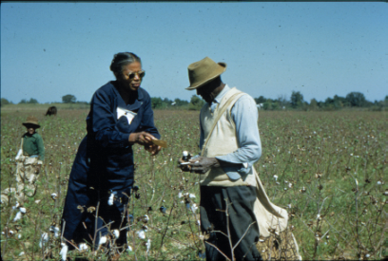

Slide 10
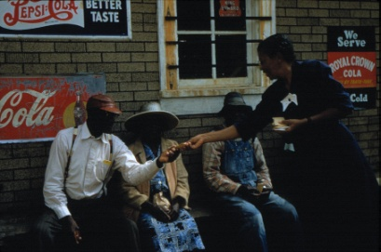

Slide 11
Community Participatory Research
CPBR is not the panacea we envisioned in 1991
As we have seen any good start can end badly
If CPBR is simply another means of getting people into clinical trials or to assess genetic differences, then its ethics should be questioned.

Slide 12
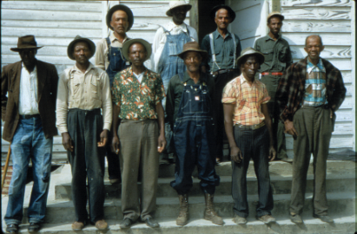

Slide 13
The Tuskegee Study of Untreated Syphilis in the Negro Male
The Tuskegee Syphilis Study was, perhaps, the most unethical study American history.
600 AA men who contracted Syphilis were followed for 40 years without treatment.
Yet, many of its methods are used today.

Slide 14
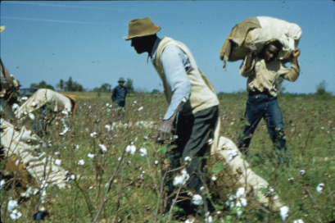

Slide 15
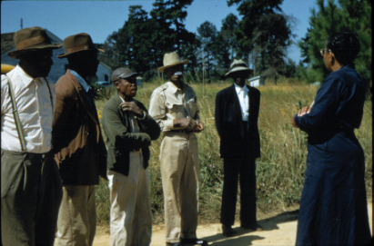

Slide 16
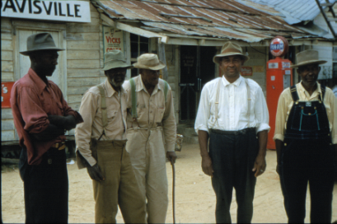

Slide 17
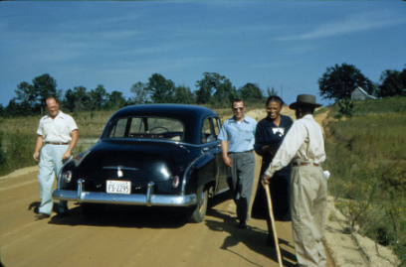

Slide 18
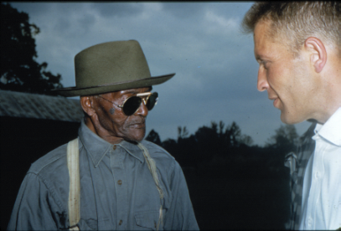

Slide 19
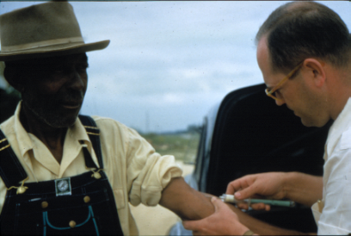

Slide 20
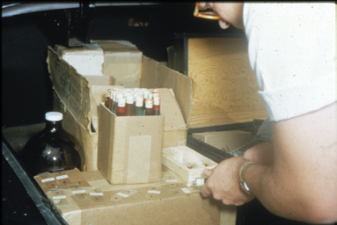

Slide 21
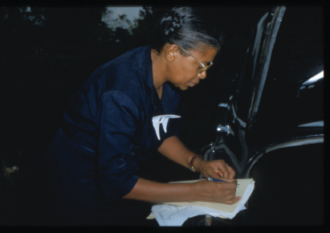

Slide 22
CHANGED RESEARCH PRACTICES
After the Tuskegee Study, the government changed its research practices to prevent a repeat of the mistakes made in Tuskegee.
1974, the National Research Act was signed into law, creating the National Commission for the Protection of Human Subjects of Biomedical and Behavioral Research.
Regulations were passed in 1974 that required researchers to get voluntary informed consent form all persons taking part in studies.
In 1974, studies using human subjects began requiring Institutional Review Boards, which decides whether they meet ethical standards.
In 1991, sixteen federal departments and agencies adopted the Federal Policy for the Protection of Human Subjects.

Slide 23
Basic Tenets of Bioethics
Non-malficence- the obligation not to inflict harm on others
Justice- fair, equitable, and appropriate treatment for all persons
Autonomy – Every person’s right to act as an independent agent free of coercion and armed with facts.
Beneficence- the moral obligation to act for the benefit of others and to promote good.

Slide 24
Levels of Community Participatory Research
Community notification
The community is informed of the intentions, risks and benefits of the study.
Community endorsement
Community representatives are asked to support the research activities.
Community advice
seeks and obtains community advice in planning, development, execution, and dissemination of the research.
Community consent
Obtains community’s approval.
Community origination
Research purpose and goals set by expressed community needs.

Slide 25
The Tuskegee Study of Untreated Syphilis in the Negro male (1932-1972): An example of CPR
Community Notification Churches / Businesses
Community Endorsement Business Establishments
Community Advice The Tuskegee Institute
Community Consent Macon County Medical Society
Community Origination The Negro Health Movement
Cultural Competence Nurse Eunice Rivers

Slide 26
PHS Commissioned Corps
1967

Slide 27
Review: TIMELINE
1932, Follow-up effort organized into study of 399 men with syphilis and 201 without. The men would be given annual physical assessments. Motin agrees to support study if “Tuskegee gets its full share of the credit” and Black professionals are involved (Dibble and Rivers are assigned to the study).
1934, First papers suggest health effects of untreated syphilis.
1936, Study criticized because it is not known if the men are being treated. Local physicians asked to assist and asked not to treat men. It was also decided to follow the men until death.
1940, Efforts to hinder men from getting treatment by military draft effort.
1945, Penicillin accepted as treatment of choice for syphilis.
1947, US PHS establishes “Rapid Treatment Centers” to treat syphilis, men in study are not treated, but syphilis declines.

Slide 28
TIMELINE, (con’t)
1962, Since 1947, 127 Black medical students are rotated through the unit doing the study.
1968, Peter Bauxum and others, raised concern about the ethics of the study.
1969, CDC reaffirms need for study and gains local medical societies support (AMA and NMA chapters officially support continuation of study).
1970, First news articles condemns studies.
1971, Congress holds hearings and law suit initiated.
1972, Study ends and participants compensated with cash and continued medical treatment.

Slide 29
Focus on the problems which can make the difference :
Not Health Care, Not Genetics
Social justice supports the development of more “Minority” physicians, and public health scientists, but it can make little difference in HD
Genetically, all homosapians are of African Descent. Observed differences are mainly the result of greater variance

Slide 30
Focus on the problems which can make the difference Socio-Economic Status
SES remains the most powerful force producing health disparities – it is massive, multi-factorial, complex .
There is no will to solve this problem head on, however there are solutions which go un- and under utilized – head start, community participatory activities
We can overcome the effects of low SES by targeted interventions using social supports

Slide 31
Focus on the problems which can make the difference - Racism
Racism remains a pervasive force in America today. Although more benign, it remains a major determinate of health and health policy in America. The most deleterious form of racism is subtle and complex as it interacts with socio-economic status, culture and a host of political and other factors .
Race is an illusion of the Aryan mind ….that is accepted by those who are disadvantaged by it, the use of race supports racism, especially when used by African-Americans.

Slide 32
Focus on the problems which can make the difference - Racism
There is no Race problem in America… there is a Racism Problem.
If we are to afraid to define the problem we will not be able to solve it.

Slide 33
Focus on the problems which can make the difference: Culture
competitive dance…
Culture: History, Expression, Values, Goals : Contents of our character.
The problem of health care utilization is much less accessibility of health care than acceptability of health care
Racial data has largely been changed to ethnic data already, but most people have not noticed
Solving the problem of health disparities requires that we address the problems of Culture. - including issues of trust, competing risks, internalized racism….

Slide 34
Infant Mortality Rates by Race:
United States, 1915-2010*
*Note: For years 1915-1960, “White” included persons stated to be “White,” “Cuban,” “Mexican,” or “Puerto Rican.” All others during that time period were referred to as “Nonwhite.”

Slide 35
Black-White Ratio of Infant Mortality,United States: 1915-2010*
YEAR
*Note: For years 1915-1960, “White” included persons stated to be “White,” “Cuban,” “Mexican,” or “Puerto Rican.” All others during that time period were referred to as “Nonwhite.”

Slide 36
Age Adjusted Death Rate Ratio
 | 1950 | 1960 | 1970 | 1980 | 1990 | 2000 | 2002
Heart Ds | 1.0 | 1.0 | 1.1 | 1.1 | 1.2 | 1.3 | 1.3
Stroke | 1.3 | 1.4 | 1.4 | 1.4 | 1.5 | 1.4 | 1.4
Cancer | 0.9 | 1.0 | 1.1 | 1.3 | 1.3 | 2.6 | 1.2
Diabetes | 1.0 | 1.2 | 1.2 | 2.0 | 2.2 | 2.2 | 2.1
HIV | --- | --- | --- | --- | 3.2 | 8.3 | 8.6
Homocide | 10.9 | 9.6 | 9.4 | 5.8 | 6.6 | 5.7 | 5.6

Slide 37
Examples of Solutions
Racism / Race
Acceptabilty / Accessability
Cultural Humility / Competence
Minority Institutions / Majority

Slide 38
Health Disparities Model
Racism
< 30%
Care &
Genes
10%
SES
>30%
+
+
Culture
<30%
+
+
EQUALS
African American Health disparities
So, why are most funds directed to the factors that do not impact Health Disparities?

Slide 39
Understanding the Problem
Why did the puritans come to America?
Confederates: the right to control, coerce, and exploit

Slide 40
A continuing struggle
Federalists vs Slavers
Unionists vs Confederates
Re-Constructionists vs Klu Klox Klans
Intergationists vs Segregationists
Social Liberals vs Social Conservatives

Slide 41
Corporate vs. Servant Leadership
In Corporate leadership: The community serves the Corporation and the Corporation serves the leader
In servant leadership: The leader serve the corporation and the corporation serves the community

Slide 42
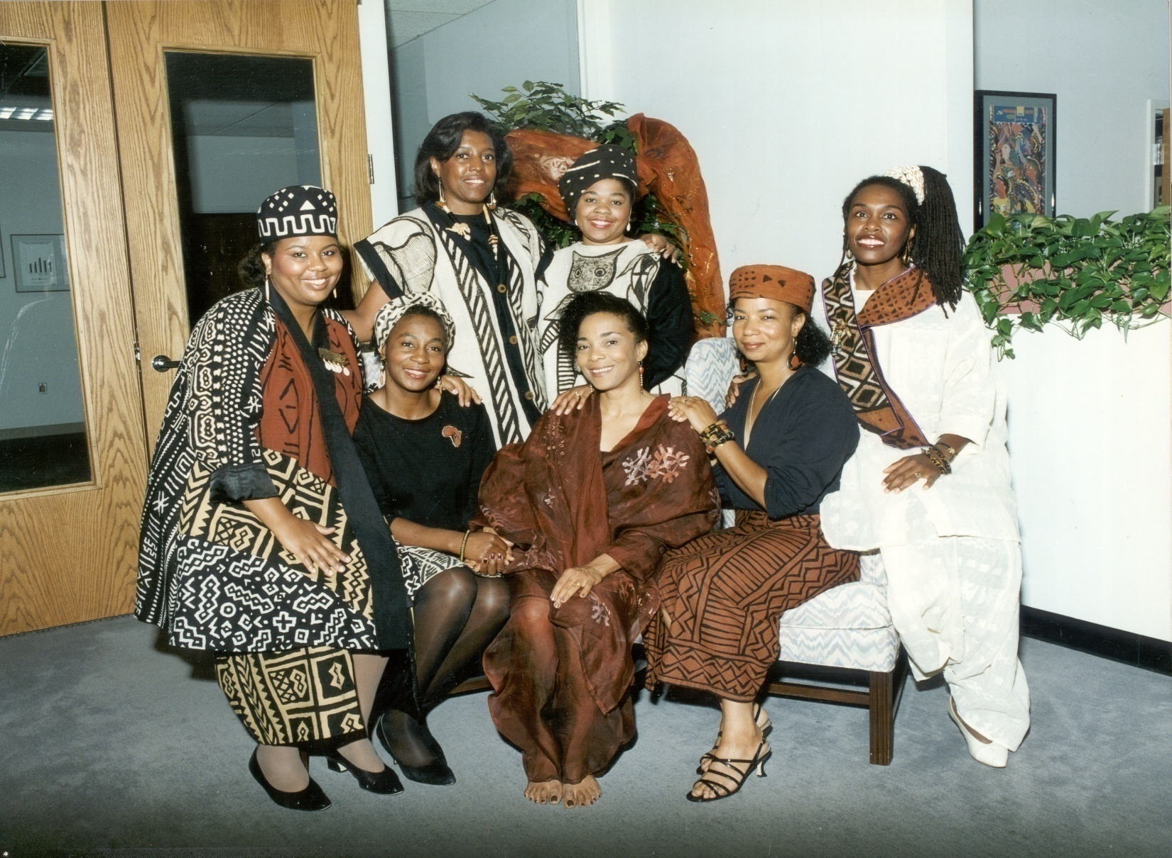

Slide 43
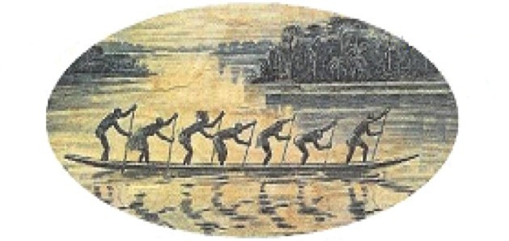
CHAI
Community Health Analytics, Inc.
Pulling Together for Community Health

