Slide 1


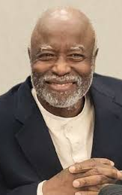

Dr. William “Bill” Carter Jenkins
William C. Jenkins
July 26, 1945-February 17, 2019
1963-67 Morehouse College BA Mathematics
1972-74 Georgetown University MS Biostatistics
1975-77 University of North Carolina MPH
1977-83 University of North Carolina PhD Epidemiology
1986-87 Harvard University Postdoc, Biostatistics

Slide 2
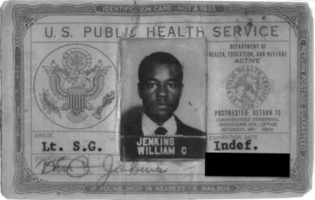
First Job was at the National Center for Health Statistics (NCHS), Washington, DC
Notes:
In 1970 as a young officer in the US Public Health Commissioned Corps for the first time attending the annual conference of the American Statistical Association Bill sat in on a session on minority health. All the presenters were white and except for himself and one other person so was the audience. After the session Bill and his fellow black biostatistician discussed the need for self-determination—that Black people should always be at the table in studying their health. As a result of that experience Bill nutured a vision of creating a cadre of independent African American researchers and leaders who defined what to study and how to create health for people of color. He never wavered from that vision. In the 1980’s while at CDC he created Project Imohtep which expanded to become the Public Health Sciences Institute of Morehouse College. These programs were a national pipeline, designed to prepare undergraduates for the rigors of graduate programs in epidemiology and biostatistics. In 1991 he took a leave of absence from CDC to develop the Masters of Public Health program at the Morehouse School of Medicine, the first nationally accredited graduate program at an Historically Black College and University. After that he supported the establishment of graduate programs in public health among HBCU’s throughout the nation. Bill contributed directly to the attainment of masters and doctorates by over 700 people of color.

Slide 3



Expand The Public Health Workforce
Mentor, Mentor, Mentor!!!

Slide 4
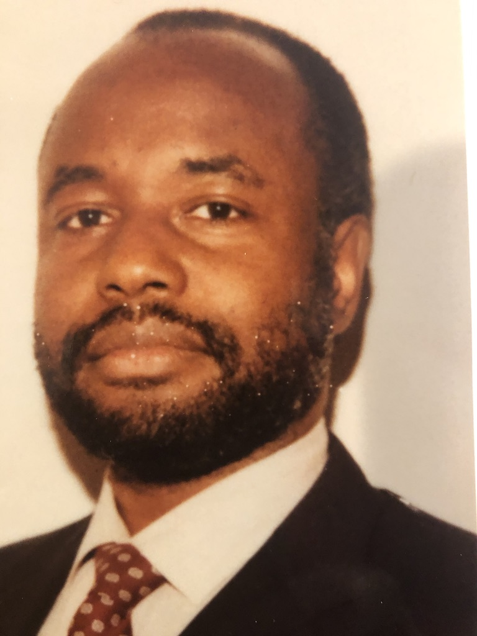

Bill’s vision of self-determination in public health research and leadership
American College of Epidemiology
1991
“Morbidity/Mortality Gap:
Is it Race or Racism?”
Notes:
Became a national leader in professional public health organizations
Established the Public Health Sciences Institute at Morehouse College.
Established Master’s of Public Health (MPH) program at Morehouse School of Medicine 1992.
Founded, Society for the Analysis of African American Public Health Issues (SAAPHI),

Slide 5
1995
Bill is appointed Manager of the Tuskegee Participant Health Benefits Program
He expands the activities of the program to include a Presidential apology
Produces one of the only documentaries that interviews survivors and their family members:
Voices of the Tuskegee Study
https://www.youtube.com/watch?v=3e5VfgsGp1k
Notes:
He had some reservations about the media coverage and public attention that the case inspired because he feels that the participants have been misrepresented as simple, unintelligent and helpless, while he sees them as national heroes, who stuck with the study believing that it had some great societal good. He says that working with the survivors and their families changed him forever, taught him grace. It's made him more committed to fighting inequality from the inside.

Slide 6

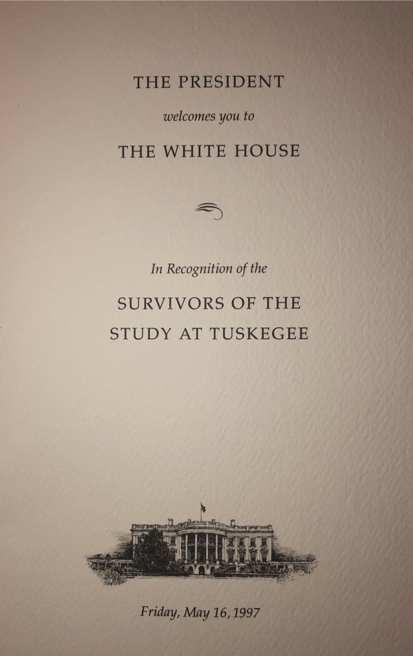
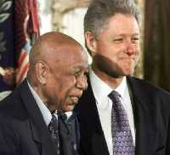
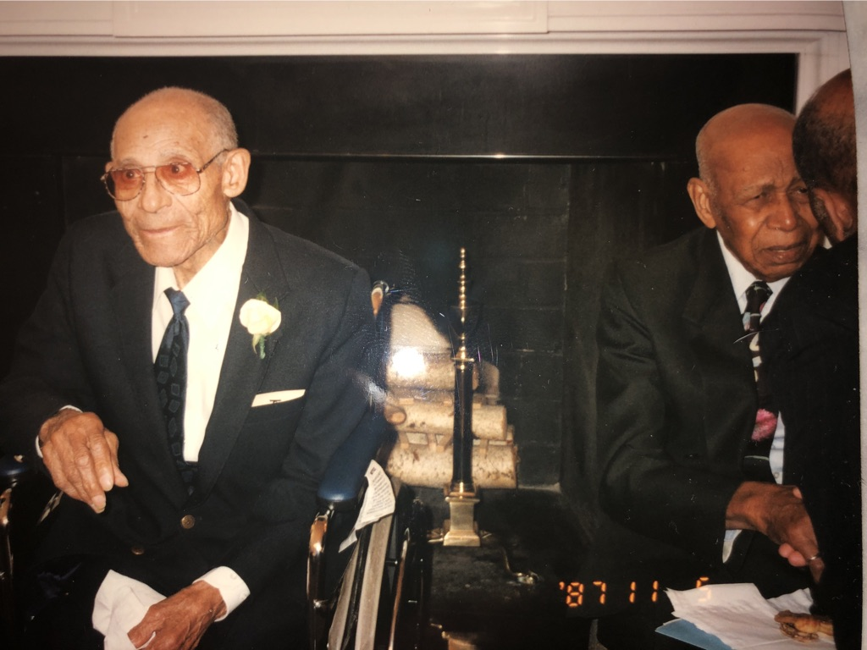
1997 Presidential Apology

Slide 7
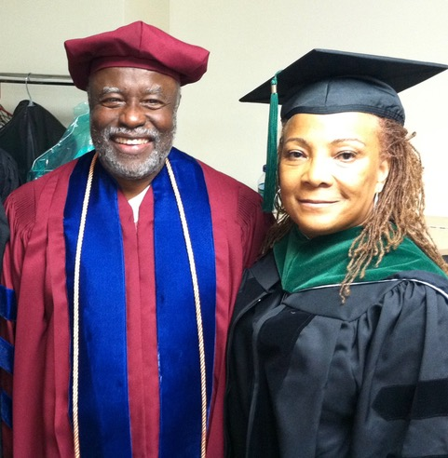
Bill frequently lectured about the Tuskegee study of syphilis in the Negro male
“…the men weren’t victims. They were heroes…they were trying to do some good for their community.”
For him they were heroes-men of grace and dignity- who stood up to their adversity and whose sacrifice sparked an ethics revolution in the conduct of medical research in the US.
Notes:
He had some reservations about the media coverage and public attention that the case inspired because he feels that the participants have been misrepresented as simple, unintelligent and helpless, while he sees them as national heroes, who stuck with the study believing that it had some great societal good. He says that working with the survivors and their families changed him forever, taught him grace. It's made him more committed to fighting inequality from the inside.

Slide 8


